Slide 1
Environmental projects development and management
Course presentation:
ERASMUS+ project “INTEGRATED DOCTORAL PROGRAM FOR ENVIRONMENTAL POLICY, MANAGEMENT AND TECHNOLOGY – INTENSE”

Slide 2
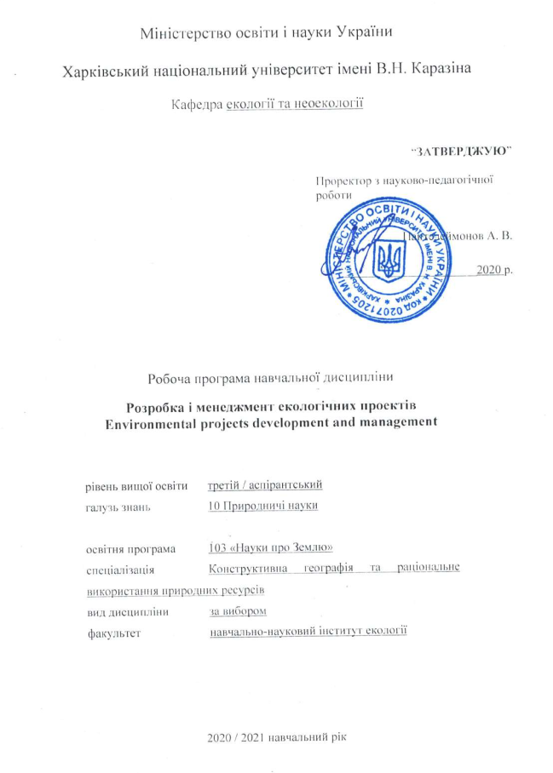
Summary
This 3 ECTS course aims to development of theoretical knowledge and practical skills for environmental projects development and effective management (EPDM). It provide students with detailed information about the substantiation of the environmental project concept, key international and UA national legislation, modern approaches and tools to project functional analysis and assessment. Course included main approaches to project risks management and assessment, decision making in conditions of risk and uncertainty, project cycle management according to the EC recommendations, development and management of environmental projects in the public sphere, management of research projects.
The course contains individual and group assignments aimed at developing practical skills on environmental projects design, assessment and management.

Slide 3
Aims and objectives
The main purpose of course is to form the professional competences in the development, assessment and management of environmental projects to achieve project goals and meet the stakeholders’ expectations.
The course is aimed at the following: to introduce main theoretical and methodological principles of development and effective management of environmental projects; to help PhD students to study the approaches of analyze the technical, economic, environmental, social consequences of the environmental projects implementation, taking into account risks and uncertainties during the design and implementation stages of environmental projects; to form practical skills on project research work; understanding the project approach in their professional activities and for the environmental policy implementation.

Slide 4
General learning outcomes
By the end of the course, successful students will have:
Substantiation of the environmental project concept, key international and UA national legislation, modern approaches and tools to project functional analysis and assessment;
Ecological and economic consequences of anthropogenic impact on the natural environment, determination of its ecologically safe changes and means of preservation;
To develop scientifically sound recommendations to support project management decisions;
To develop and analyze of environmental projects;
To develop scientifically sound recommendations to support management decisions in environmental protection and nature restoration activity.

Slide 5
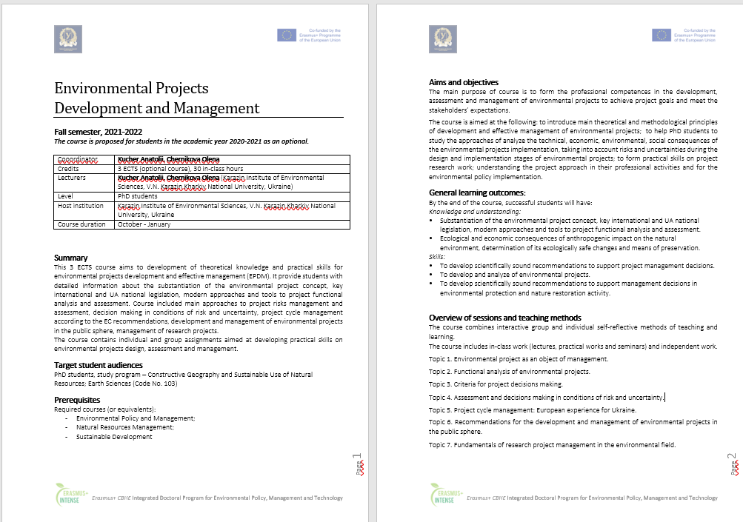
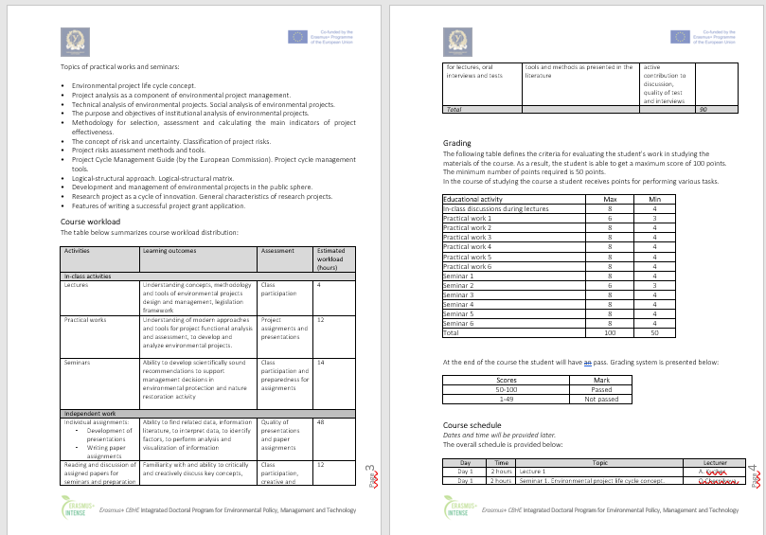
Syllabus

Slide 6
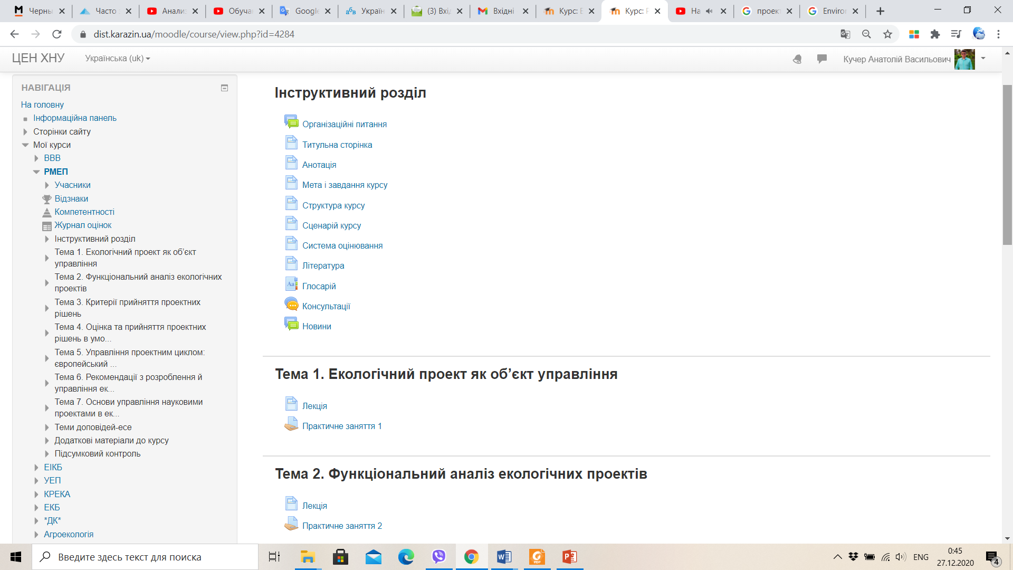
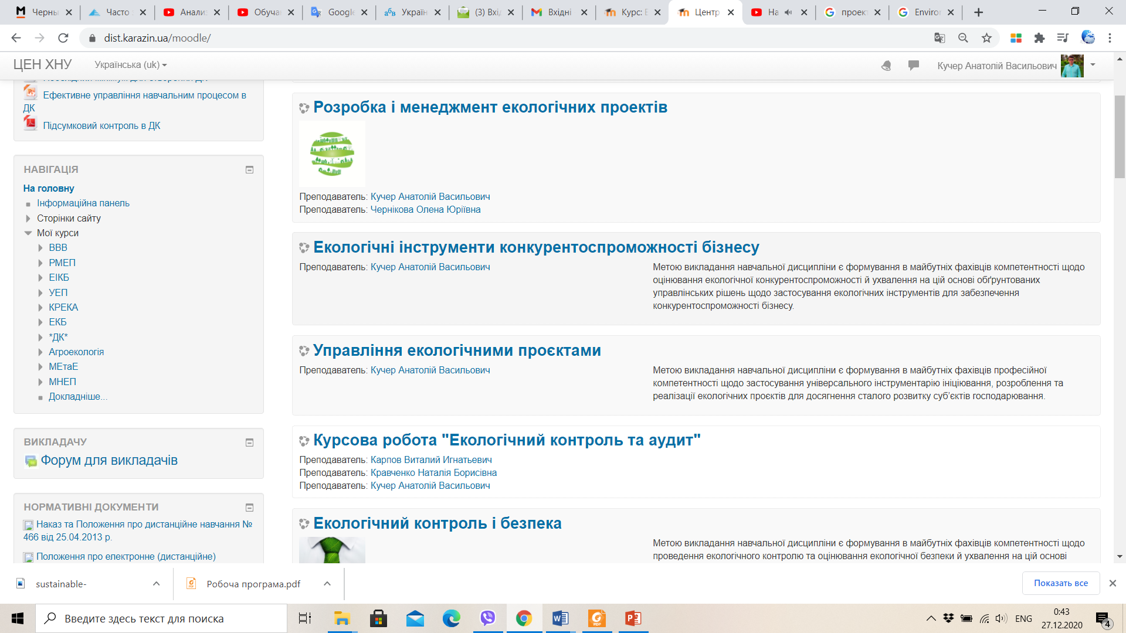
The course is available on the KKNU Moodle
https://dist.karazin.ua/moodle/course/view.php?id=4284

Slide 7
Types and forms of classes, methods of interaction between teacher and student
The course "Environmental Projects Development and Management" is studied in the third semester in PhD program and ends with the test.
The course includes
theoretical material,
practical tasks and recommendations for their implementation,
questions for essay reports,
knowledge control (in particular, question for the final test).
The course consists of a complex of lectures on 7 topics and 7 practical tasks, 1 control work and the final test.
For individual consultations – “Forum” and "Chat".

Slide 8
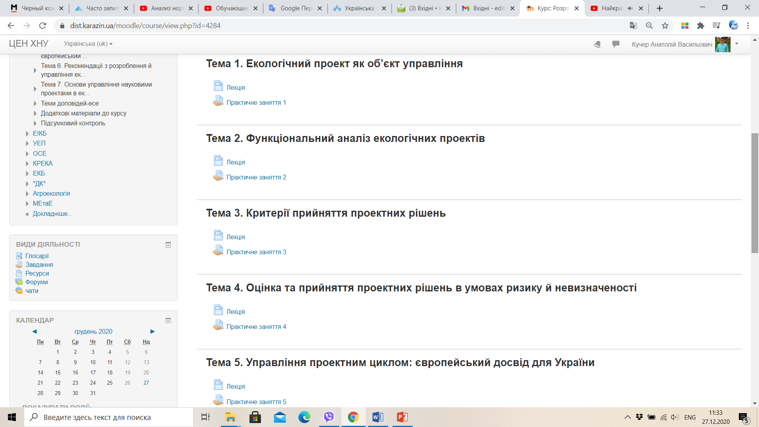
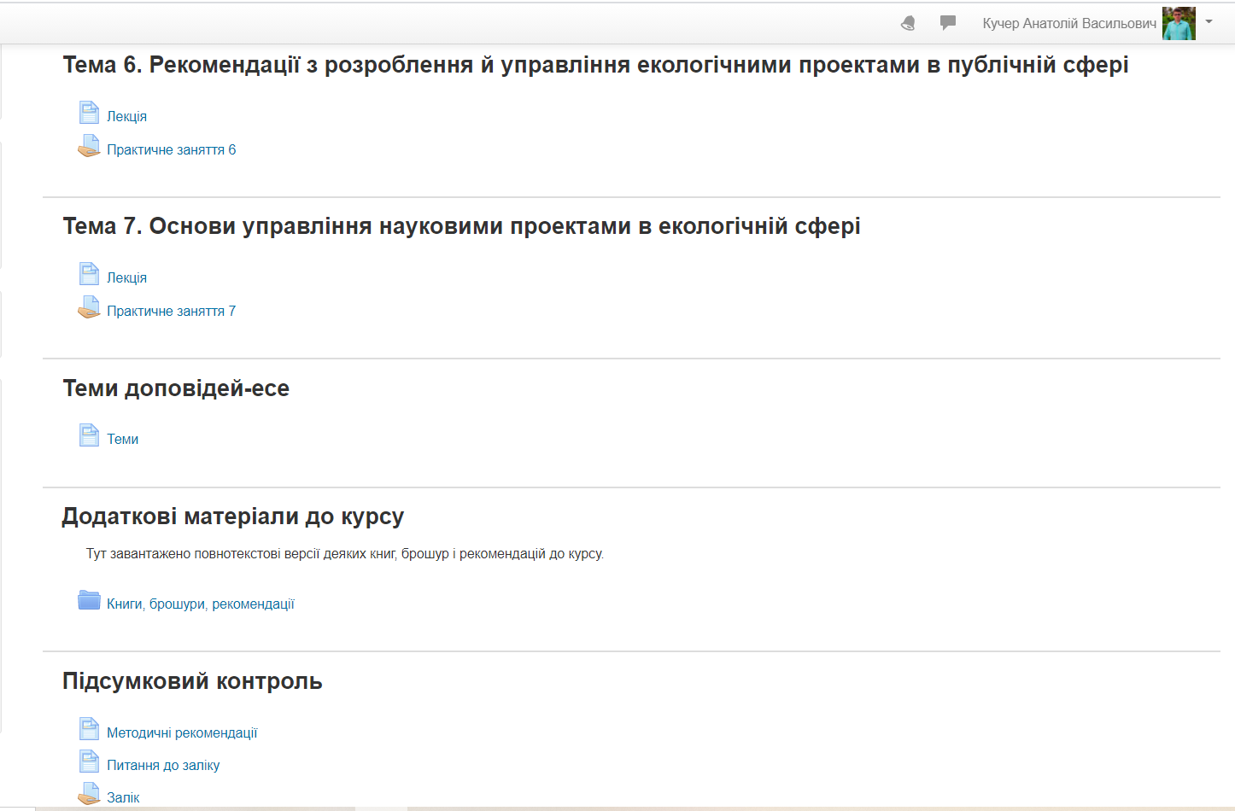
The course is divided into 7 topics:

Slide 9
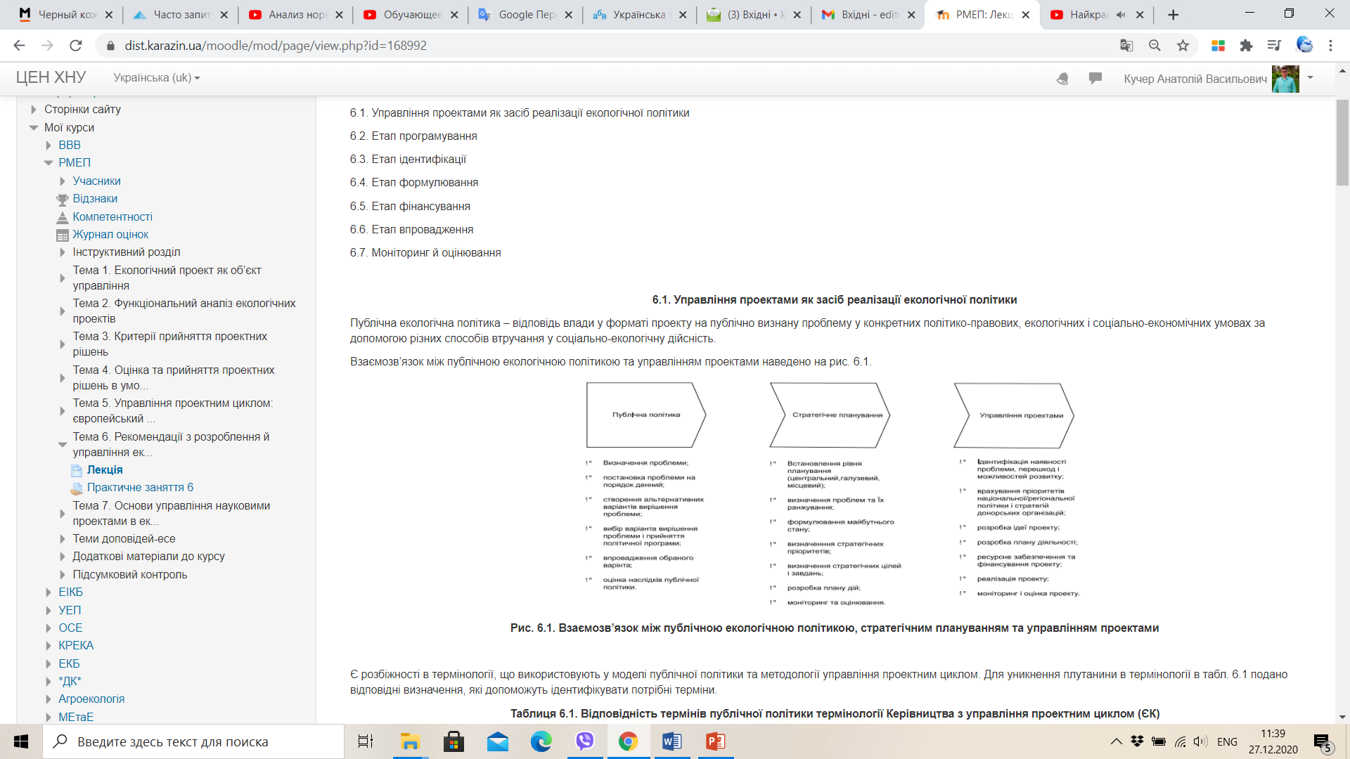
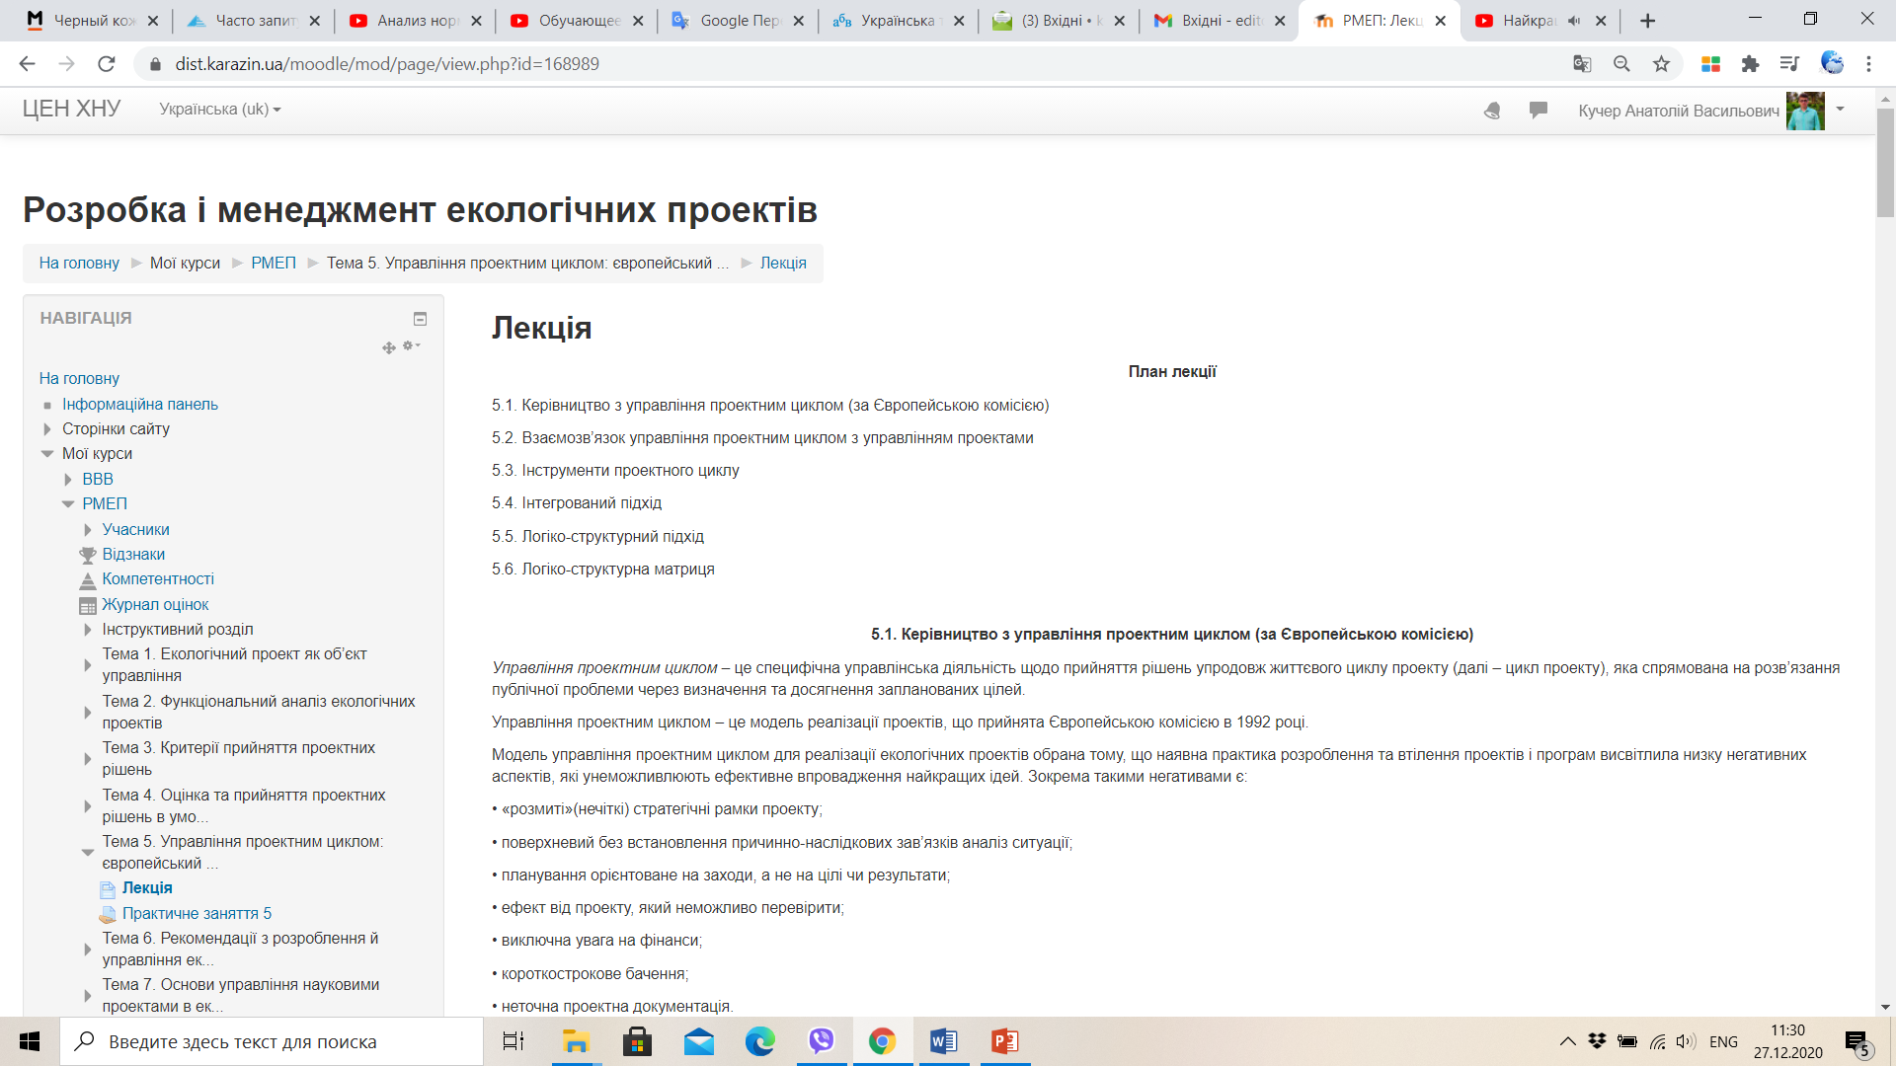
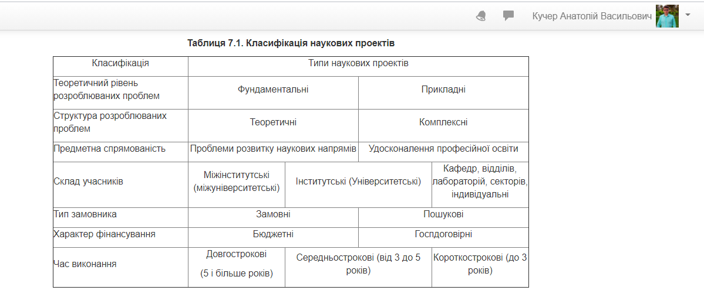
Some topics from the course

Slide 10
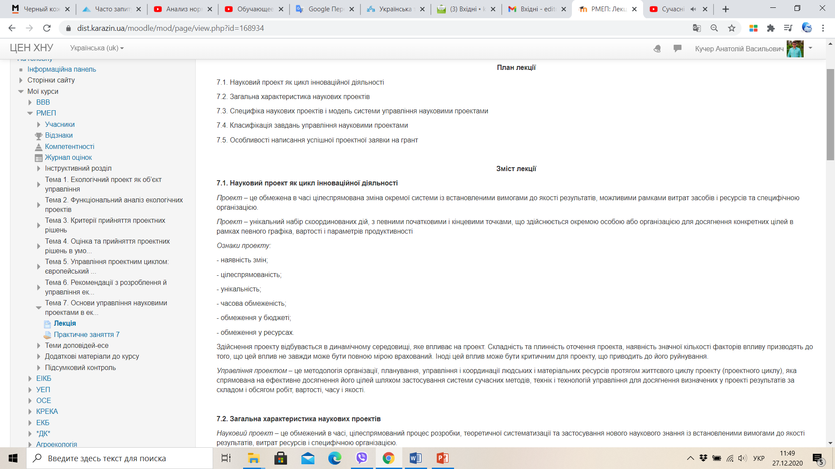
Each them contains: questions, text

Slide 11
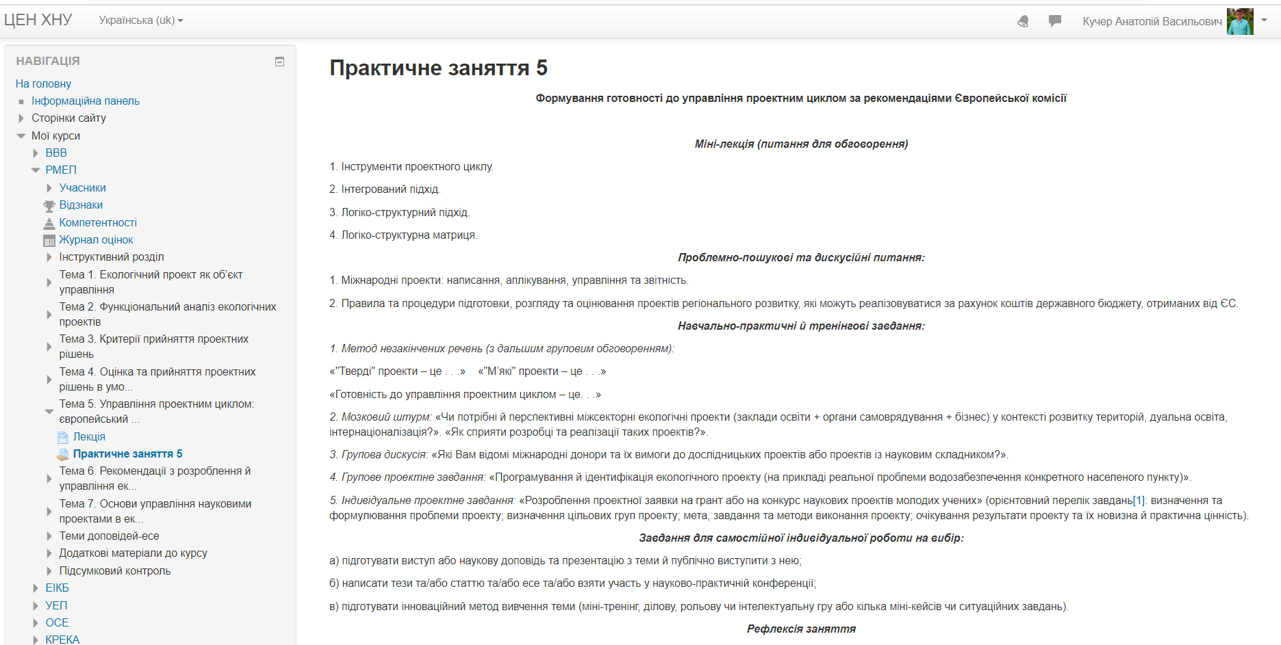
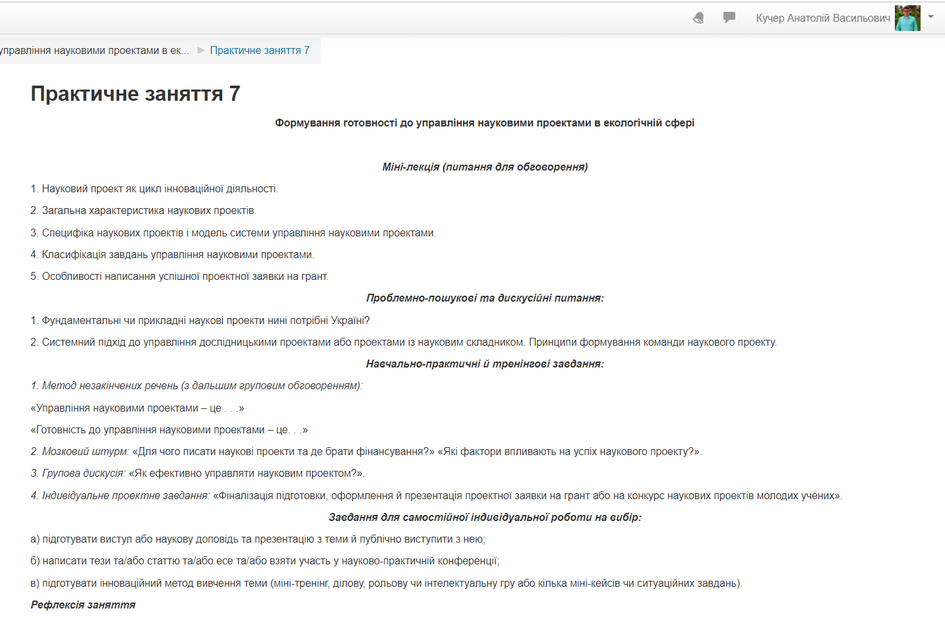
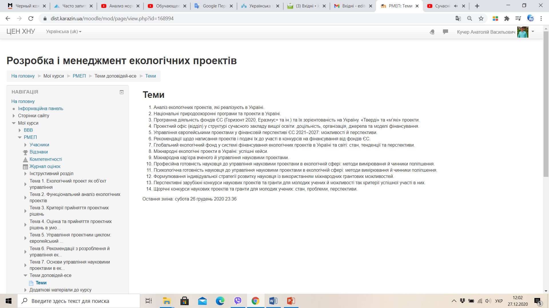
The course consists of 7 Workshops :

Slide 12
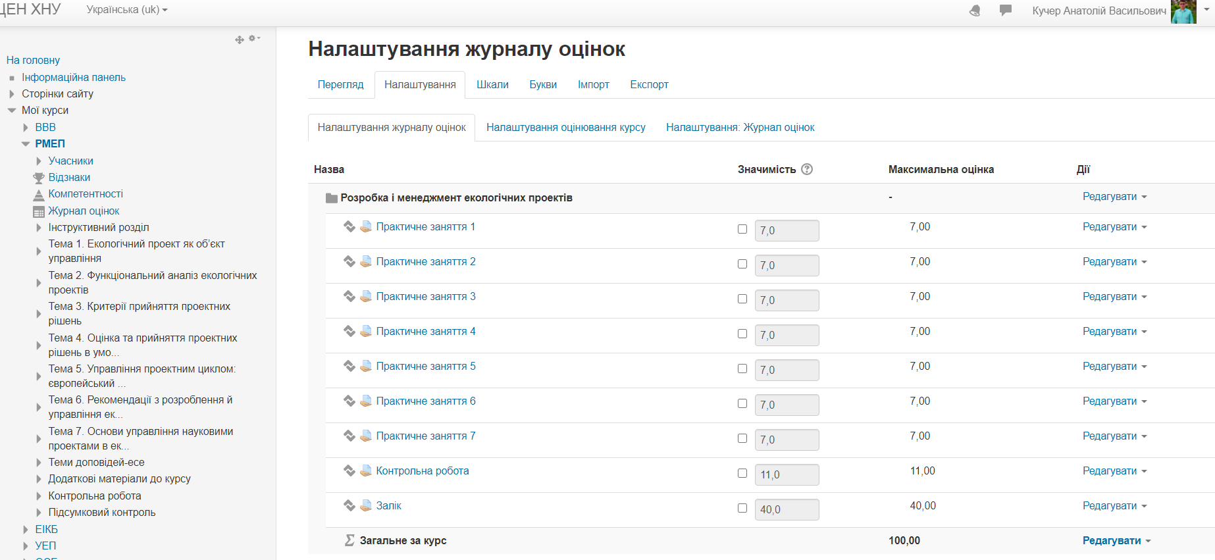
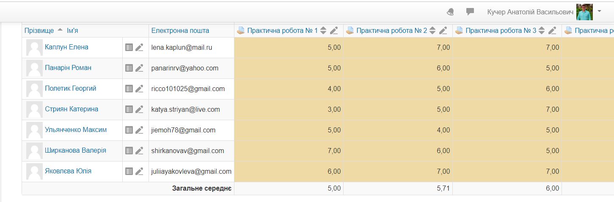
Gradebook setup
&
Achievement results

Slide 13
Course authors:
Cooordinator: Anatolii Kucher,
V. N. Karazin Kharkiv National University (KKNU), Ukraine
kucher@karazin.ua
Olena Chernikova,
V. N. Karazin Kharkiv National University (KKNU), Ukraine
Authors: Anatolii Kucher,
V. N. Karazin Kharkiv National University (KKNU), Ukraine
Olena Chernikova,
V. N. Karazin Kharkiv National University (KKNU), Ukraine

