Slide 1
Geomatics and Modelling
Course presentation:
ERASMUS+ project “INTEGRATED DOCTORAL PROGRAM FOR ENVIRONMENTAL POLICY, MANAGEMENT AND TECHNOLOGY – INTENSE”

Slide 2
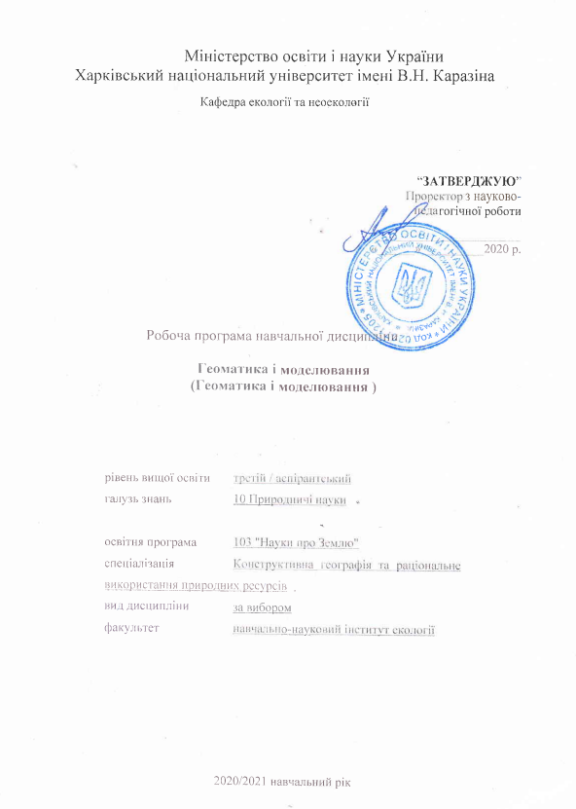
Summary
The course "Geomatics and Modeling" is designed for PhD graduate students, conducting research on "environmental protection".
The course is designed to increase the level of knowledge and skills of graduate students in the application of geomatics and modeling in research.
The course involves active independent and classroom work with specialized computer software.

Slide 3
Aims and objectives
The course aims to teach PhD students in the methods of geomatics and modeling in the implementation of their specific scientific research as part of the preparation of a doctoral dissertation (PhD).
The brevity of the course "Geomatics and Modeling" presupposes the accelerated integration of knowledge and skills acquired during training at the first or second educational levels. Geomatics and modeling are now used in almost all branches of science and technology. These scientific areas include a huge variety of methods and technologies for solving specific scientific and practical problems. In the course of preliminary training, graduate students already have a basic knowledge base in these disciplines.

Slide 4
General learning outcomes
After completing the course, graduate students must acquire new knowledge and develop existing competencies:
basic knowledge of the functionality available in the GIS
experience with free QGIS software
knowledge of free sources for obtaining geodata, in particular, space images
basic knowledge of spatial data analysis
in-depth knowledge of certain types of spatial data analysis (depending on the chosen topic of scientific work)
be able to identify key philosophical problems of social sciences;

Slide 5
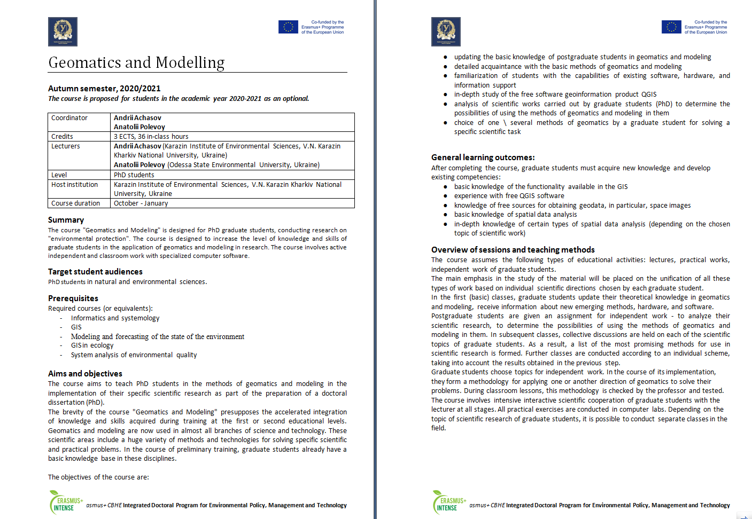
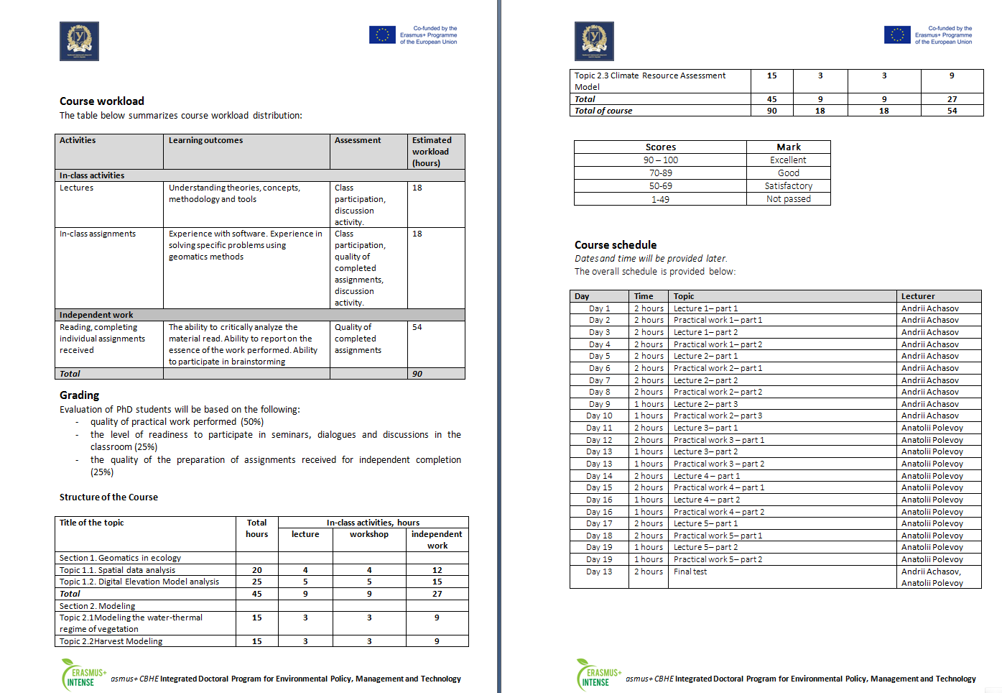
Syllabus

Slide 6
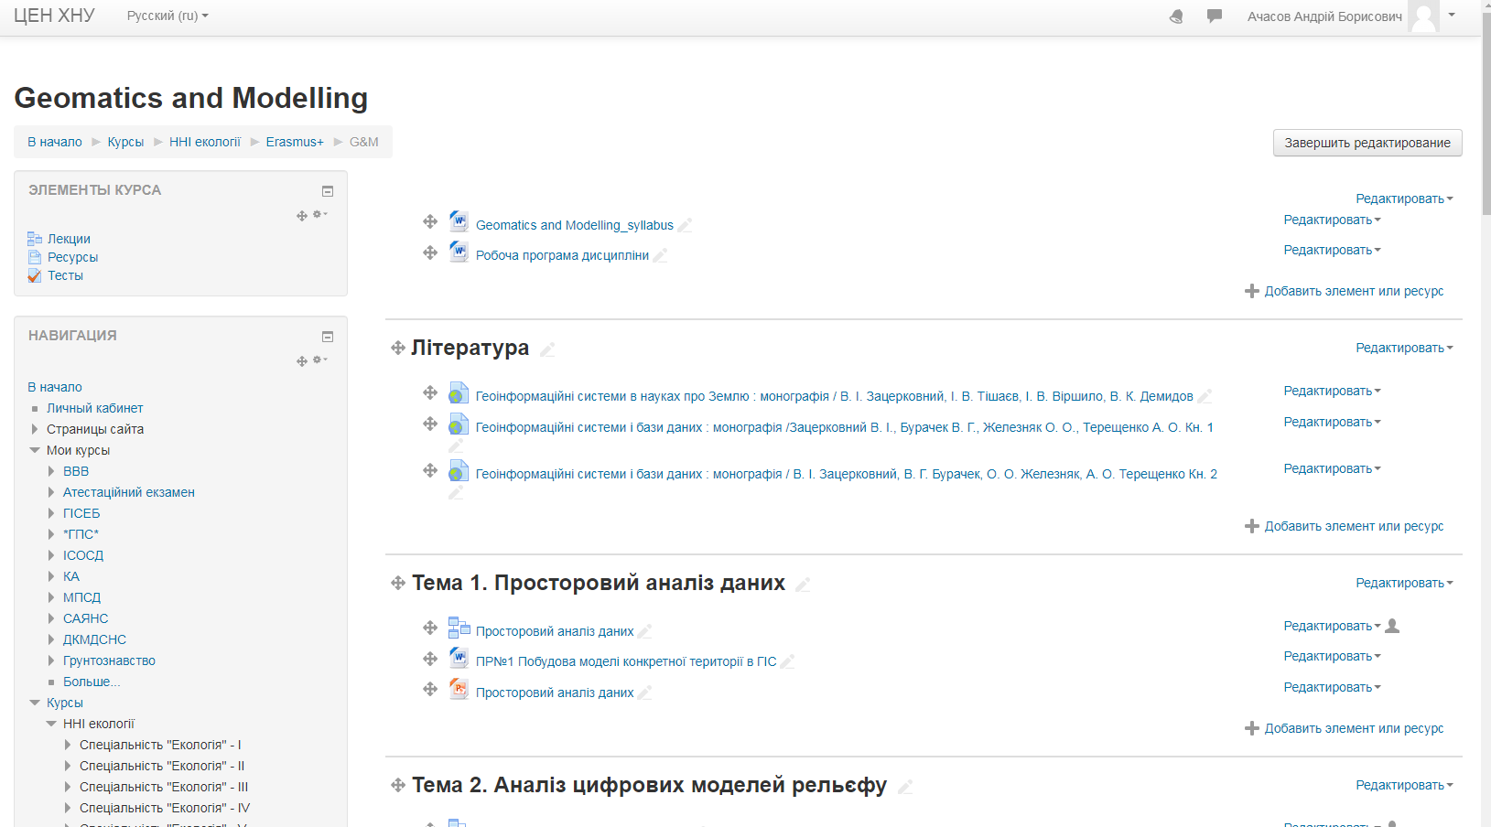
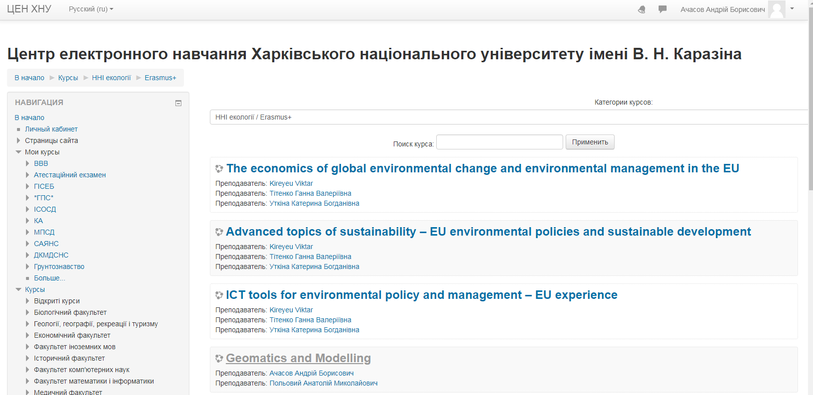
The course is available on the KKNU Moodle
https://dist.karazin.ua/moodle/course/view.php?id=2291

Slide 7
Types and forms of classes, methods of interaction between teacher and student
The course “Geomatics and Modelling" is studied in the 1-st semester in PhD program and consists of 2 sections and ends with the final test.
The course includes
theoretical material
practical tasks and recommendations for their implementation
questions for self-examination
knowledge control (in particular, examination task)
The course consists of a complex of lectures on 5 topics and 5 practical tasks and the final test.
For individual consultations – “Forum”.

Slide 8
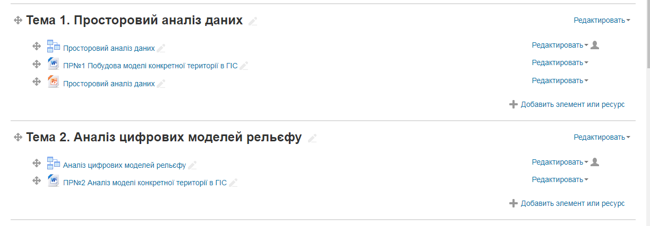
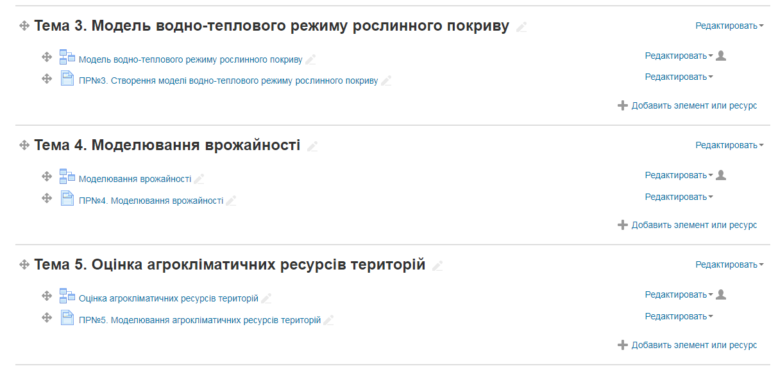
The course is divided into 2 sections:
Section 1. Geomatics in ecology
Section 2. Modeling

Slide 9
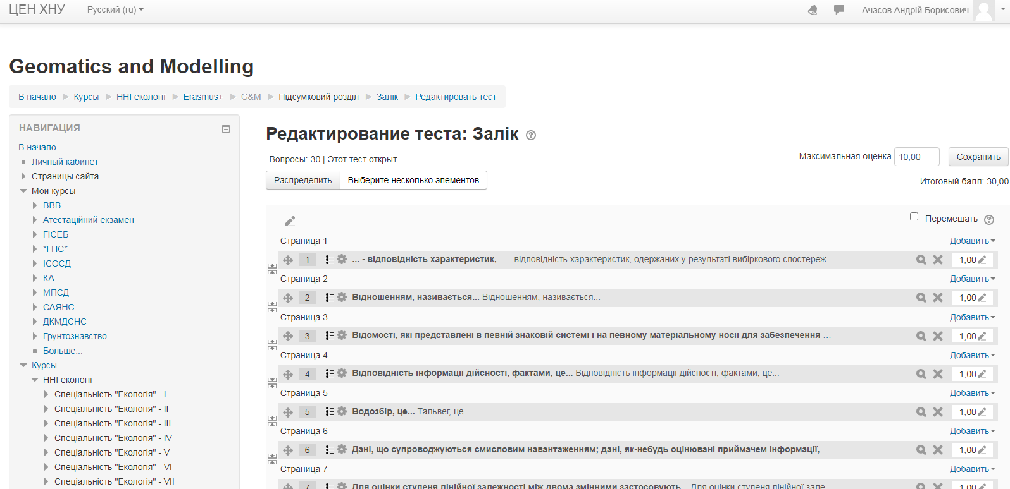
Each topic contains questions

Slide 10
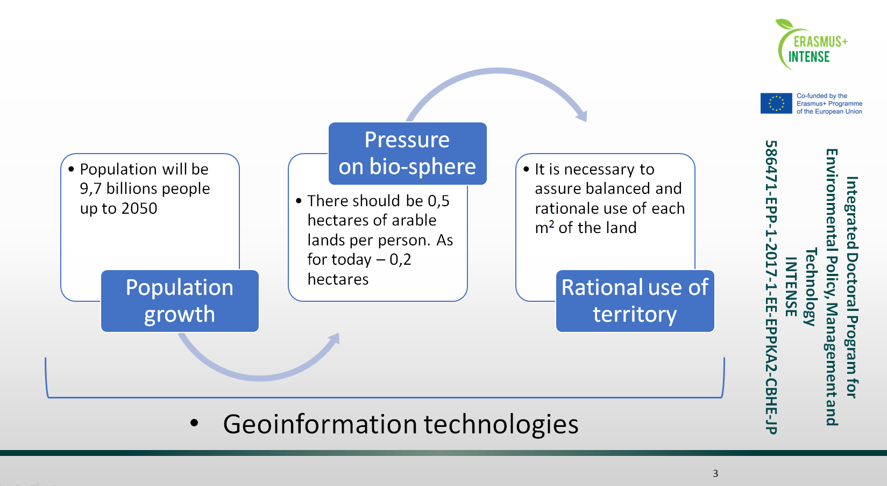
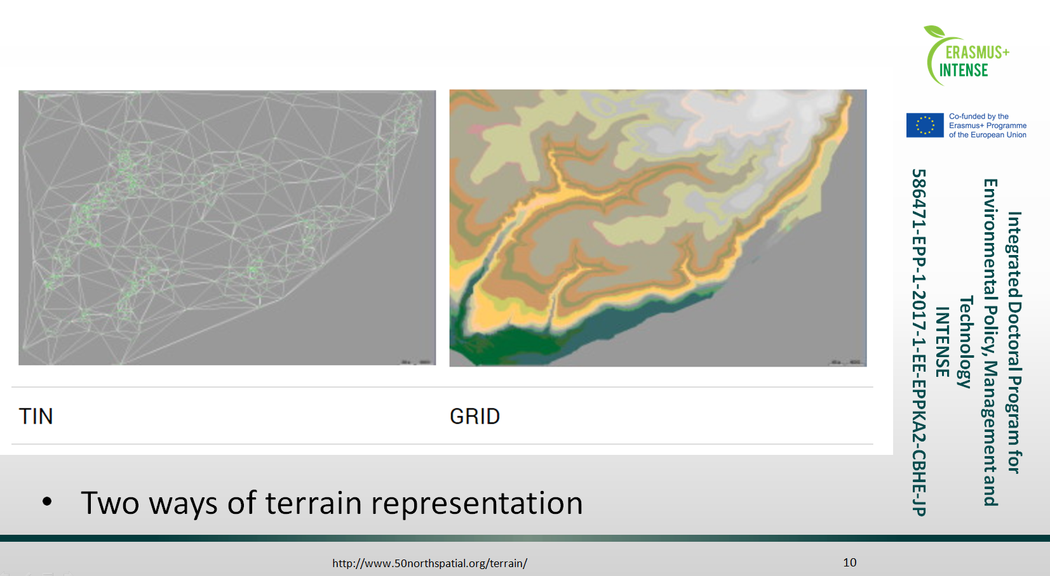
The offered materials include PowerPoint presentations that cover theoretical issues of the topic :

Slide 11
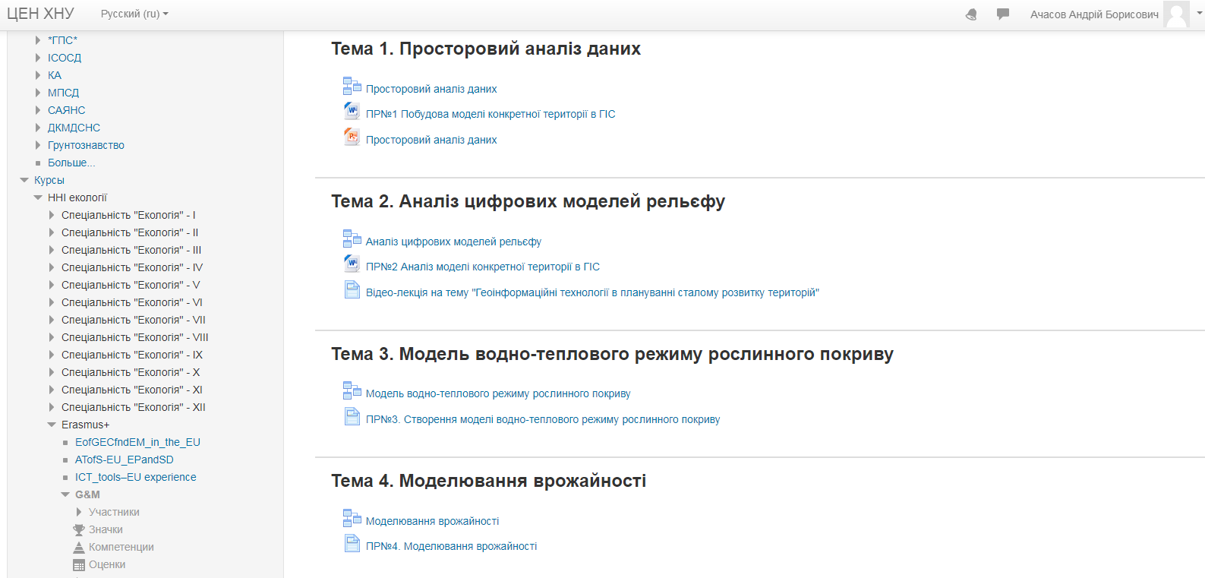
The course consists of 4 practical work:

Slide 12
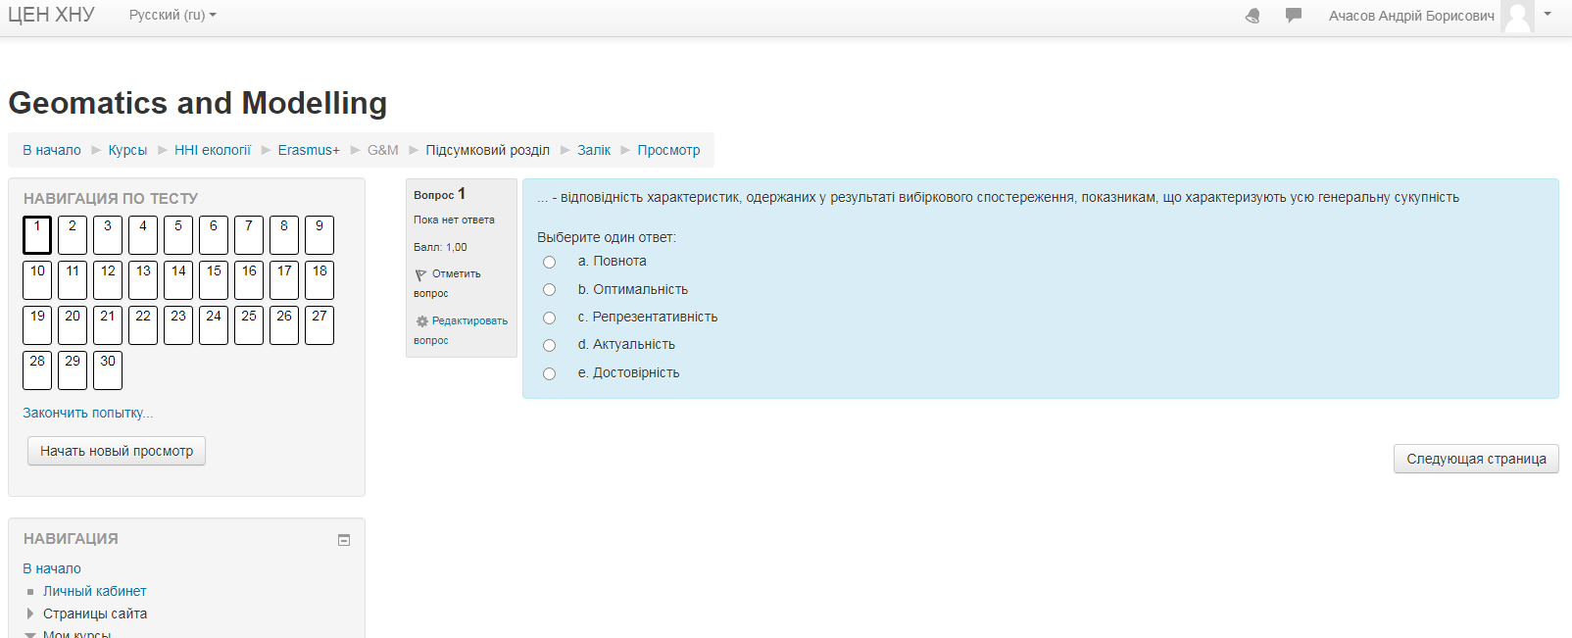
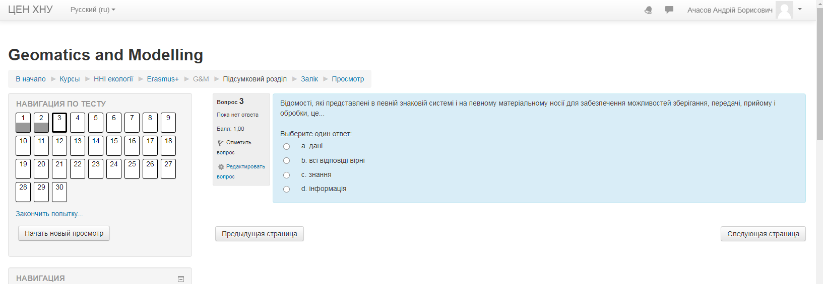
Test preparation

Slide 13
Course authors:
Cooordinator: Andrii Achasov,
V. N. Karazin Kharkiv National University (KKNU, Ukraine
achasov@karazin.ua
Authors: Andrii Achasov,
V. N. Karazin Kharkiv National University (KKNU), Ukraine
Anatolii Polevoy ,
Odessa State Environmental University (OSEU), Ukraine

