Slide 1
PHILOSOPHY OF SCIENCE
Course presentation:
ERASMUS+ project “INTEGRATED DOCTORAL PROGRAM FOR ENVIRONMENTAL POLICY, MANAGEMENT AND TECHNOLOGY – INTENSE”

Slide 2
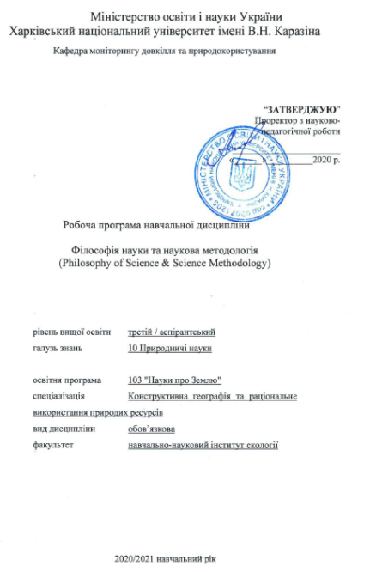
Summary
This 3 ECTS course serves as a sills course of the project INTENSE.
It provides PhD students coming from natural science backgrounds with a basic understanding of philosophy of sciences.
In addition, it introduces PhD students the concept of science, various ways of defining science, science and pseudo-science, philosophy and science, methodological topics like what is a concept, fact, model, hypothesis, law, theory, explanation, observation, experiment, objectivity.
The course helps to develop analysation and argumentation skills.

Slide 3
Aims and objectives
The aim of the course is to introduce the main concepts and arguments of philosophy of science.
The course addresses the following topics from the philosophy of science perspective:
the concept of science, various ways of defining science, science and pseudo-science, philosophy and science,
methodological topics like what is a concept, fact, model, hypothesis, law, theory, explanation, observation, experiment, objectivity.
The course helps to develop analysation and argumentation skills.

Slide 4
General learning outcomes
By the end of the course, successful students will:
understand the general questions of the philosophy of science;
fluent in the terminology of the philosophy of science;
to think critically about the applicability of science as a philosophical category of cognition;
understand the methodology of the philosophy of science;
be able to identify key philosophical problems of natural and technical sciences;
be able to identify key philosophical problems of humanities;
be able to identify key philosophical problems of social sciences;

Slide 5
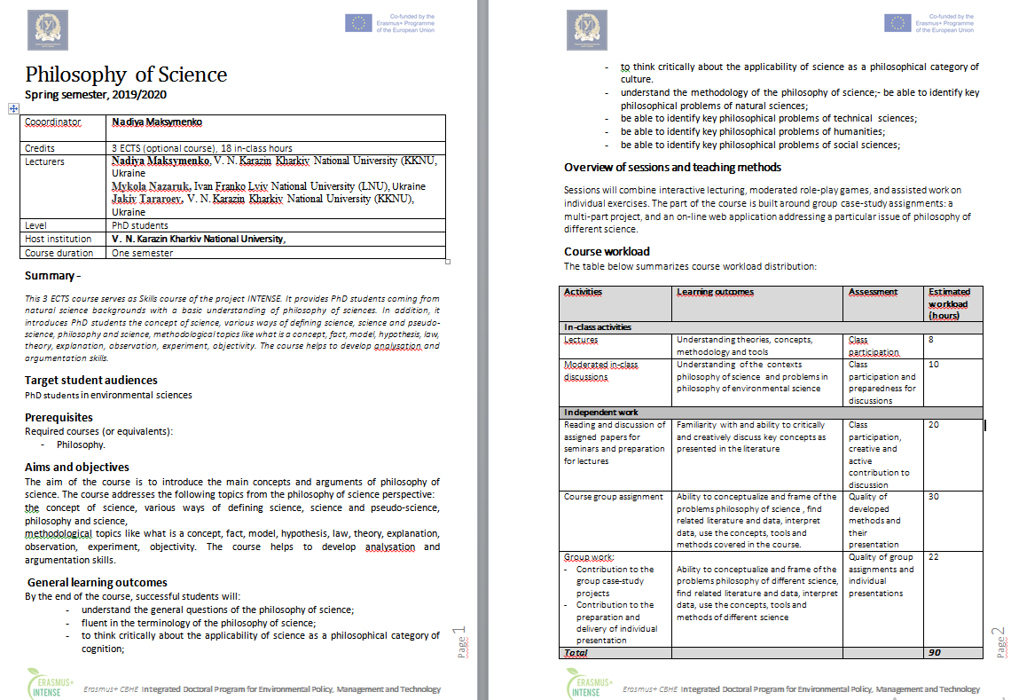
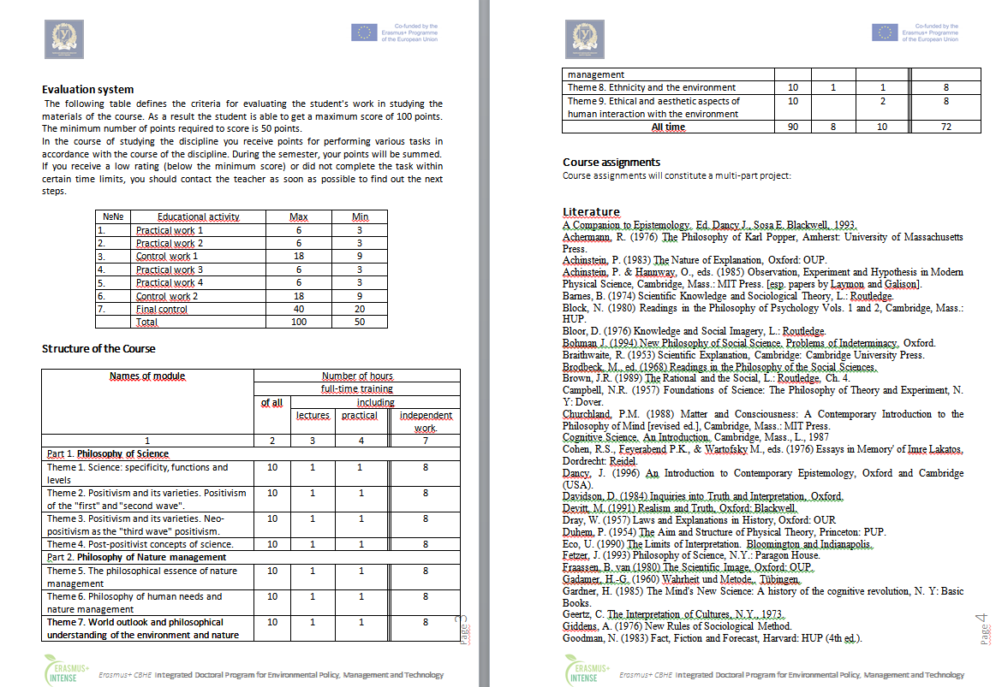
Syllabus

Slide 6
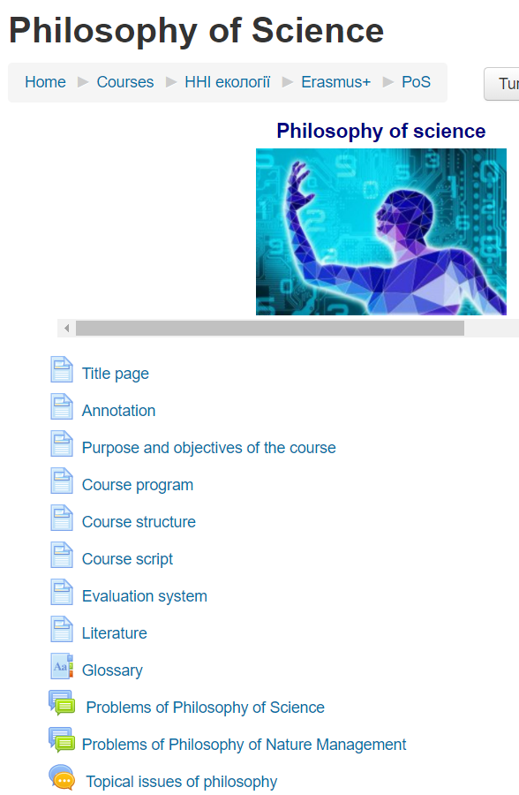
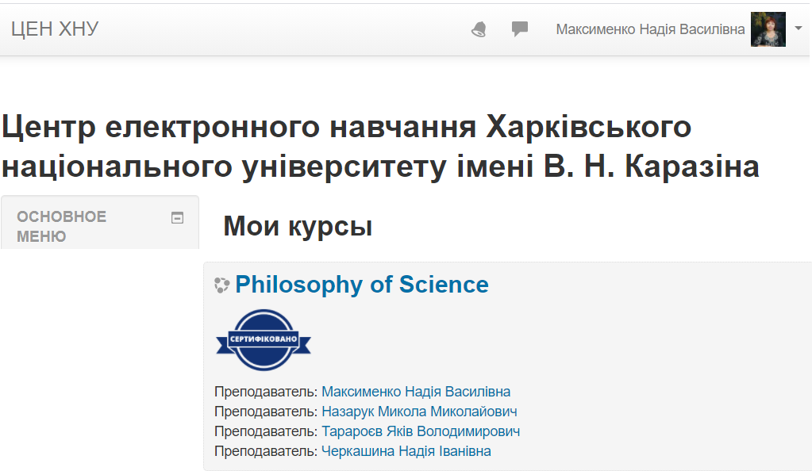
The course is available on the KKNU Moodle
https://dist.karazin.ua/moodle/course/view.php?id=2291

Slide 7
Types and forms of classes, methods of interaction between teacher and student
The course "Philosophy of Science" is studied in the 1-st semester in PhD program and consists of 2 sections and ends with the exam.
The course includes
theoretical material,
practical tasks and recommendations for their implementation,
questions for self-examination
knowledge control (in particular, examination task).
The course consists of a complex of lectures on 9 topics and 4 practical tasks, 2 control works and an examination task.
For individual consultations – “Forum” and "Chat".

Slide 8
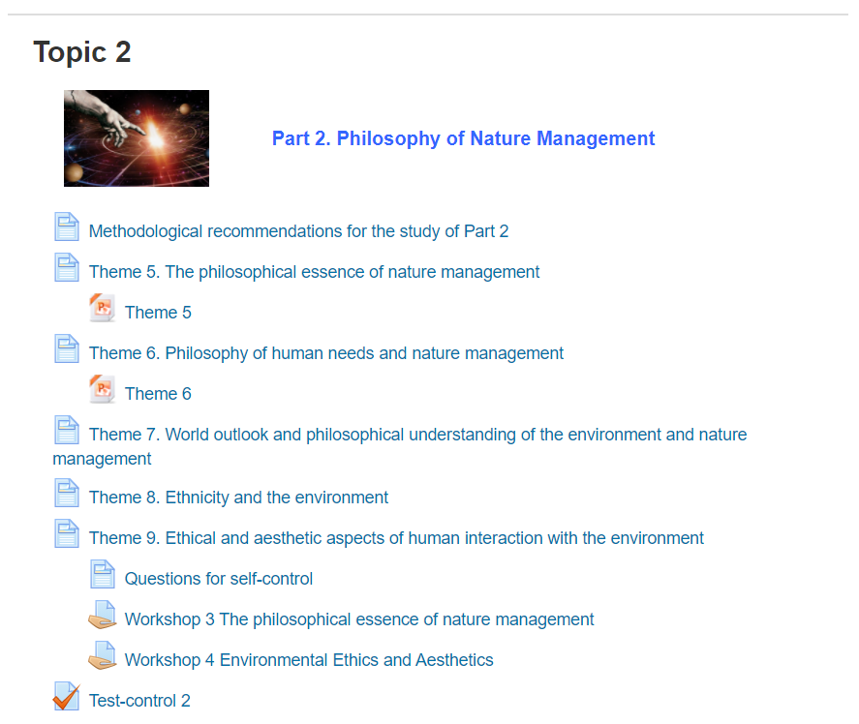
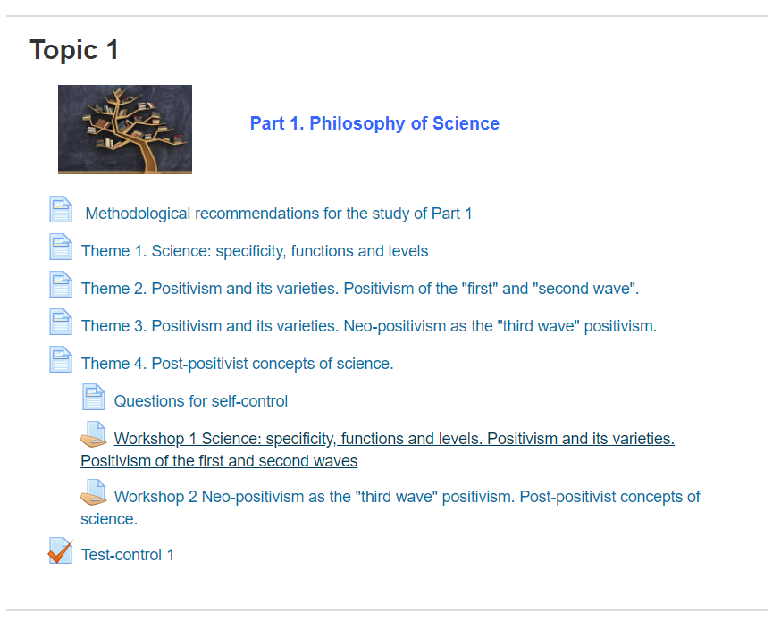
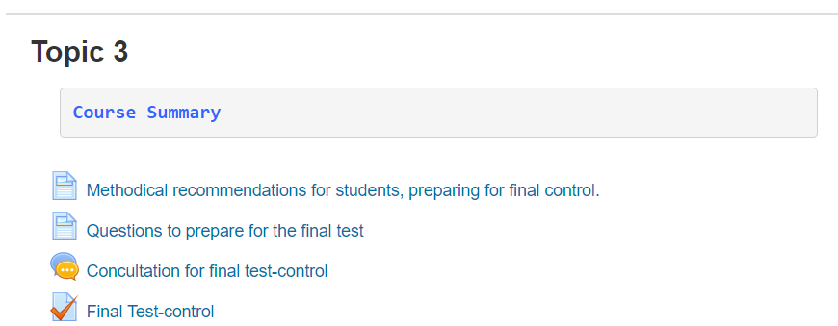
The course is divided into 3 topics:

Slide 9
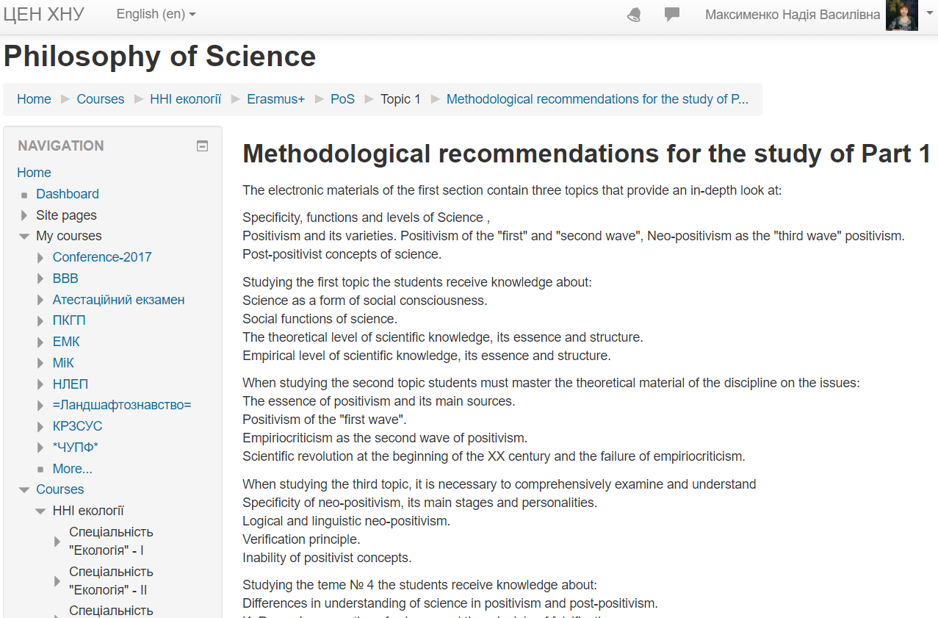
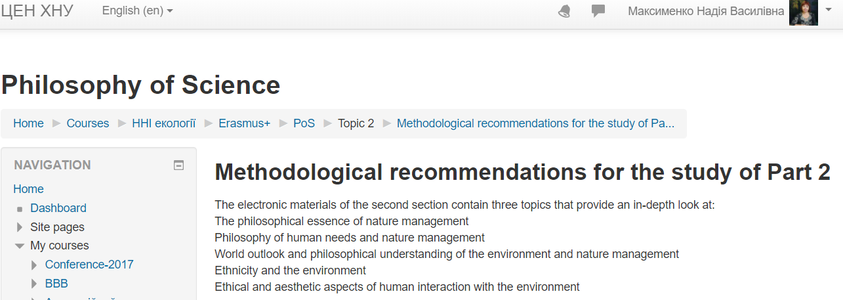
Each topic contains methodological recommendations for the study

Slide 10
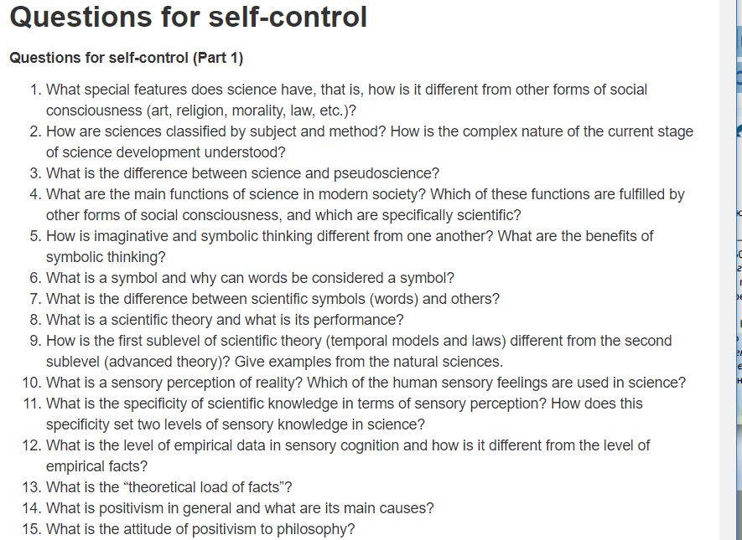
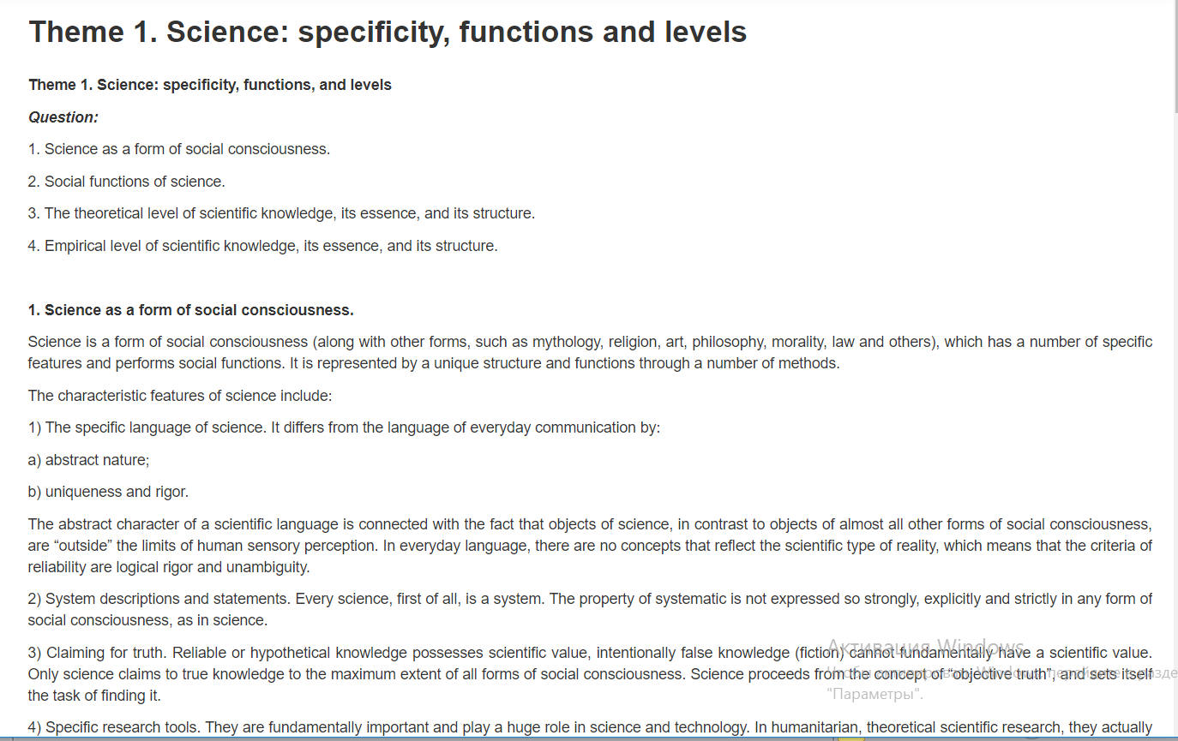
Each topic contains: questions, text, questions for self-control

Slide 11
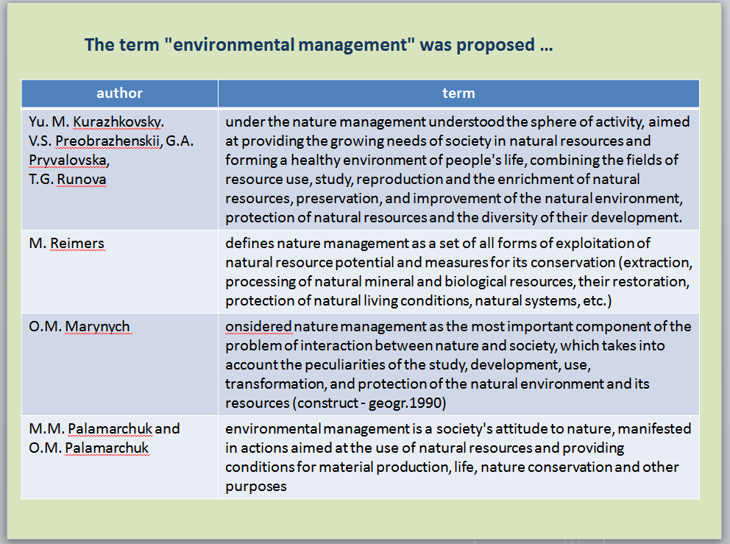
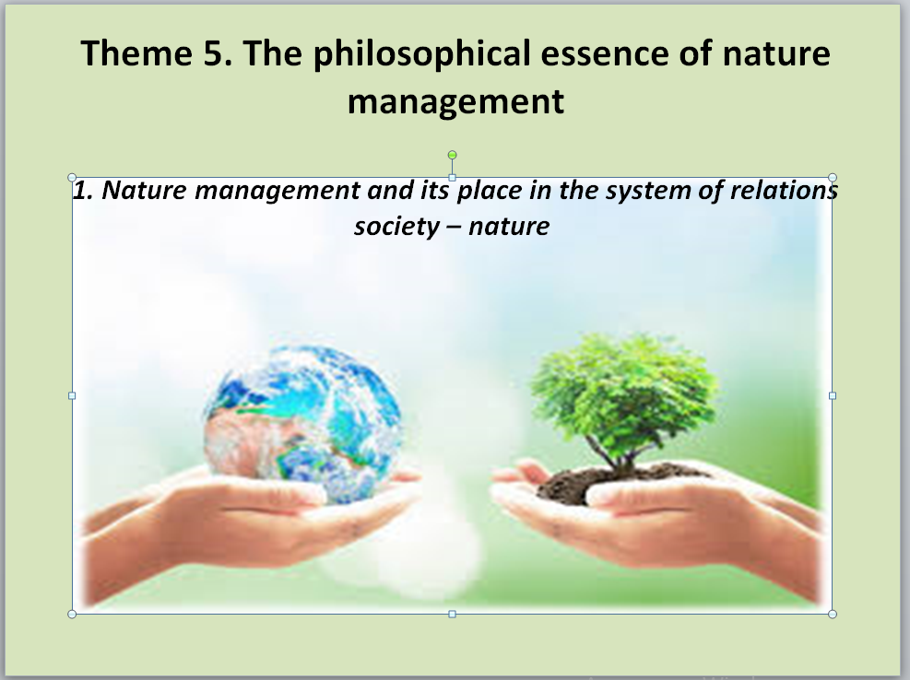
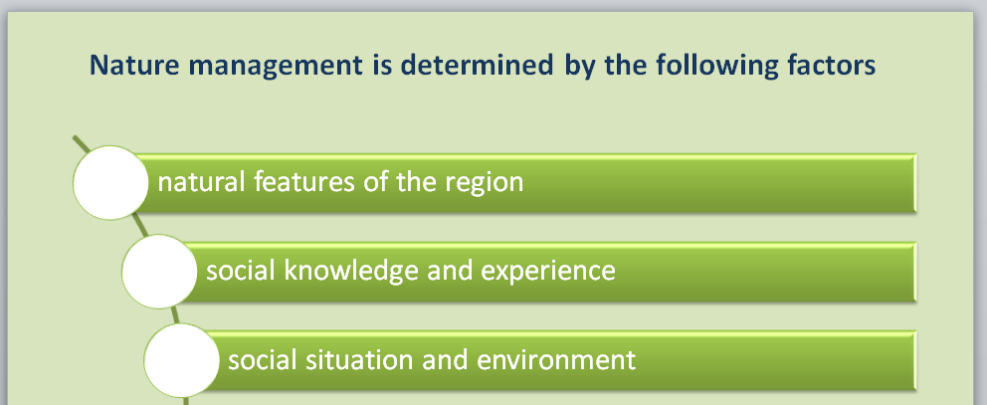
The offered materials include PowerPoint Presentations that cover theoretical issues of the topics:

Slide 12

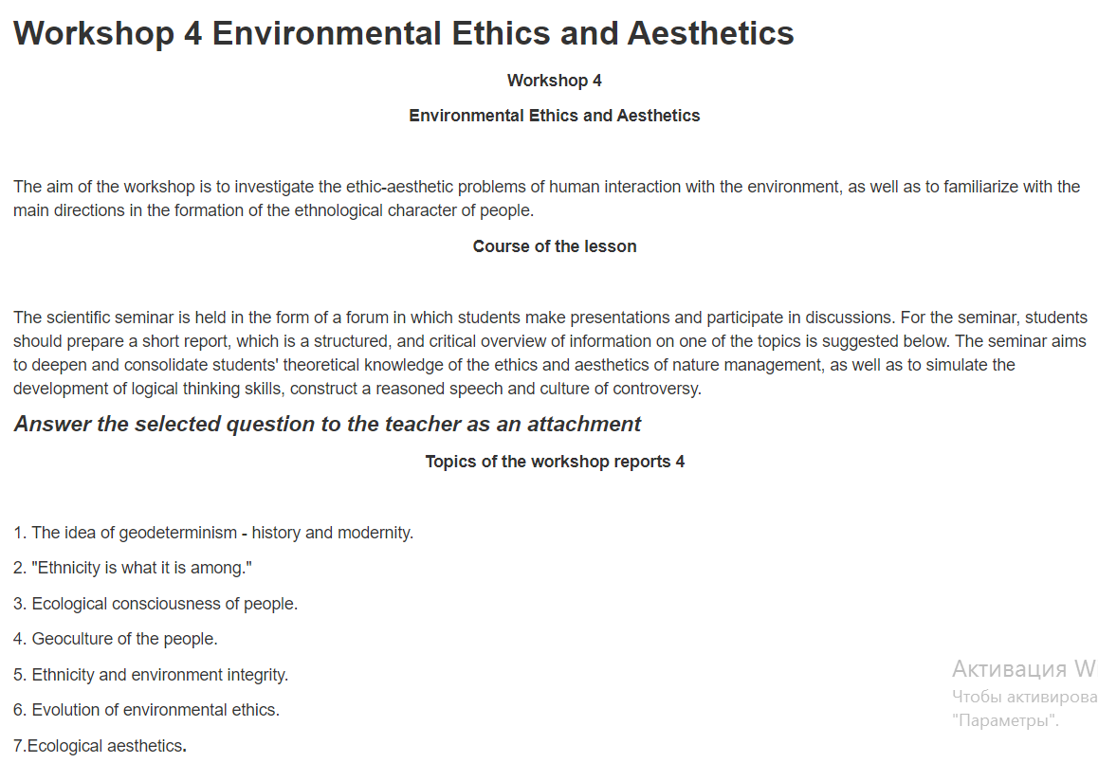
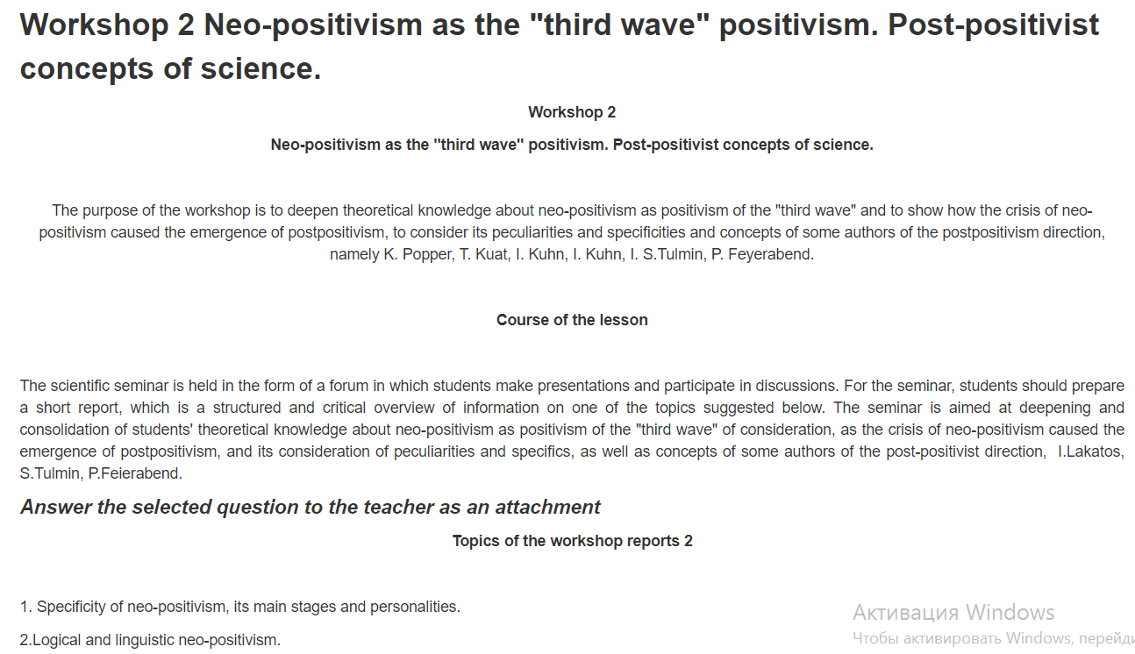
The course includes 4 workshops :

Slide 13
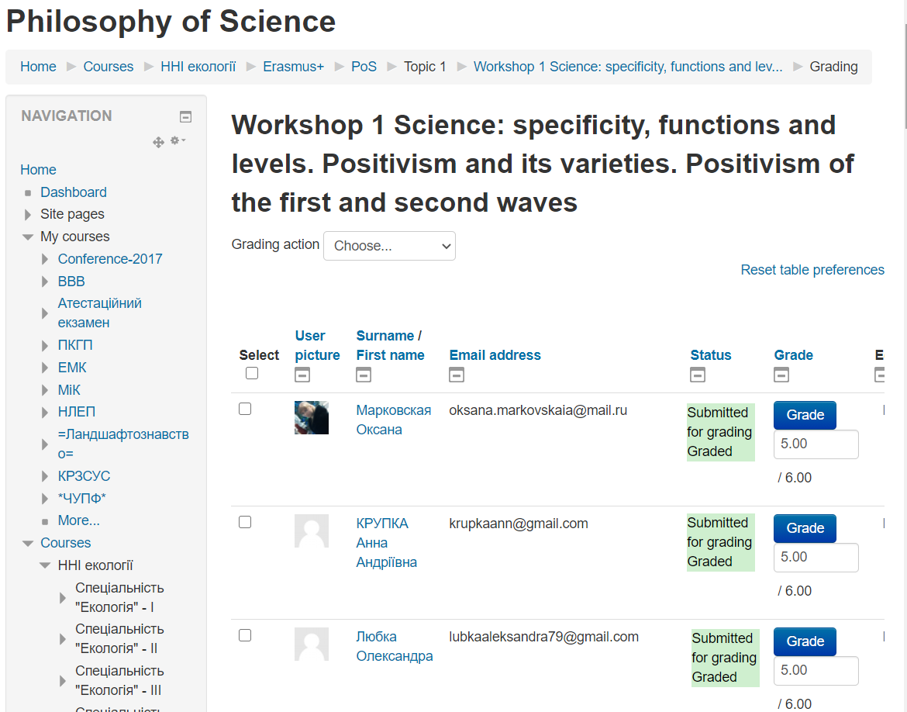
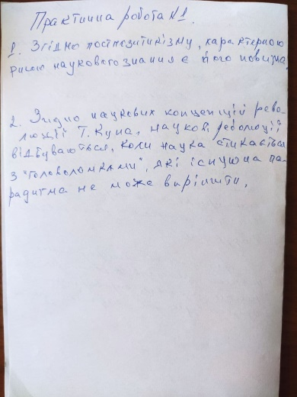
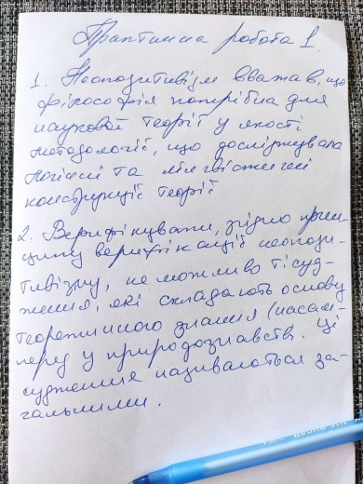
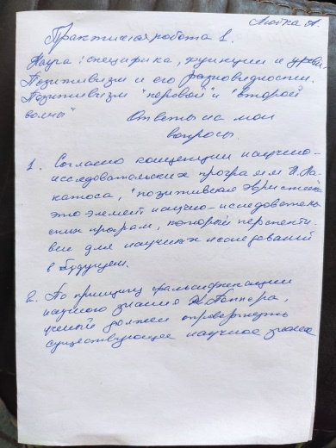
On Workshops students answer the questions in a written form and upload their answers to Moodle; it allows the teacher to better control the learning process and their achievements.

Slide 14

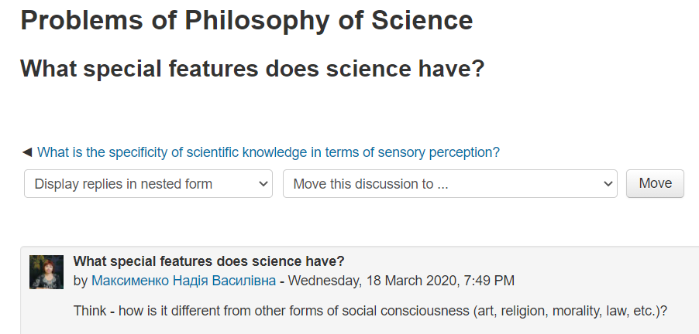
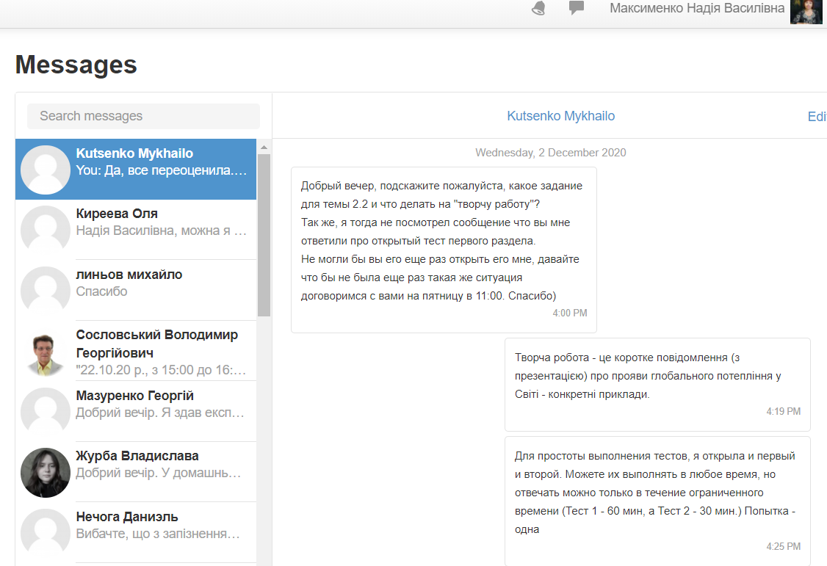
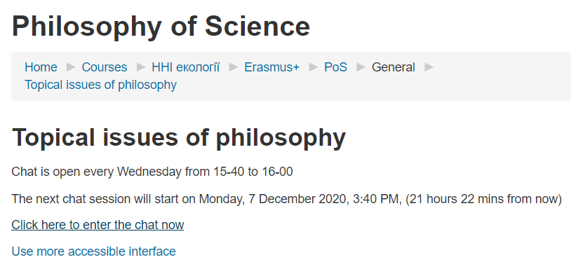
To communicate with students, there is a Chat, Forum and Messages:

Slide 15
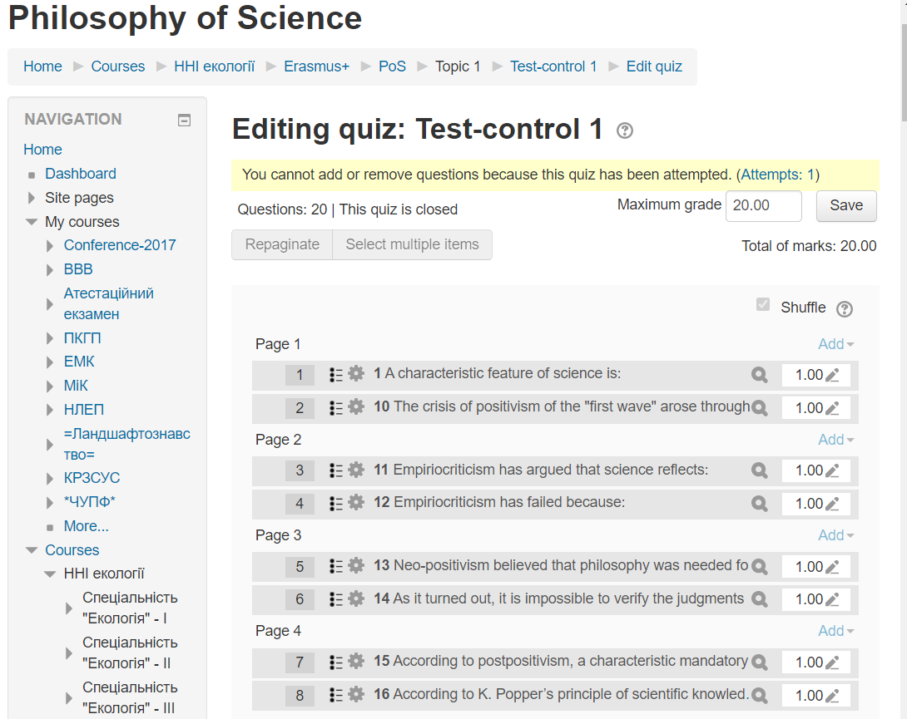
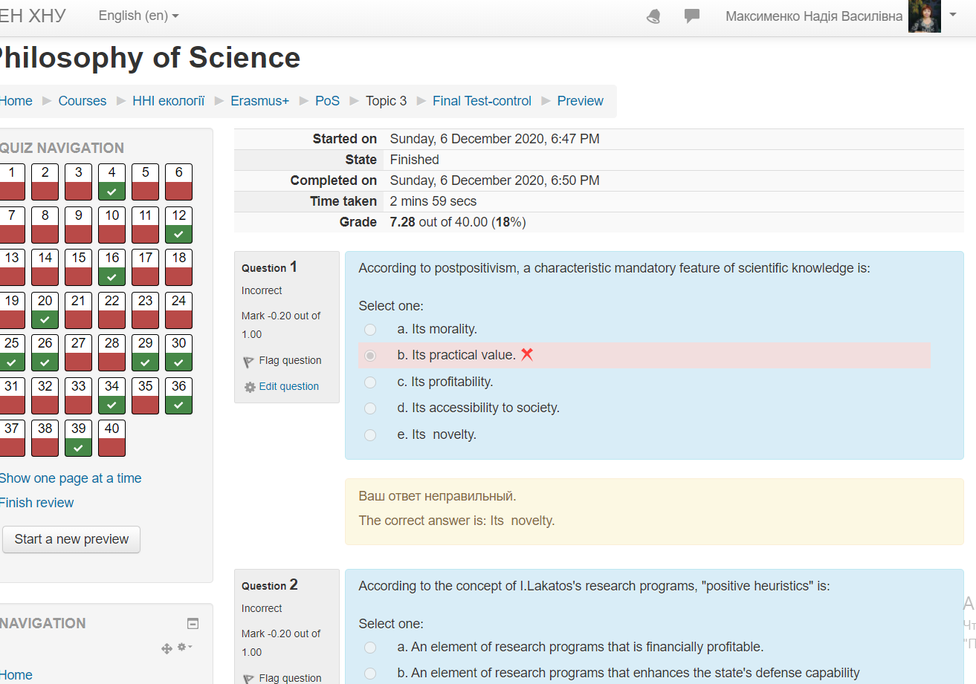
Test preparation, execution and validation

Slide 16
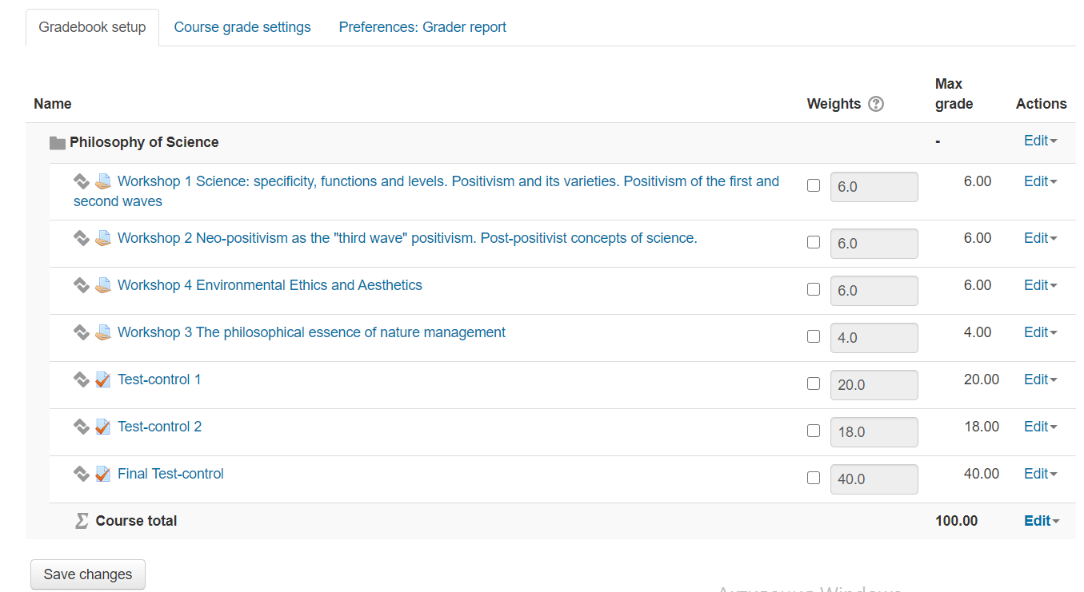
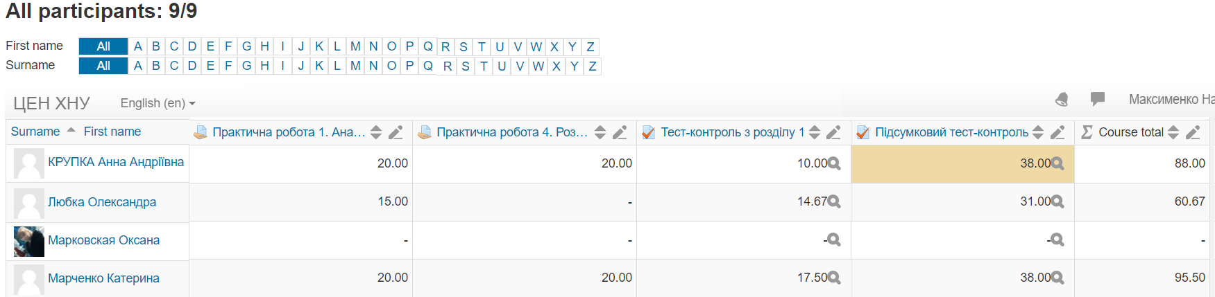
Gradebook setup
&
Achievement results

Slide 17
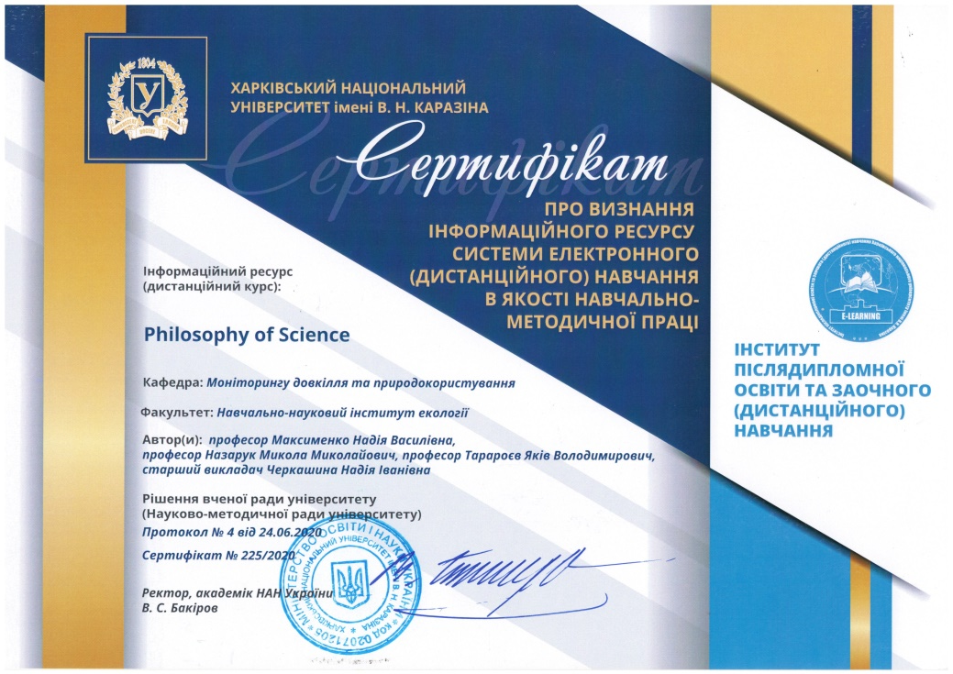
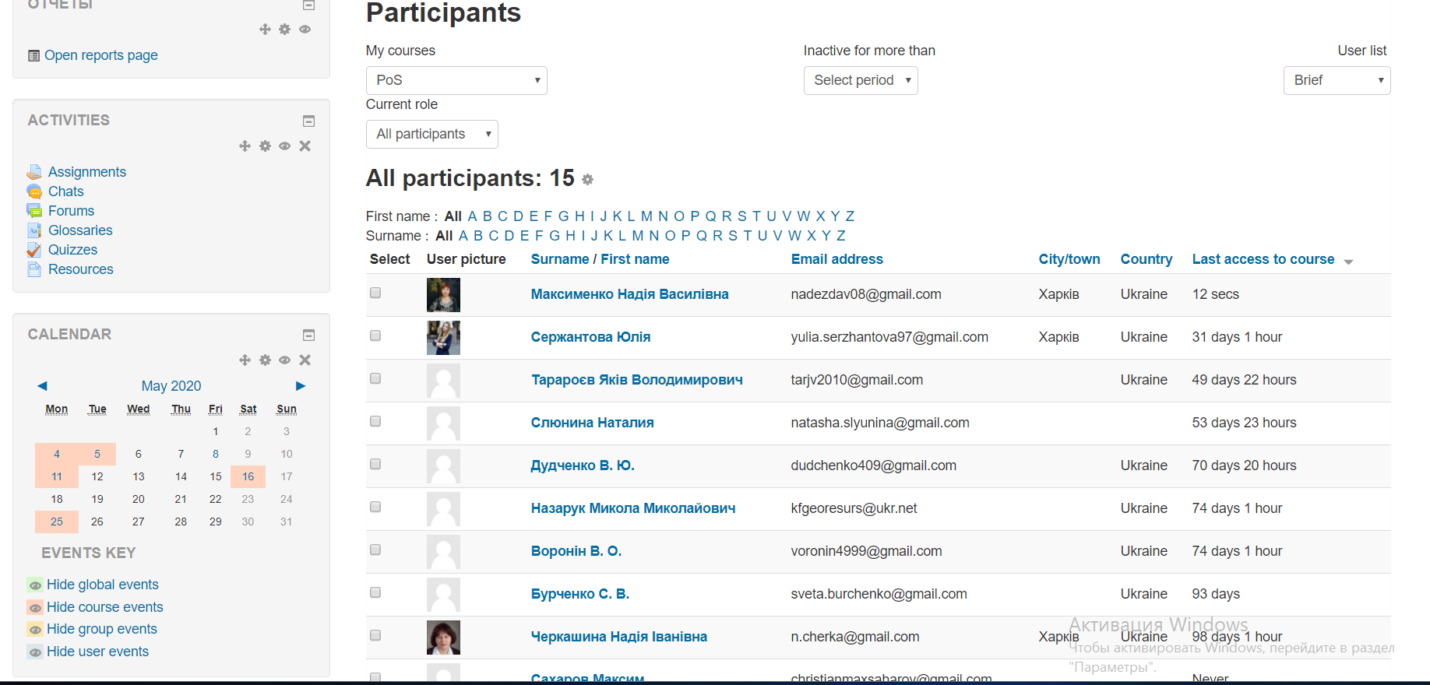
Approbation and certification of the course

Slide 18
Course authors:
Cooordinator: Nadiya Maksymenko,
V. N. Karazin Kharkiv National University (KKNU, Ukraine
maksymenko@karazin.ua
Authors: Nadiya Maksymenko,
V. N. Karazin Kharkiv National University (KKNU), Ukraine
Mykola Nazaruk,
Ivan Franko Lviv National University (LNU), Ukraine
Jakiv Tararoev,
V. N. Karazin Kharkiv National University (KKNU), Ukraine

