Slide 1
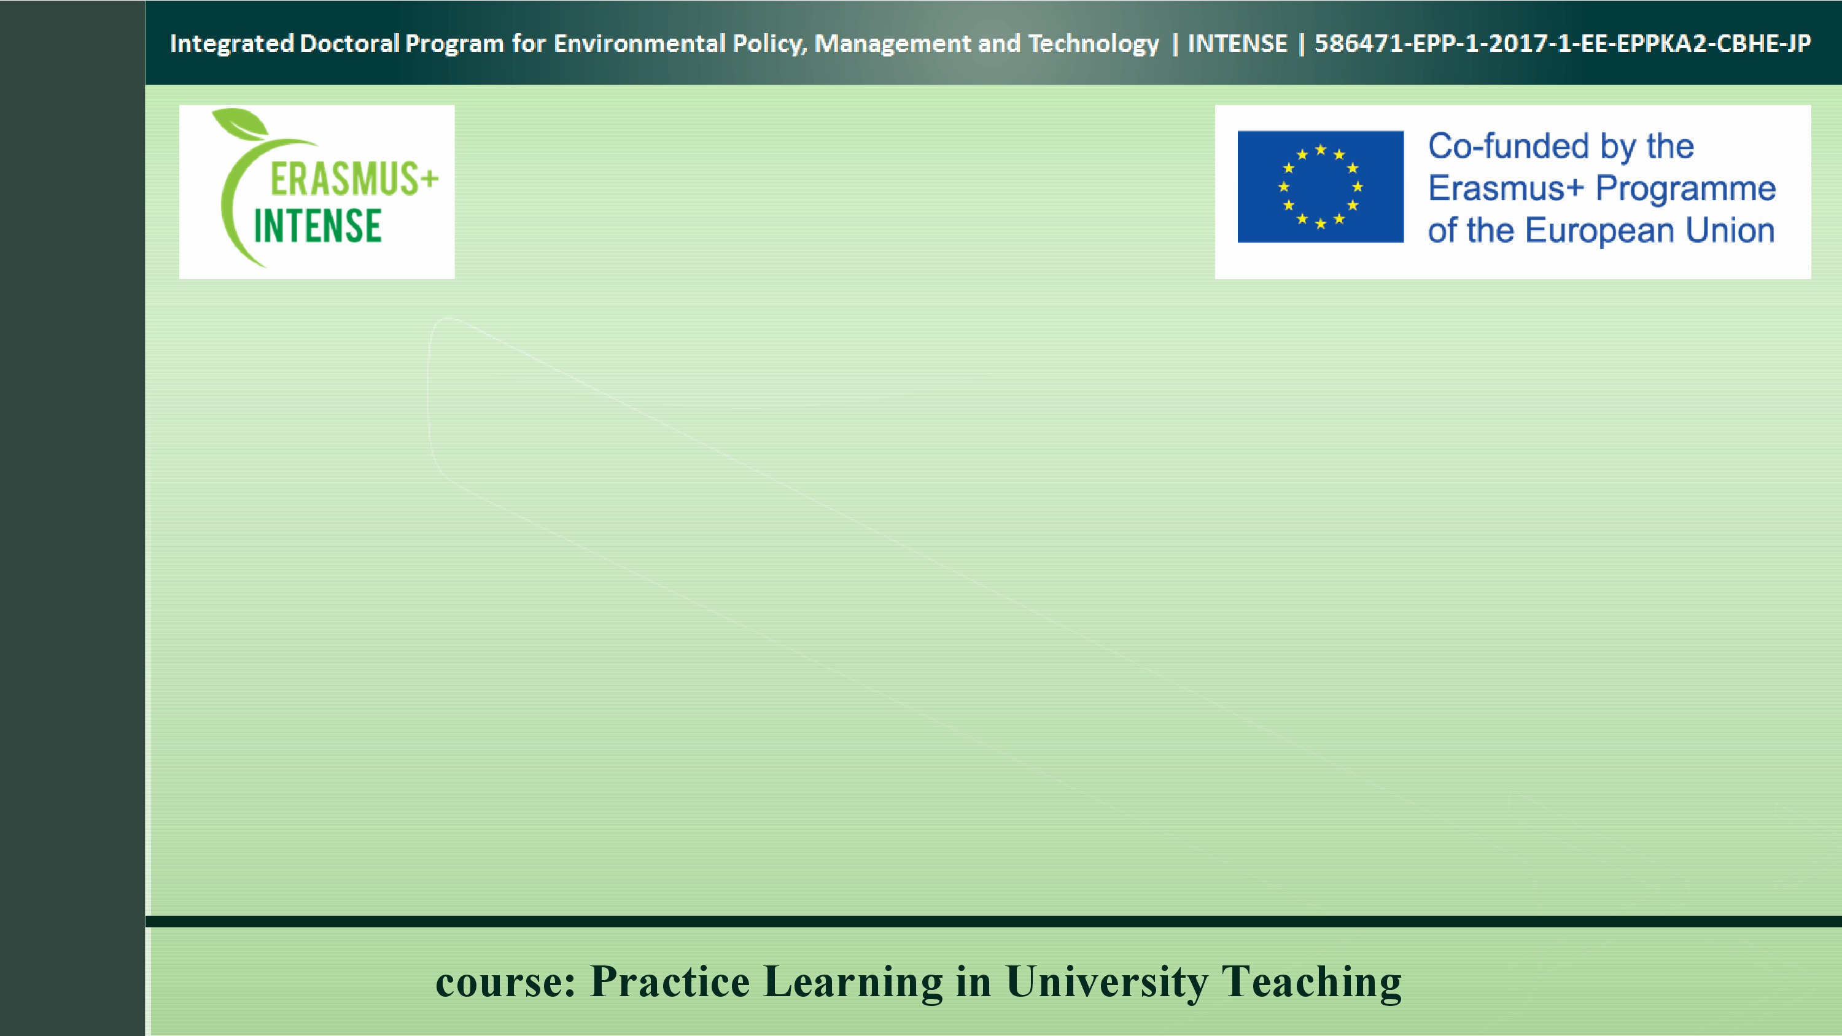
Course presentation:
Practice Learning
in
University Teaching
ERASMUS+ project “INTEGRATED DOCTORAL PROGRAM FOR ENVIRONMENTAL POLICY, MANAGEMENT AND TECHNOLOGY – INTENSE”

Slide 2

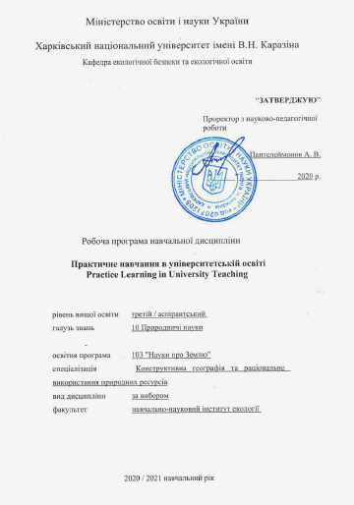
This 3 ECTS course serves as the skills course of the project INTENSE
This course provides opportunities to expand practical skills and gain competence in organizing any practical classes and practices
In addition, the course familiarizes PhD students with technologies and techniques for practical training in university education, techniques for forming the content of practical classes and laboratory workshops, designing quality teaching materials for practical classes, etc
The course develops practical skills, the practice of organizing research work
course: Practice Learning in University Teaching

Slide 3
The aim of the course is to form knowledge, competencies, and practical skills for future research and teaching activities of a specialist of the third educational and scientific level (PhD).
Task:
To identify historical aspects of experience and areas of university education
To define the concept of competence for the practical training of future specialists in obtaining a university education
To reveal the essence of the competence approach to the practical training of a modern university teacher
To determine the range of various practical skills, starting from the methods and techniques of forming the content of practical classes and laboratory workshops as part of academic disciplines, practices of mastering instructions for laboratory equipment, ending with practices of organizing and conducting briefings in-field practices
To determine the need for the use of information and digital technologies in the educational process and in scientific activities
course: Practice Learning in University Teaching

Slide 4
Planned learning outcomes
General competencies
Professional competencies
Deep understanding of the relationships in the system "nature - population - economy" and knowledge of scientific approaches to its study
General scientific (philosophical) competencies - the formation of a systematic scientific worldview, professional ethics, and general cultural outlook
Ability to use theoretical knowledge and practical skills of modeling and forecasting of phenomena and processes occurring in natural and social geosystems
Acquisition of universal skills of the researcher, results of own scientific research, application of modern information technologies in scientific activity
Skills of pedagogical activity in universities, organization and carrying out of educational - practical employments
Basic knowledge in the field of modern information technologies, the ability to apply software in research in the field of Earth sciences
course: Practice Learning in University Teaching

Slide 5
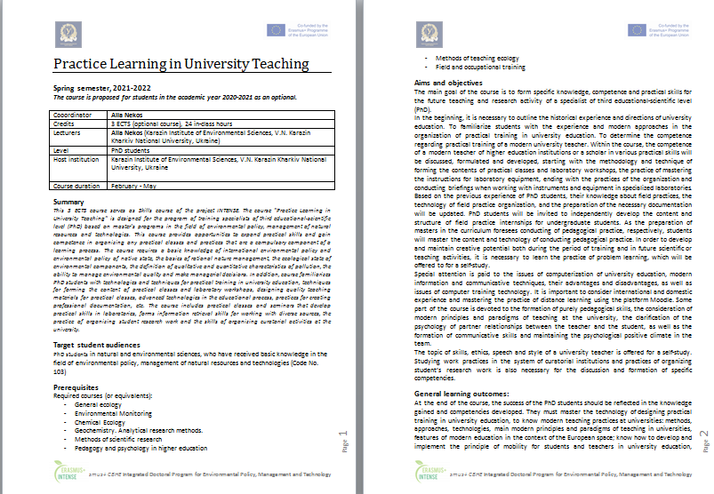
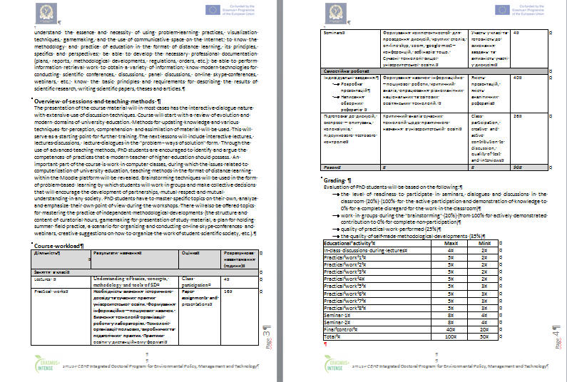
Syllabus
course: Practice Learning in University Teaching

Slide 6
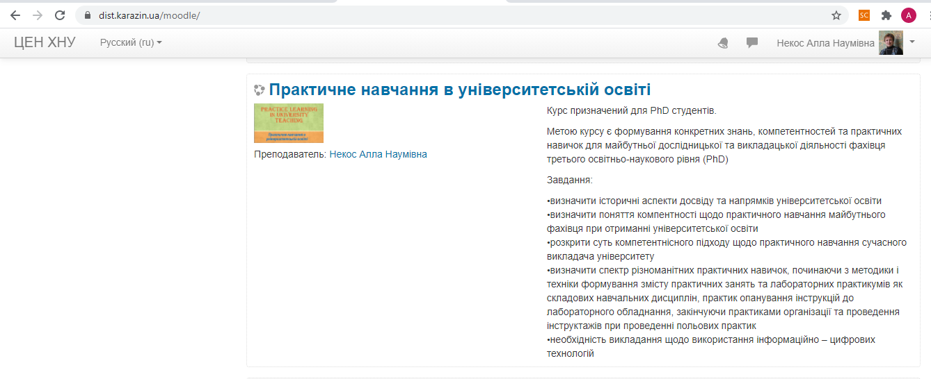
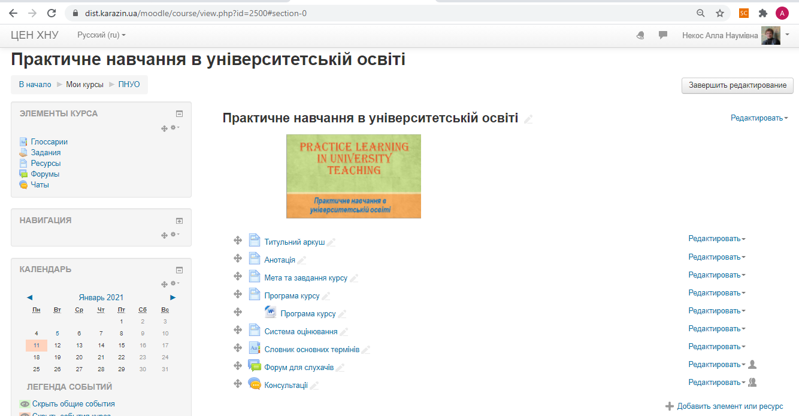
The course is available
on the KKNU Moodle
https://dist.karazin.ua/moodle/course/view.php?id=2500
course: Practice Learning in University Teaching

Slide 7
Types and forms of classes,
methods of interaction between teacher and graduate student
The course "Practical training in university education" is taught in the second semester when studying on the PhD program
The course program provides for 90 hours, of which 24 hours. classroom classes (4 hours of lectures, 16 hours of practical classes and 4 hours of seminars, 66 hours of independent work, and 4 hours of the exam)
The course program consists of 2 sections, which include 4 topics of lectures, 8 topics of practical classes, and 3 topics of seminars, and ends with an exam in the form of a written test based on the Moodle platform.
For individual consultations - "Forum" and "Chat".
course: Practice Learning in University Teaching

Slide 8
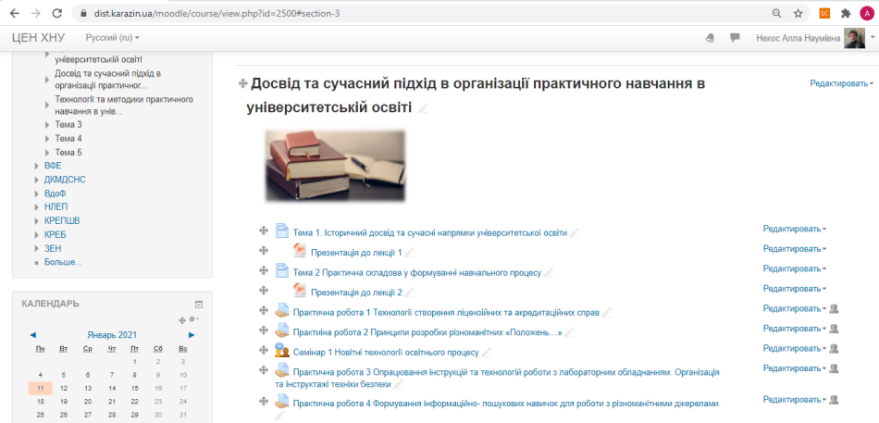
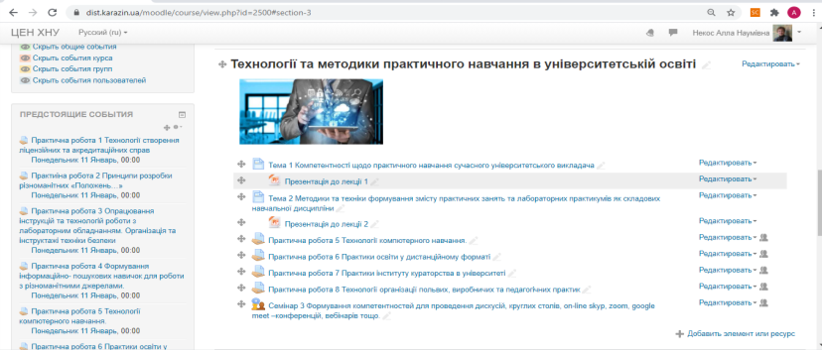
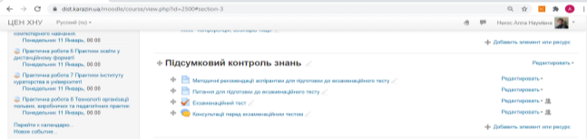
The course is divided into 3 topics:
course: Practice Learning in University Teaching

Slide 9
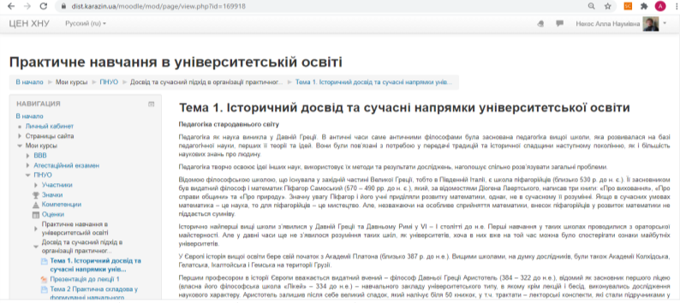
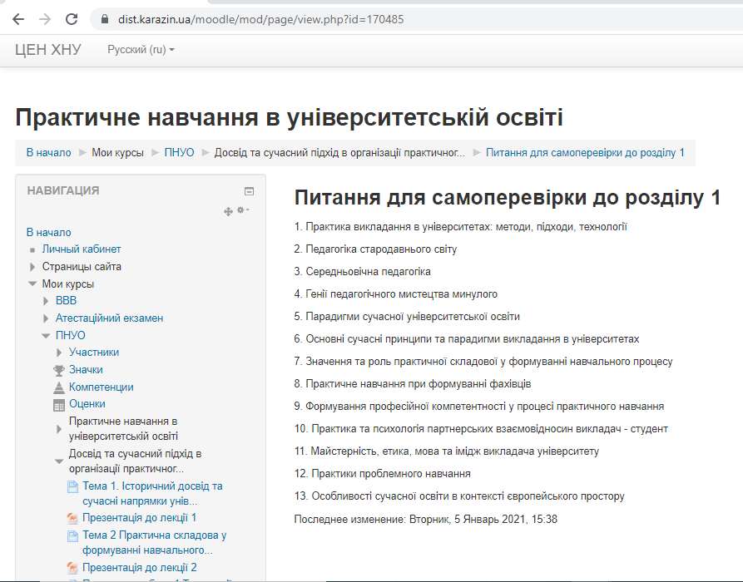
Each topics contains: questions, text, questions for self-control
course: Practice Learning in University Teaching

Slide 10
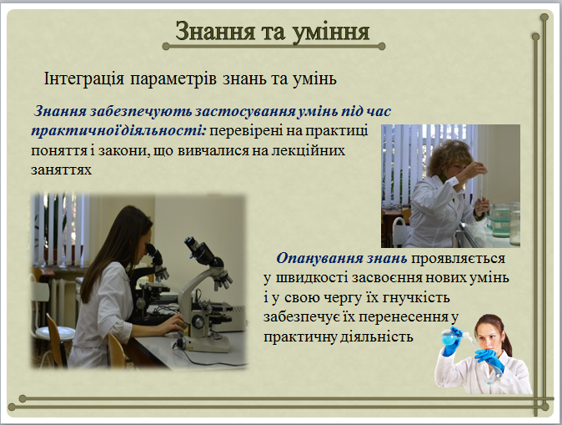
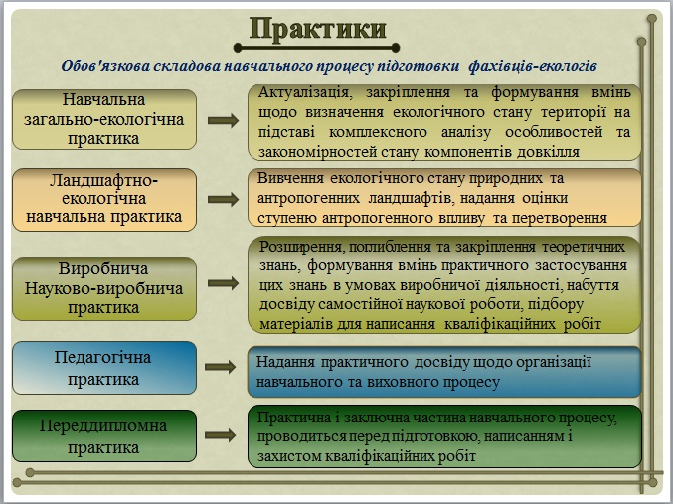
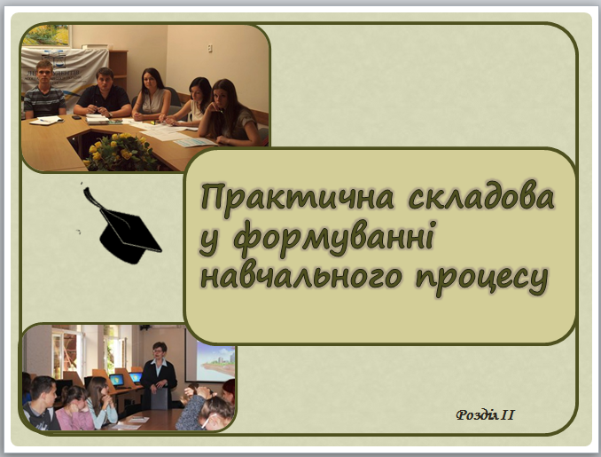
The offered materials include PowerPoint Presentations
that cover theoretical issues of the topics:
course: Practice Learning in University Teaching

Slide 11
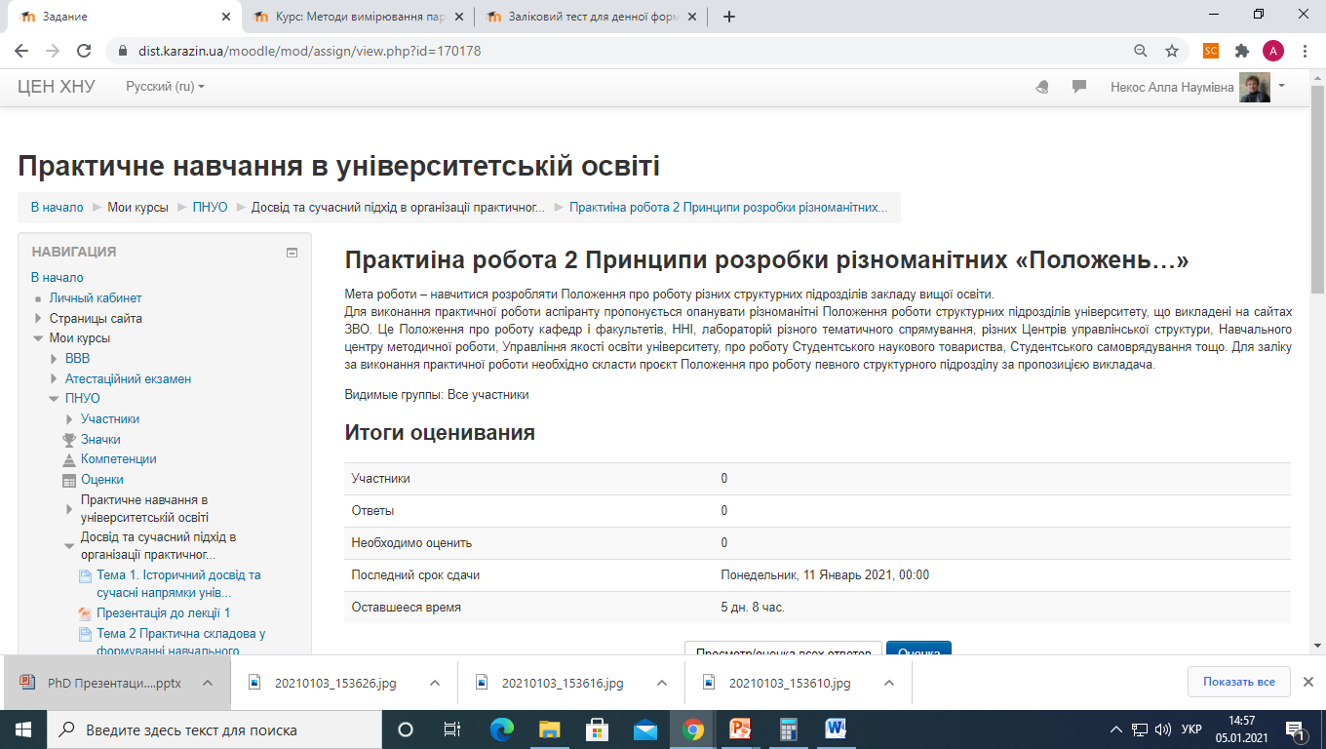
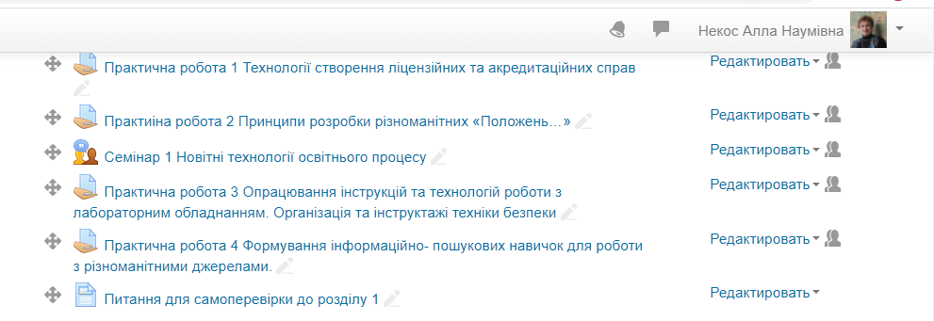
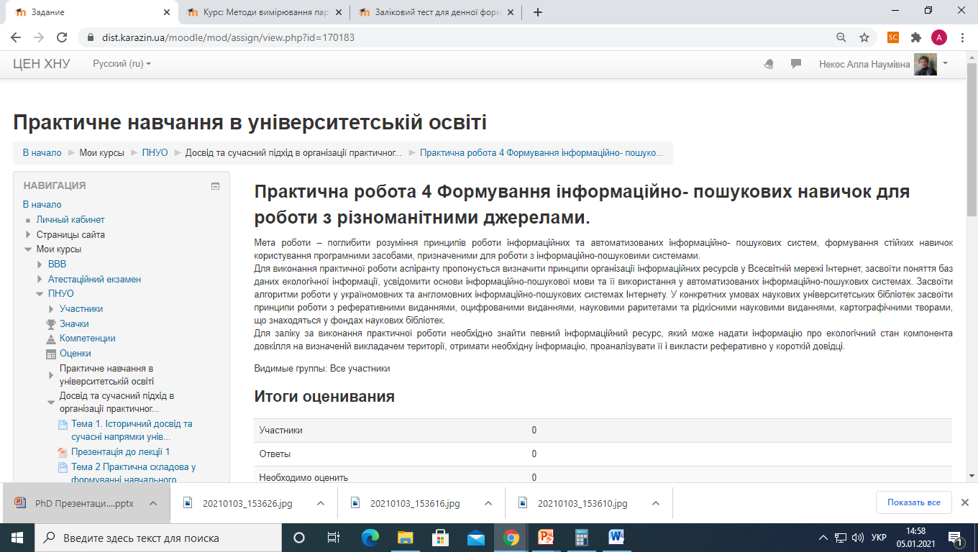
The course contains 4 workshops :
course: Practice Learning in University Teaching

Slide 12
Course authors:
COURSE : Practice Learning in University Teaching
Coordinator: Prof. Alla Nekos
V. N. Karazin Kharkiv National University (KKNU), Ukraine
nekos@karazin.ua
Authors: Prof. Alla Nekos
V. N. Karazin Kharkiv National University (KKNU), Ukraine
course: Practice Learning in University Teaching

