Slide 1
SCIENCE Methodology
Course presentation:
ERASMUS+ project “INTEGRATED DOCTORAL PROGRAM FOR ENVIRONMENTAL POLICY, MANAGEMENT AND TECHNOLOGY – INTENSE”

Slide 2
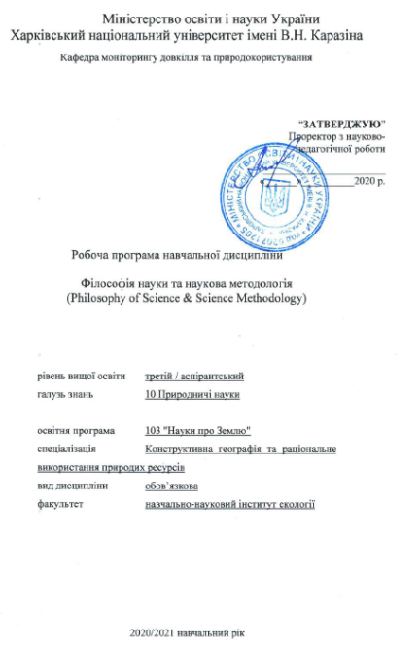
Summary
This 2 ECTS course serves as a skills course of the project INTENSE.
Course “Science Methodology” provides PhD students coming from natural science backgrounds with a basic understanding of philosophy of sciences. In addition, it introduces PhD students the concept of science, various ways of defining science, science and pseudo-science, philosophy and science, methodological topics like what is a concept, fact, model, hypothesis, law, theory, explanation, observation, experiment, objectivity.
The course helps to develop analysation and argumentation skills.

Slide 3
Aims and objectives
The main tasks of the course is :
to give an overview of methodic of the PhD programs,
planning and accomplishment of individual PhD studies,
organization of the relationships between the thesis supervisor(s) and colleagues,
and of the scientific methods for planning and carrying out independent research.
The course further provides basic information on science funding, evaluation of scientists and on science careers.

Slide 4
General learning outcomes
The doctoral student is able to make a realistic research plan for the entire course of PhD studies, in particular, posing realistic research hypotheses, plan individual experiments, and can assess the reliability of obtained experimental data.
The doctoral student is familiar with the national and international science system, understands the role of science policy, science funding and evaluation and is able to make and review a grant proposal on the topic of own thesis.
The doctoral student is able to make a presentation on her/his research topic, and can critically read and review scientific papers and reports.

Slide 5
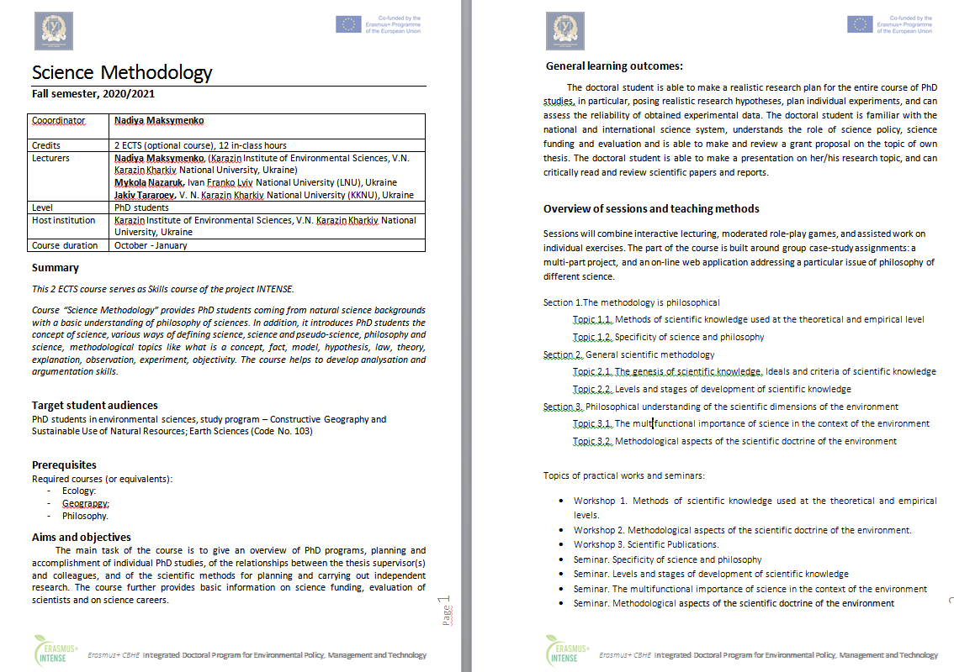
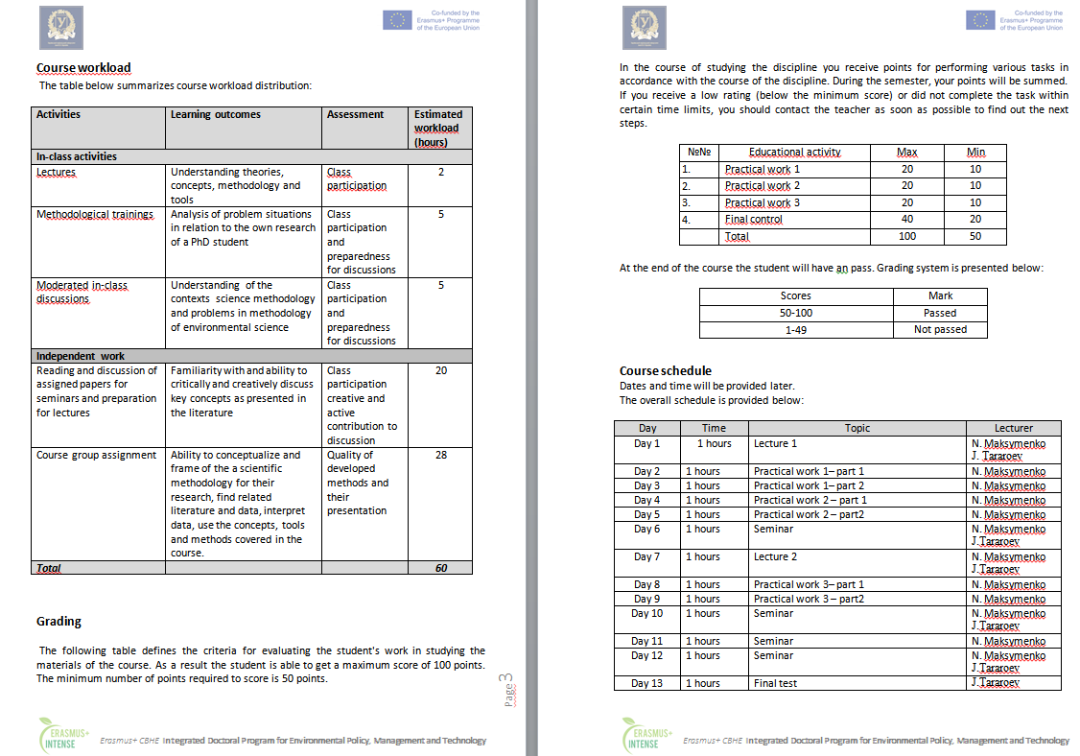
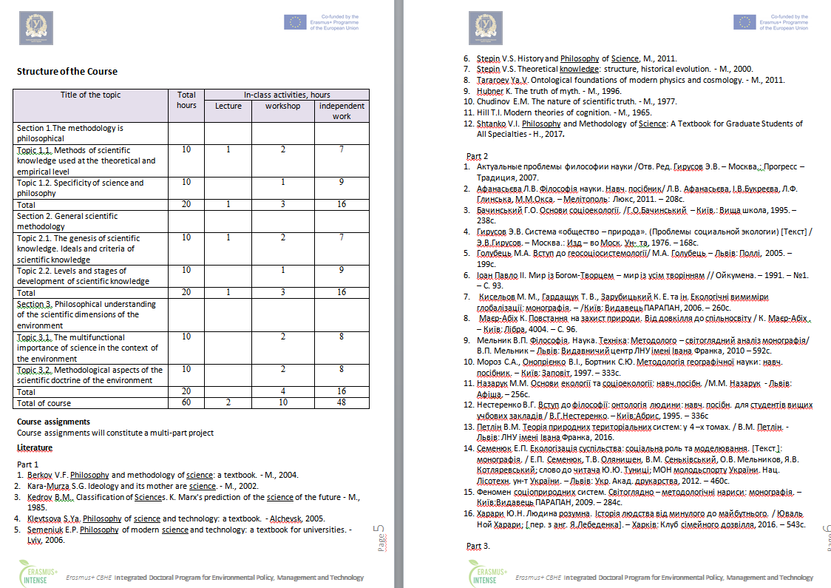
Syllabus

Slide 6
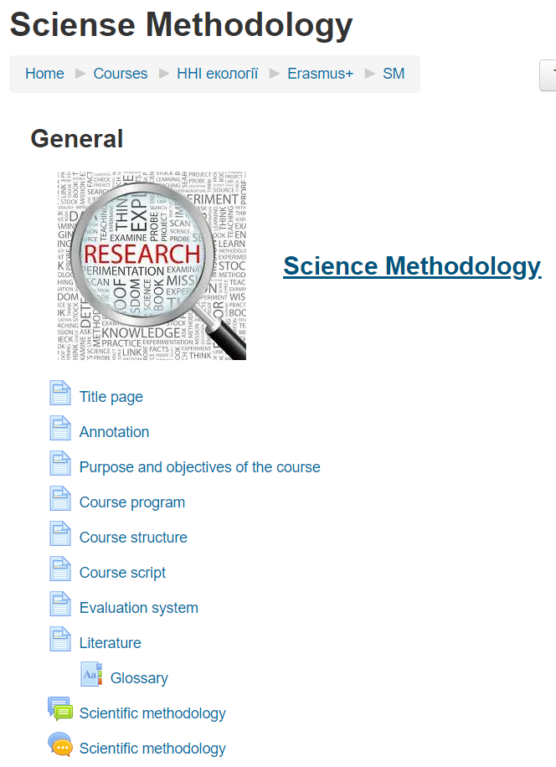
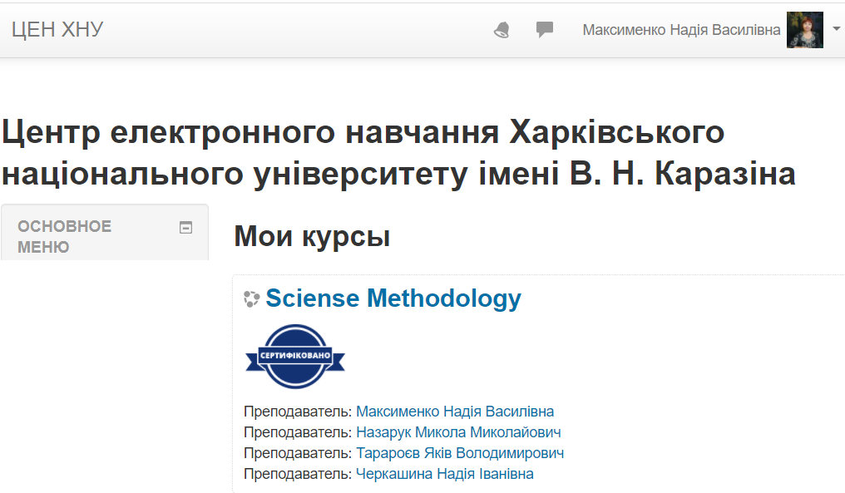
The course is available on the KKNU Moodle
https://dist.karazin.ua/moodle/course/view.php?id=2290

Slide 7
Types and forms of classes, methods of interaction between teacher and student
The course “Science Methodology” is studied in the 1-st semester in PhD program and consists of 3 sections and ends with the exam.
The course includes
theoretical material,
practical tasks and recommendations for their implementation,
questions for self-examination
knowledge control (examination task).
The course consists of a complex of lectures on 7 topics and 3 practical tasks, 1 Final control works.
For individual consultations – “Forum” and "Chat".

Slide 8
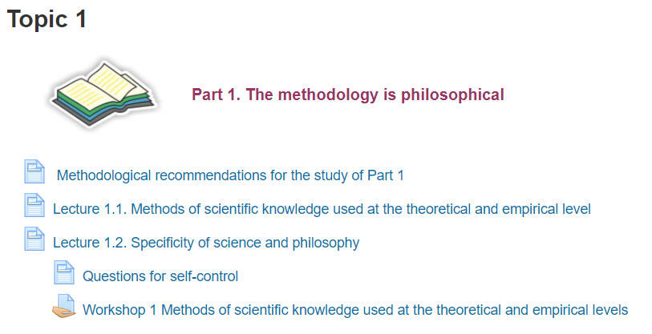
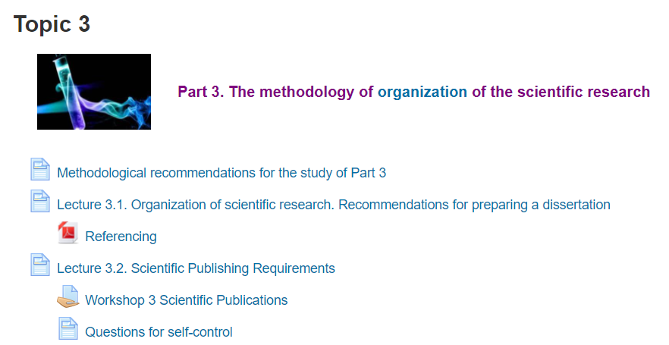
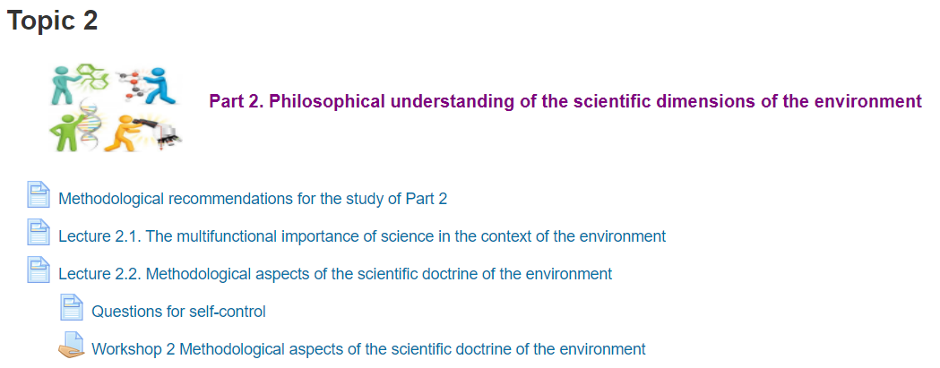
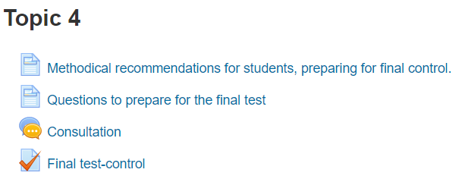
The course is divided into 4 topics:

Slide 9
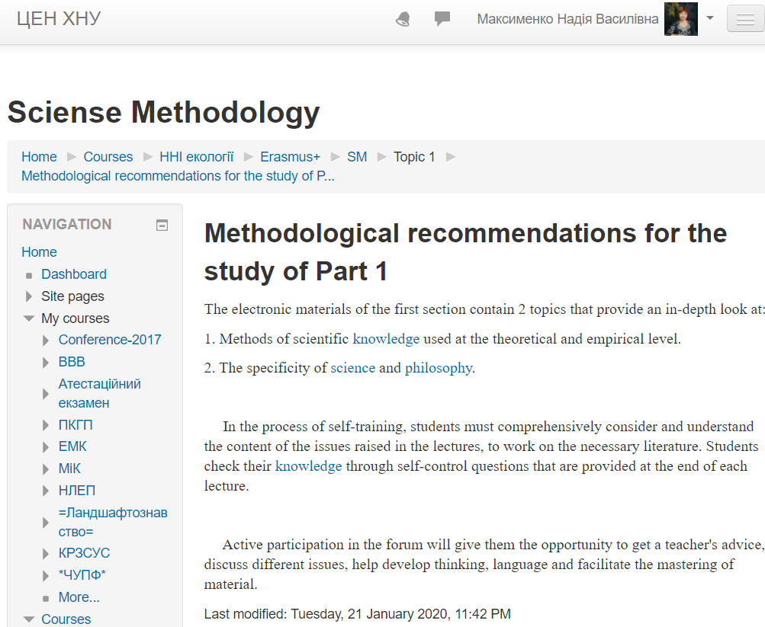
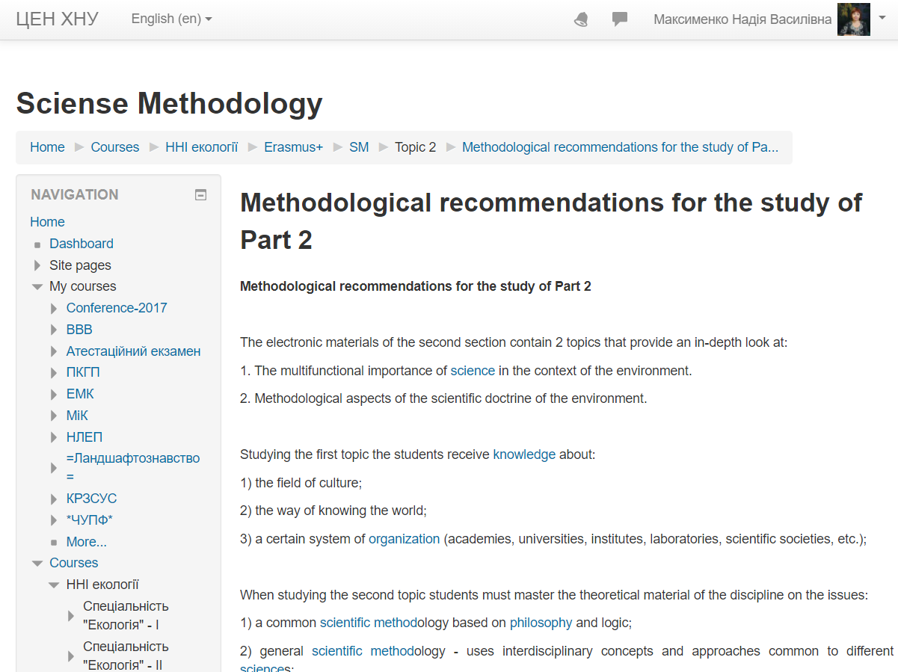
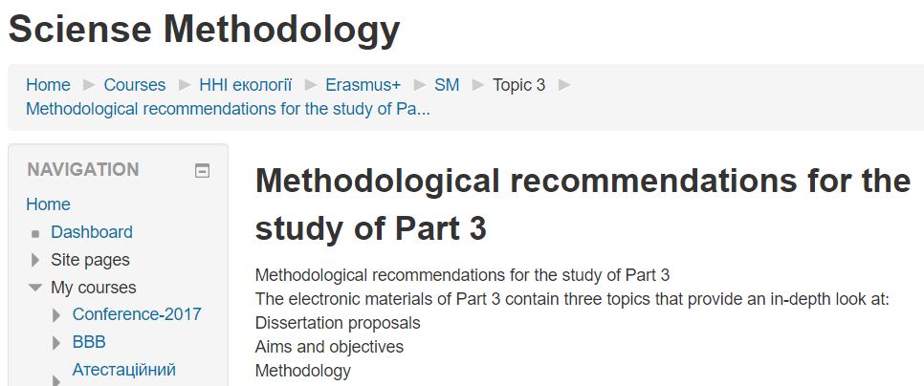
Each topic contains methodological recommendations for the study

Slide 10
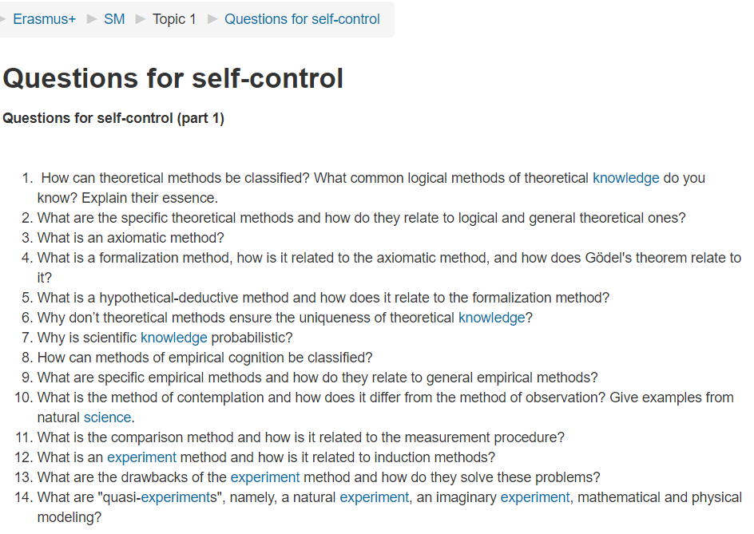
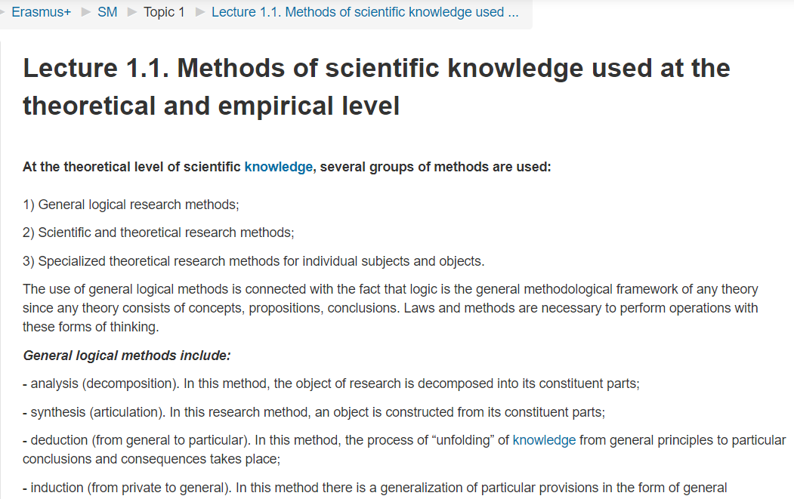
Each topic contains: questions, text, questions for self-control

Slide 11
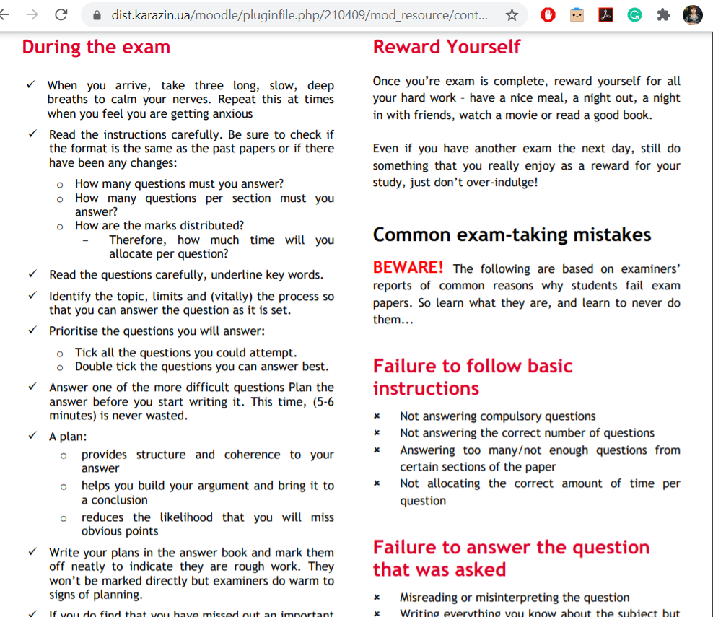
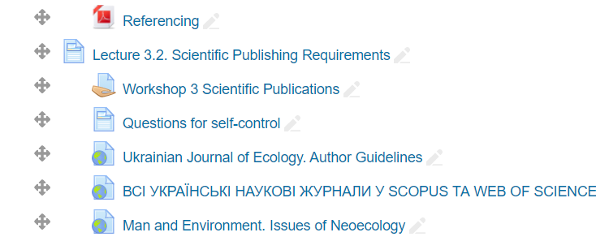
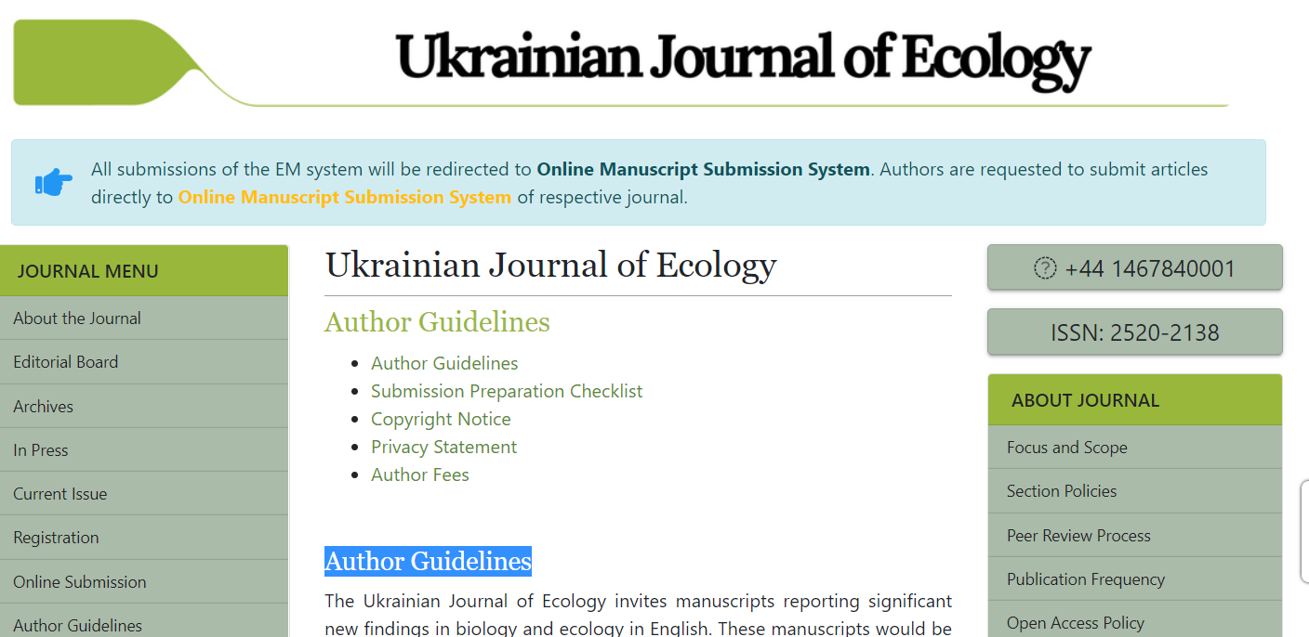
The course contains links to well-known developments and regulatory documents:

Slide 12
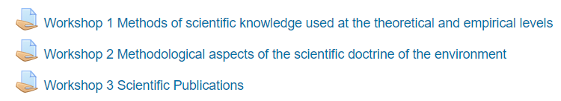
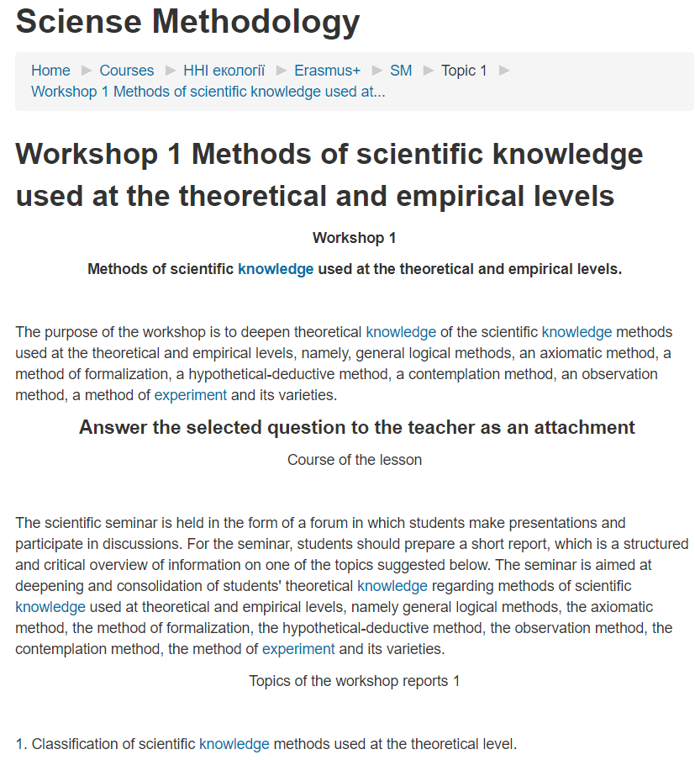
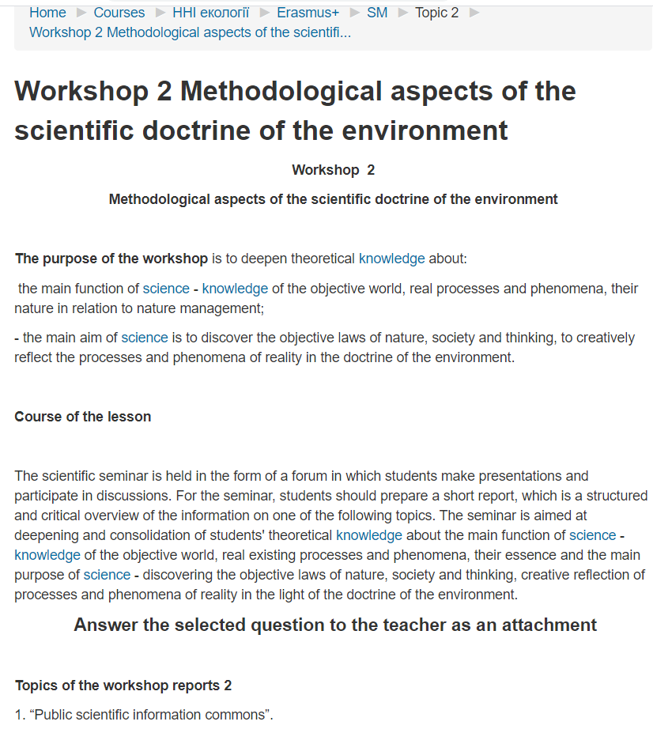
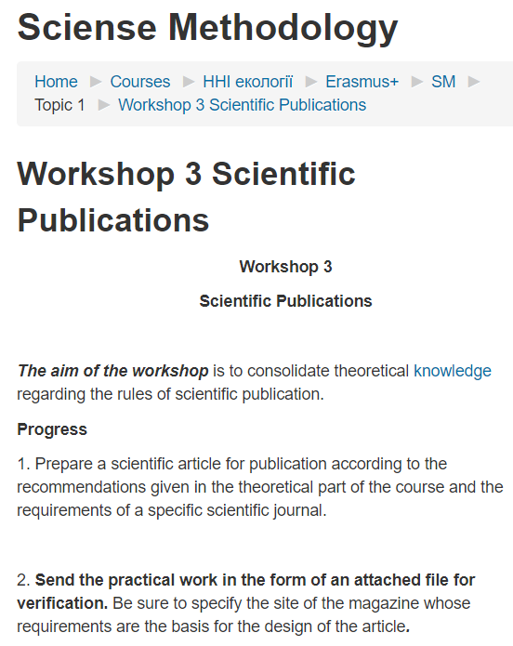
The course includes 3 workshops :

Slide 13
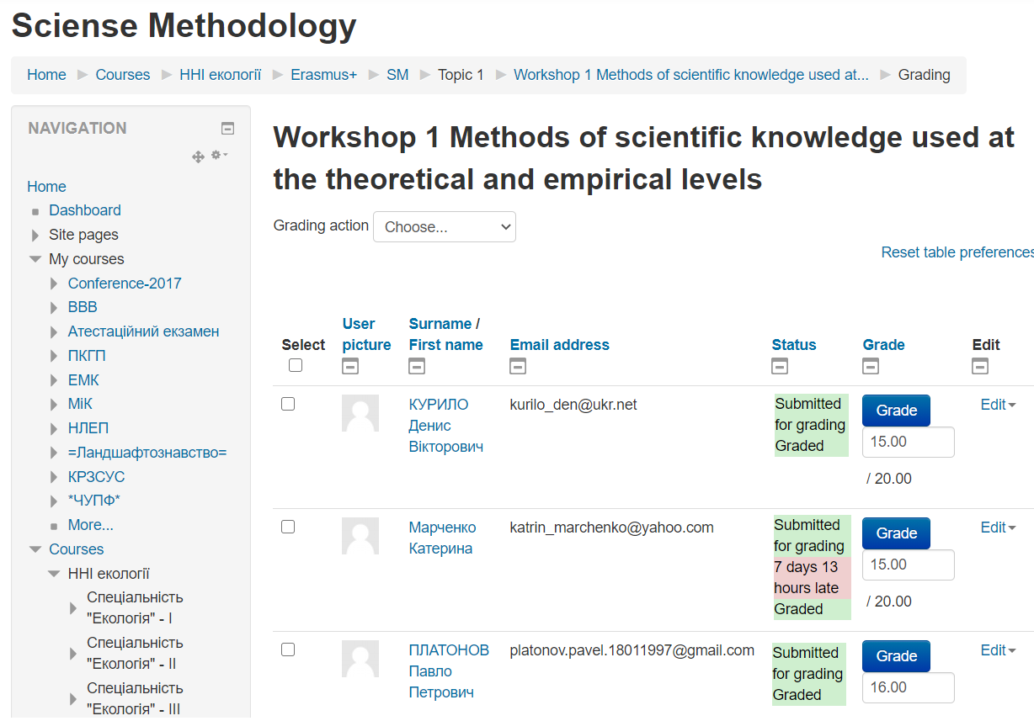
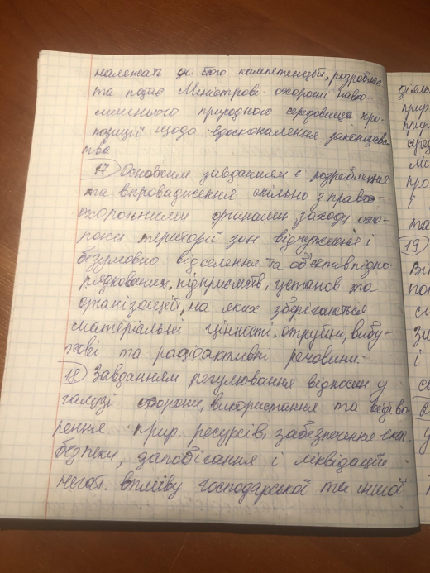
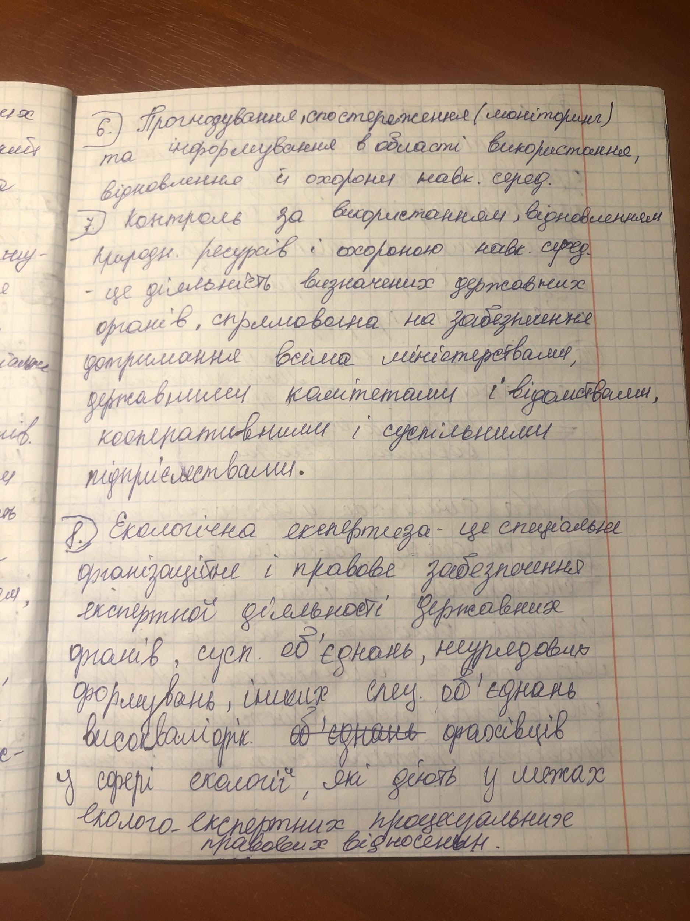
On Workshops students answer the questions in a written form and upload their answers to Moodle; it allows the teacher to better control the learning process and their achievements.

Slide 14
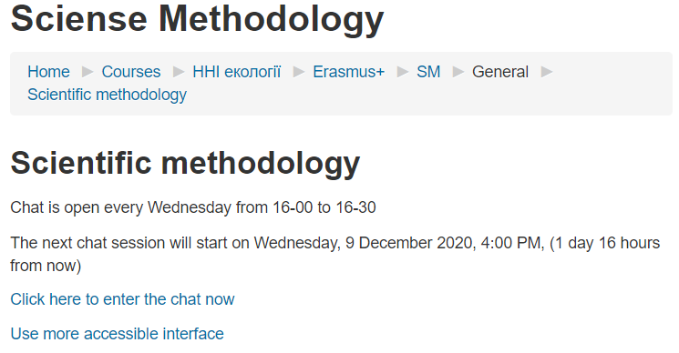

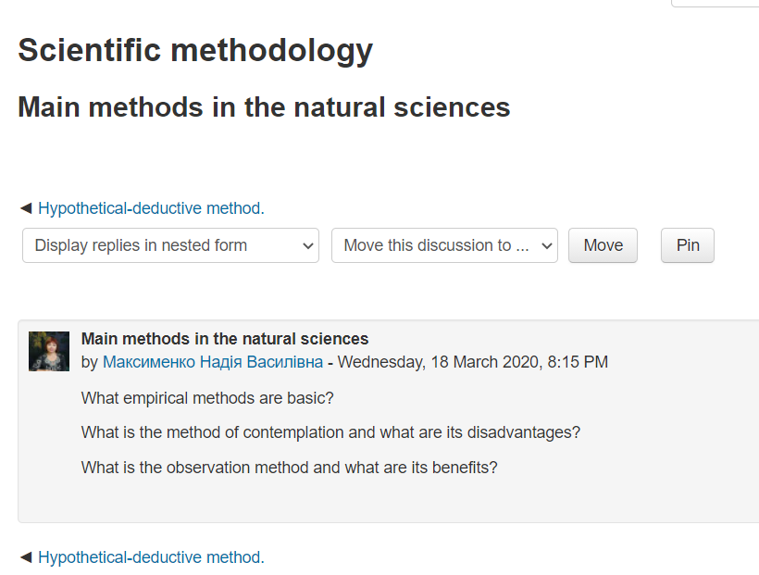
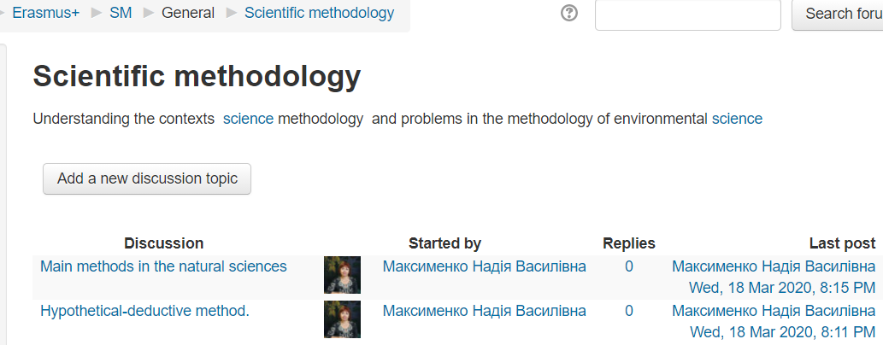
To communicate with students, there is a Chat and Forum :

Slide 15
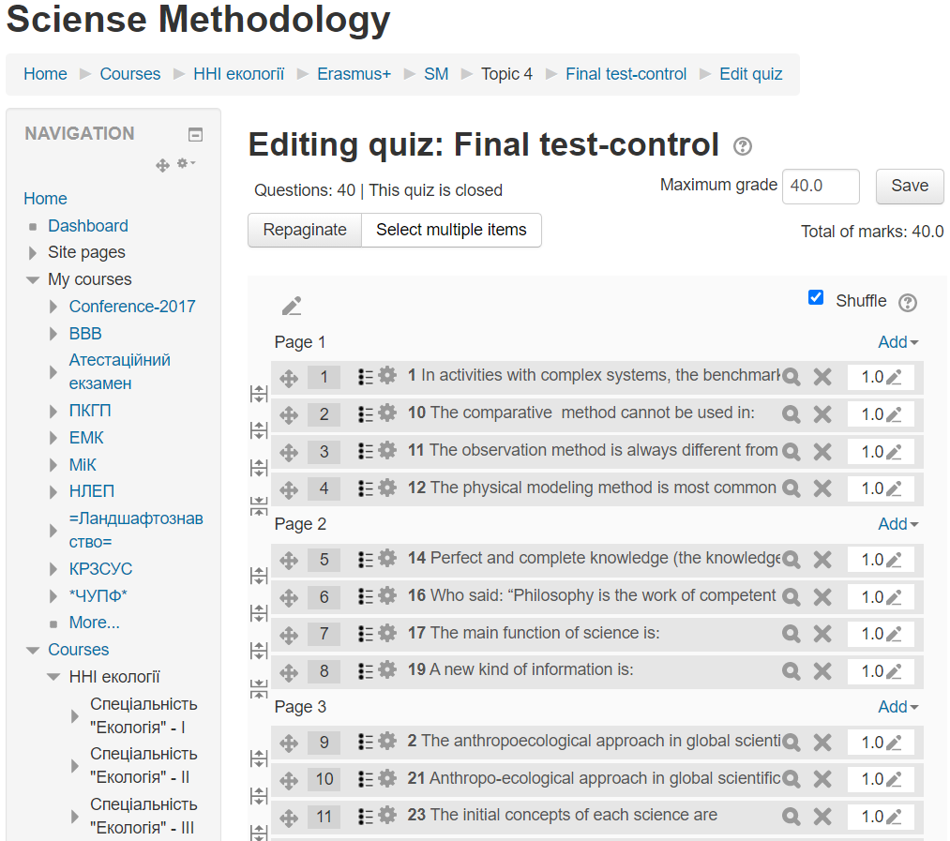
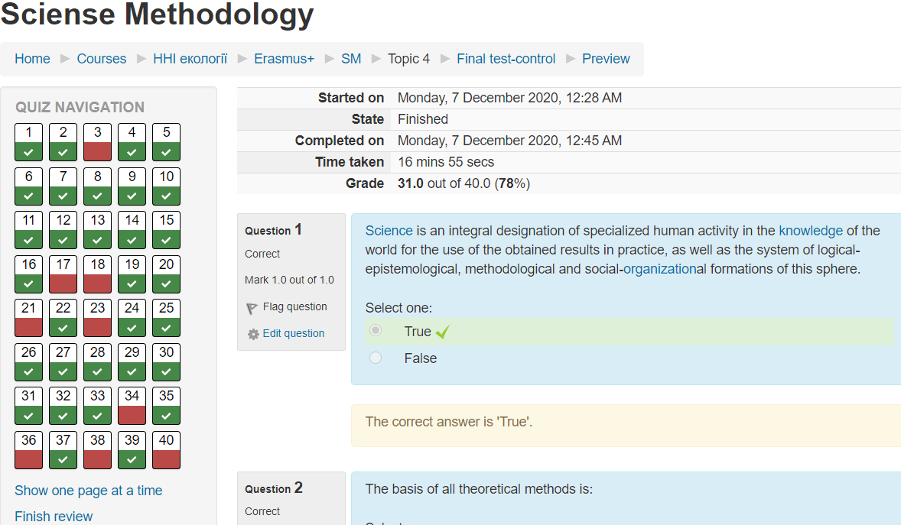
Test preparation, execution and validation

Slide 16
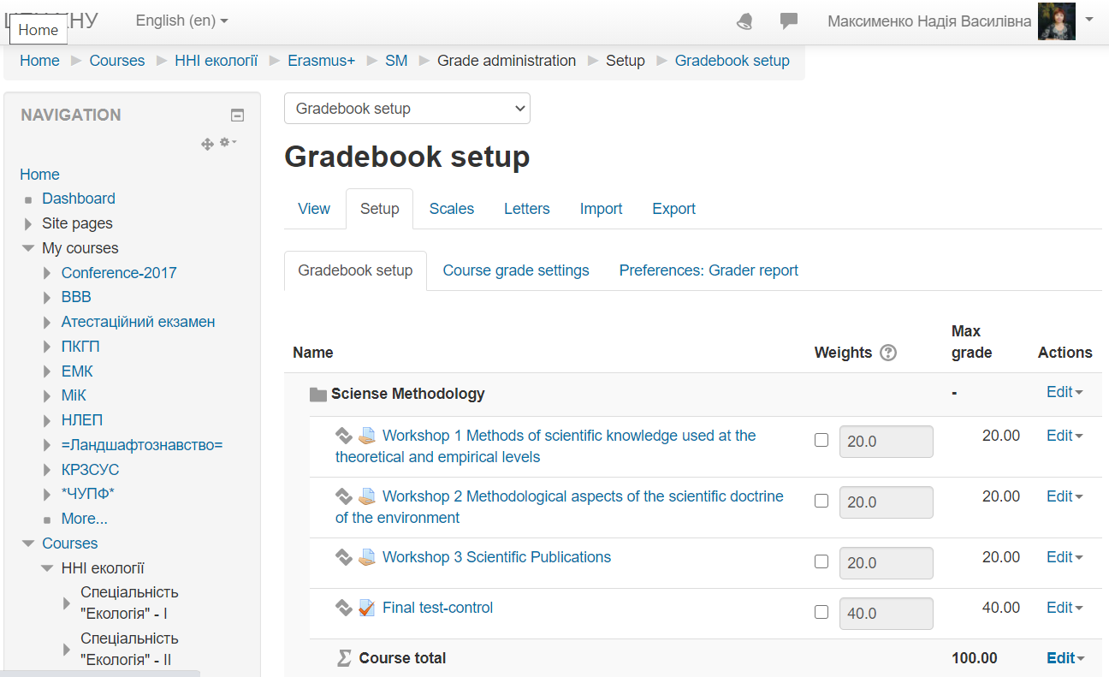
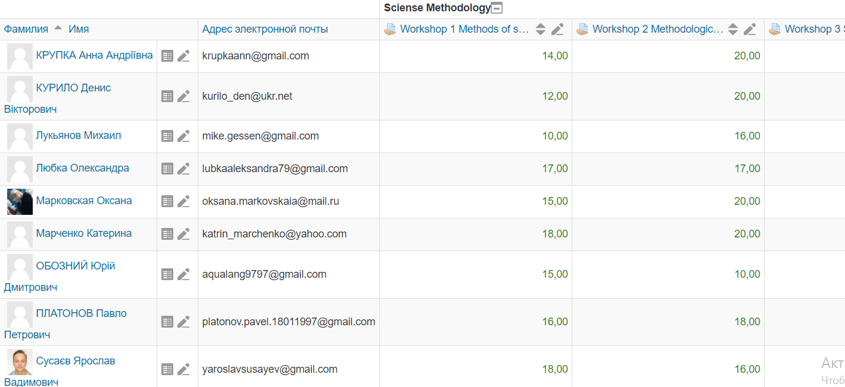
Gradebook setup
&
Achievement results

Slide 17
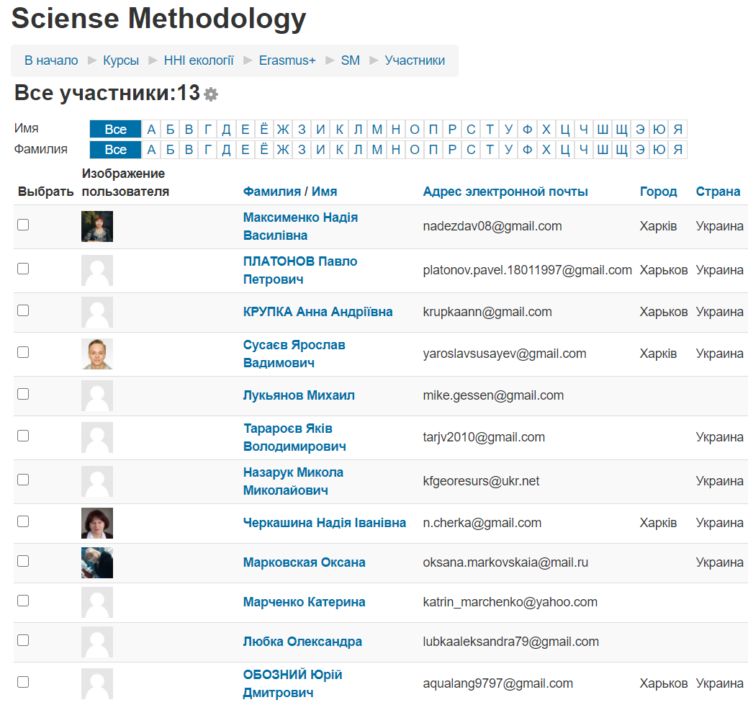
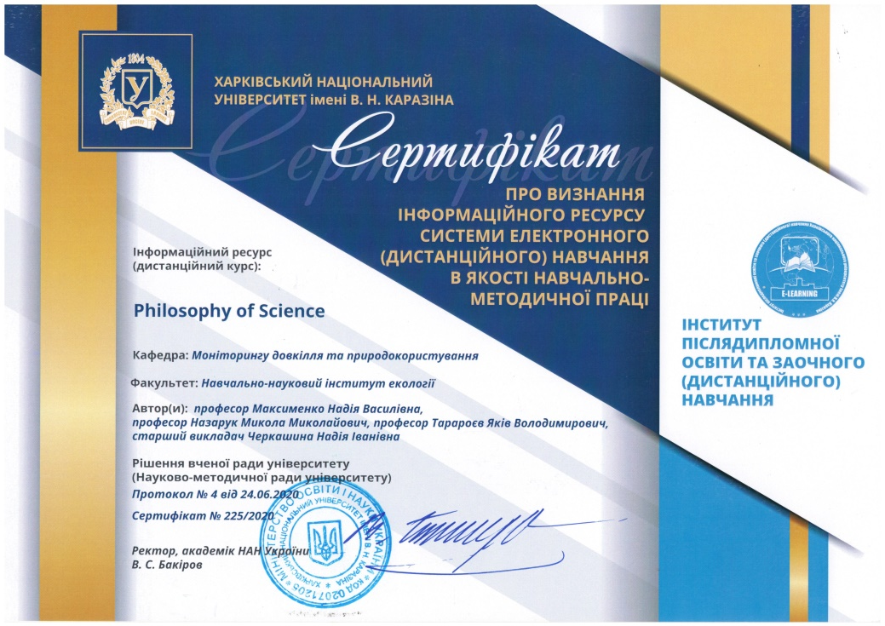
Approbation and certification of the course

Slide 18
Course authors:
Cooordinator: Nadiya Maksymenko,
V. N. Karazin Kharkiv National University (KKNU, Ukraine
maksymenko@karazin.ua
Authors: Nadiya Maksymenko,
V. N. Karazin Kharkiv National University (KKNU), Ukraine
Mykola Nazaruk,
Ivan Franko Lviv National University (LNU), Ukraine
Jakiv Tararoev,
V. N. Karazin Kharkiv National University (KKNU), Ukraine

