Slide 1
MODELS FOR ENVIRONMENTAL RISK ASSESSMENT
Course presentation:
ERASMUS+ project “INTEGRATED DOCTORAL PROGRAM FOR ENVIRONMENTAL POLICY, MANAGEMENT AND TECHNOLOGY – INTENSE”

Slide 2
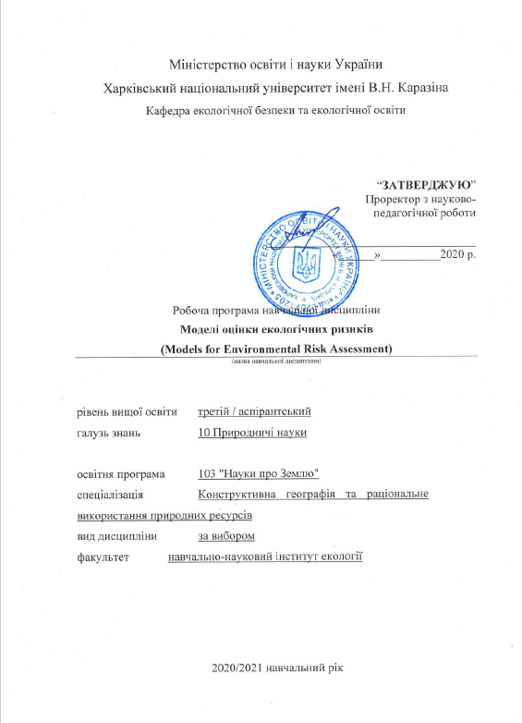
Summary
This 3 ECTS course aims to deepen knowledge about environmental risk.
It provide students with detailed information about the core concepts, principles and techniques underlying environmental risk assessment which can be applied on a national and global platform.
The course contains individual and group assignments aimed at developing in-hand practical skills in applying basic environmental and health risk assessment methods in case of air, food, soil and drinking water pollution, exposure to radiation, introduction of GMOs and transgenic plants to the environment.

Slide 3
Aims and objectives
The main course objective is to introduce the students to the key elements of risk assessment methodology, and to give a better understanding of how environmental risk is defined, as well as how risks may be evaluated and managed.
In particular, the course will discuss the core concepts, principles and stages of risk assessment, providing students with the ability to identify, explain, and make decisions about risks to public health and nature. The students will learn how risk analysis is done, how it is interpreted, and how it influences regulatory decision-making.
In general, this course focuses on applying modern concepts to diverse risk assessment issues, as well as finding the possible ways of improving the effectiveness of current risk assessment practices.

Slide 4
General learning outcomes
By the end of the course, successful students will:
understand the environmental risk assessment principles, including detailing steps in the risk assessment process
evaluate the role of causality, uncertainty and probability in environmental risk analysis
be aware of main conceptual models in risk assessment
be aware of risk assessment methodologies and procedures and be able to apply them to specific health and environmental risks
be able to identify factors that alter people’s perception of risk
understand the role of government policy with regard to environmental risk assessment and management
understand the use of scientific data to identify and characterize risk for both humans and ecosystems
have general understanding of the role of government in developing compliance standard and public policies
understand the particular challenges related to environmental risk assessment

Slide 5
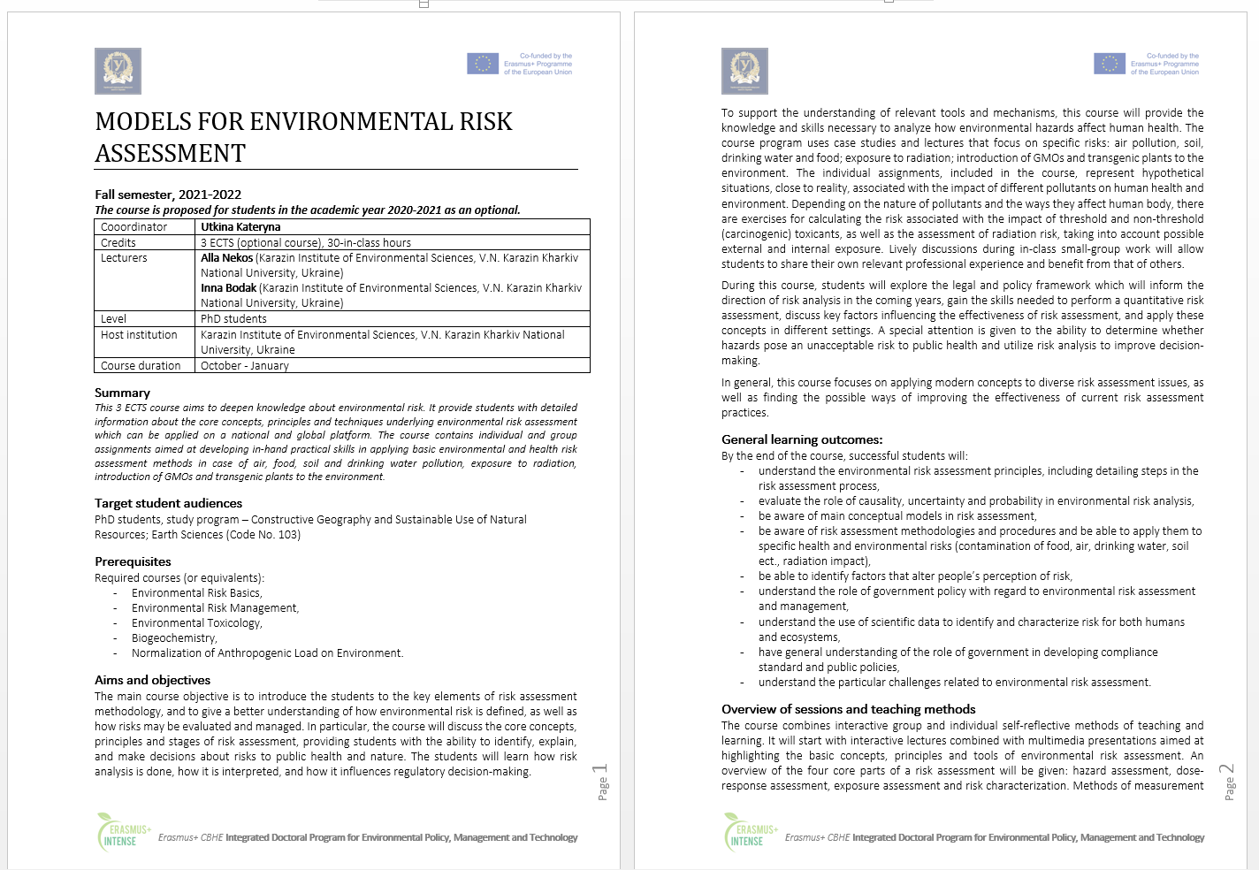
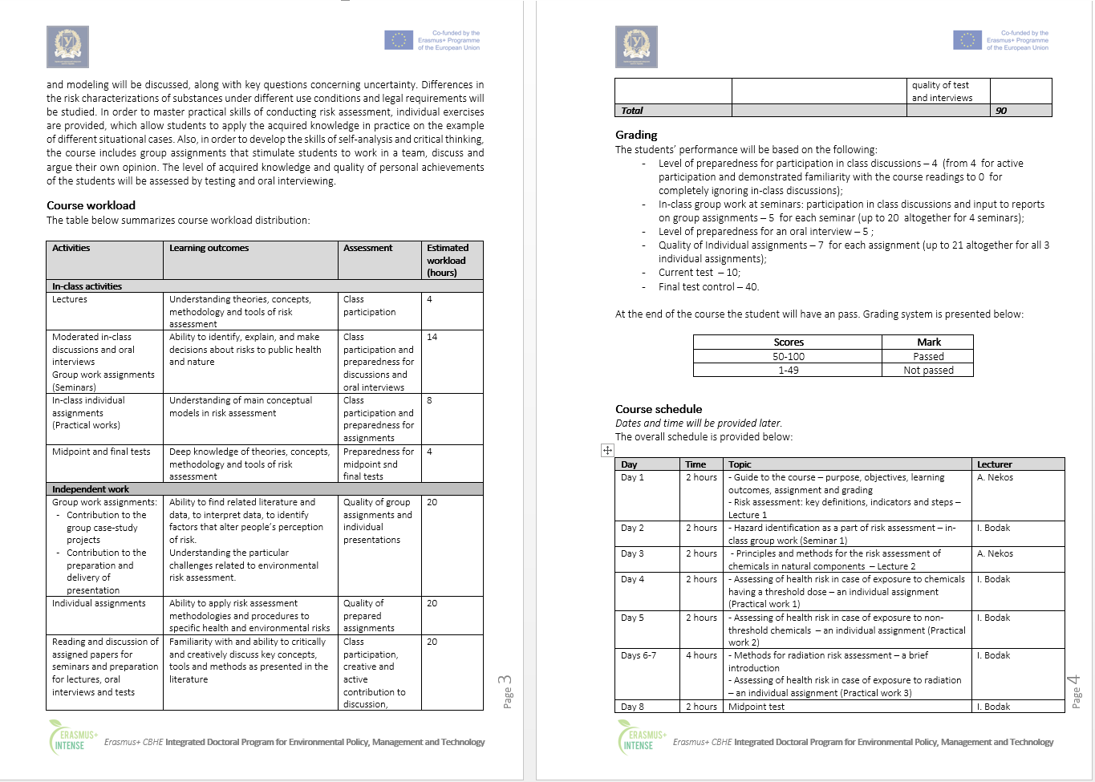
Syllabus

Slide 6
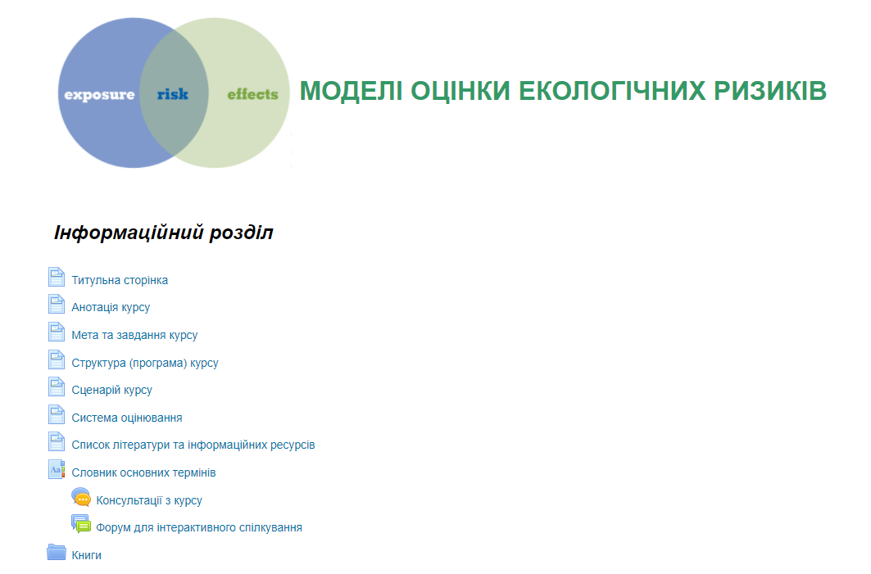
The course is available on the KKNU Moodle
https://dist.karazin.ua/moodle/course/view.php?id=3184

Slide 7
Types and forms of classes, methods of interaction between teacher and student
The course "Models for Environmental Risk Assessment" is studied in the 3rd semester in PhD program and consists of 6 sections and ends with a pass-fail test.
The course includes
theoretical material,
practical tasks and recommendations for their implementation,
questions for self-examination
knowledge control (in particular, midpoint and final tests).
The course consists of a complex of 2 lectures, 3 practical works, 5 seminars, 1 midpoint test and a final test.
For individual consultations – “Forum” and "Chat".

Slide 8
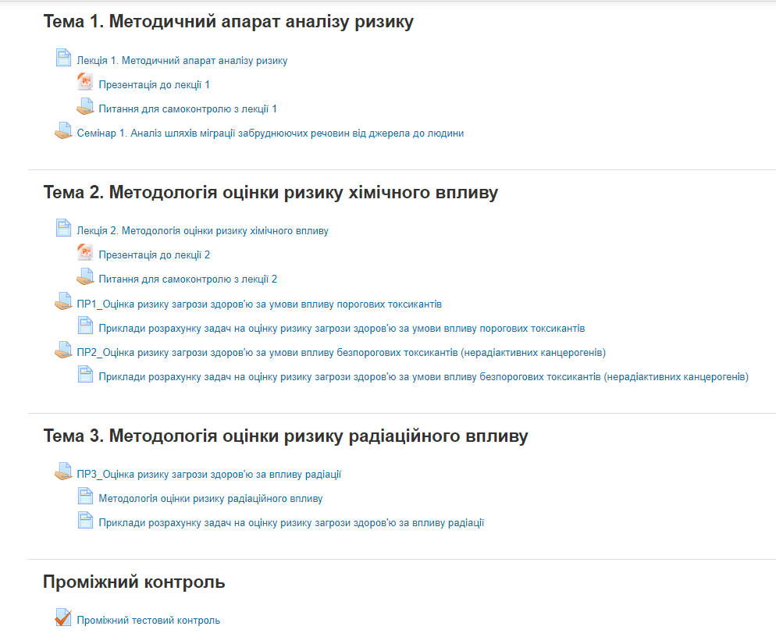
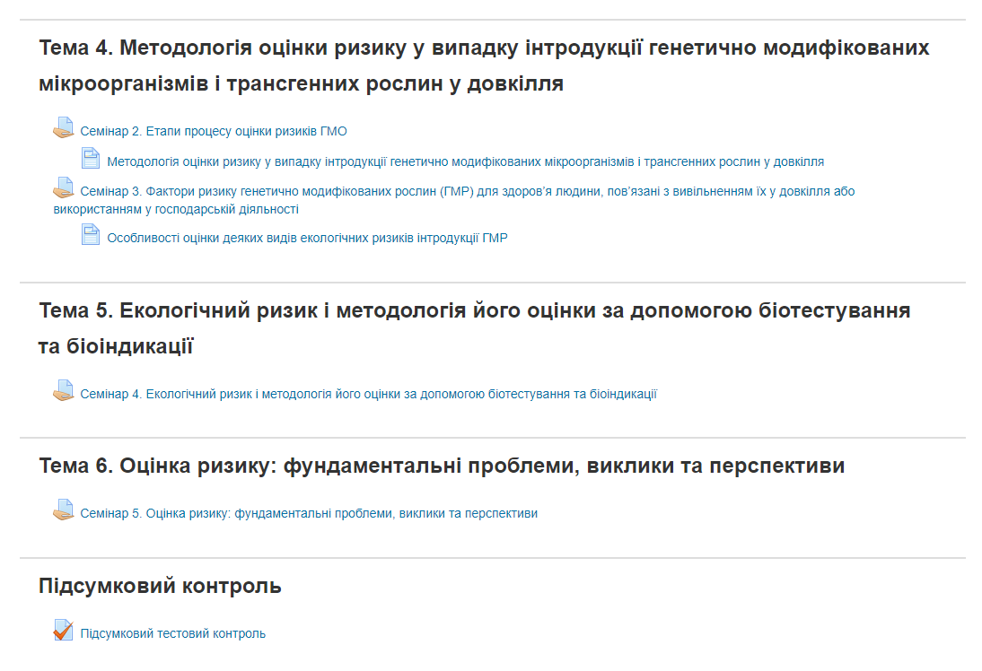
The course is divided into 6 topics:

Slide 9
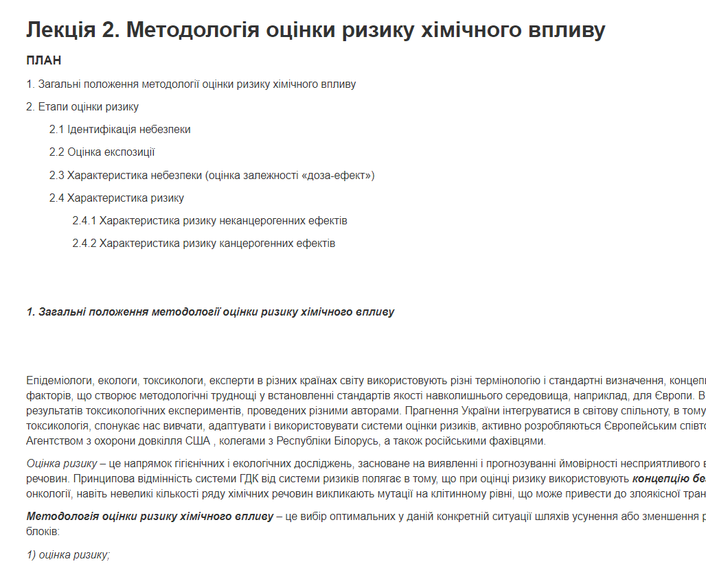
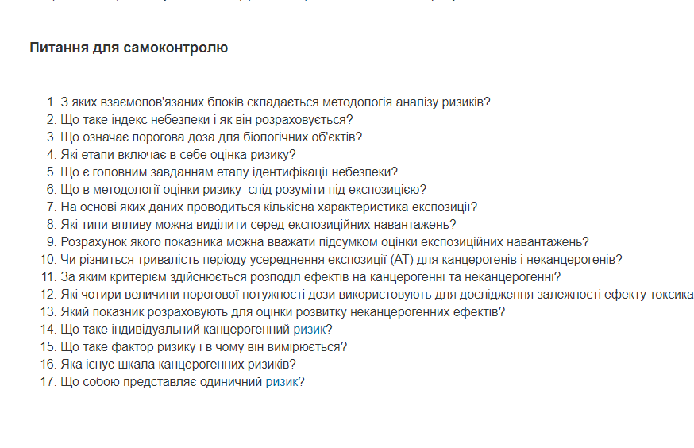
Each Lecture contains: questions, text, questions for self-control

Slide 10
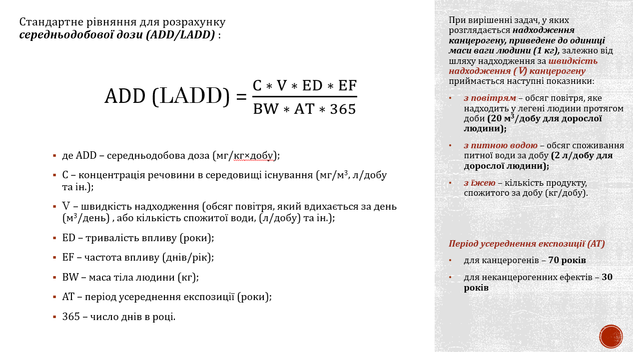
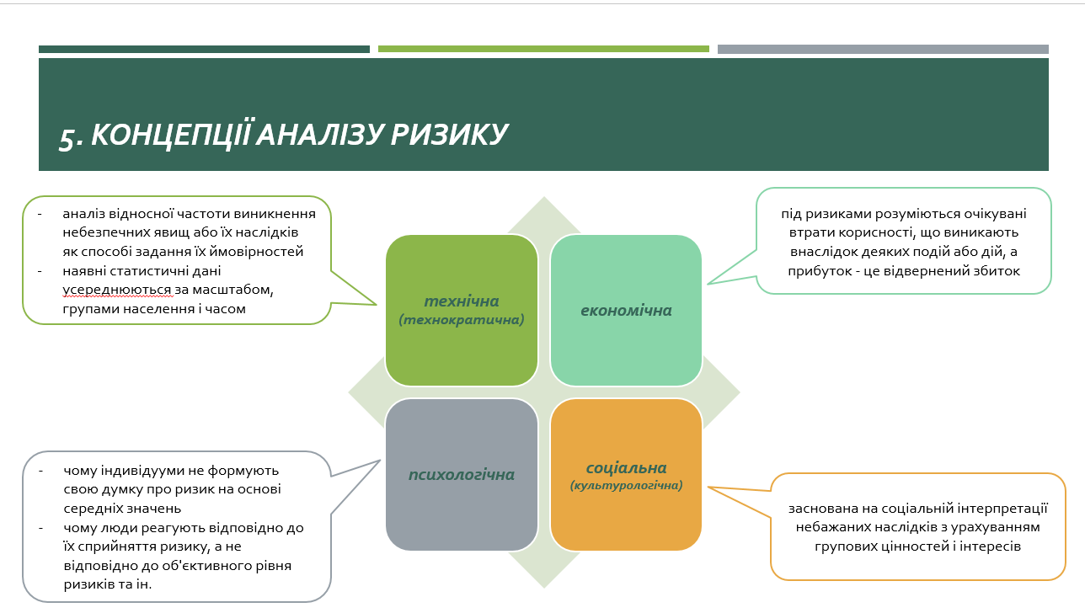
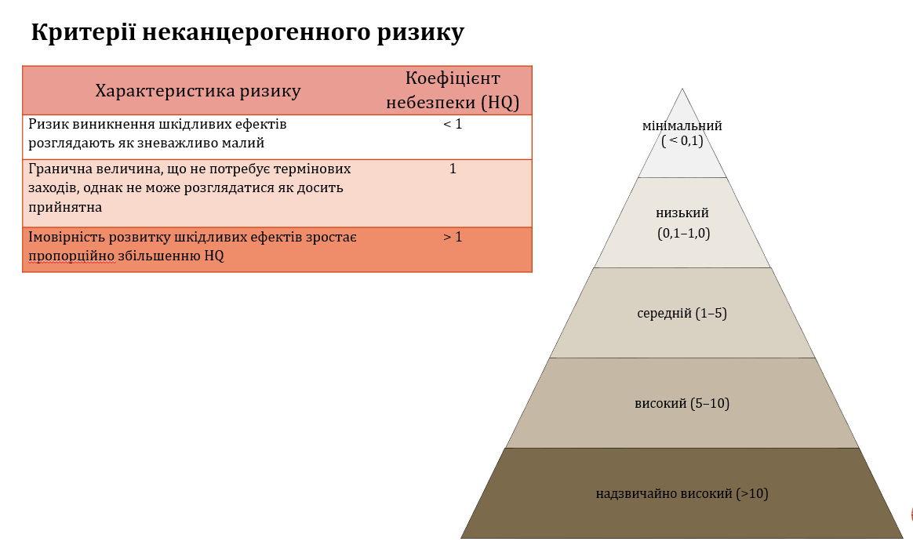
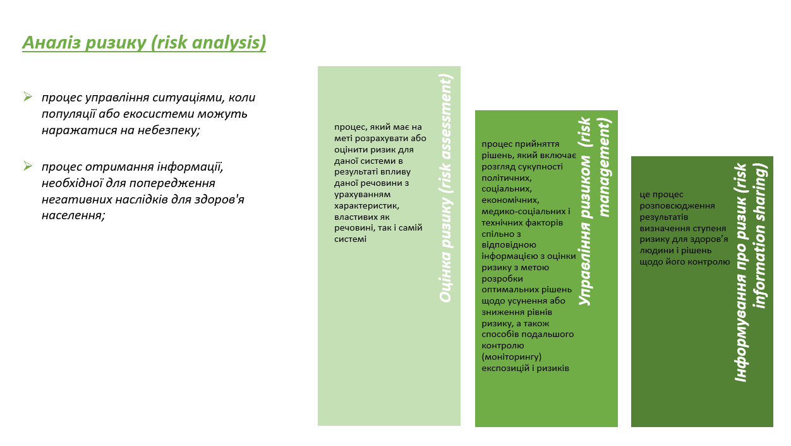
Each lecture is accompanied by PowerPoint Presentation that covers main theoretical issues of the lecture:

Slide 11
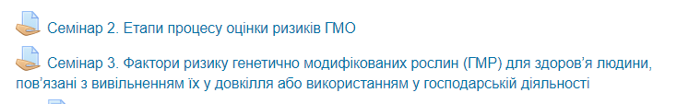
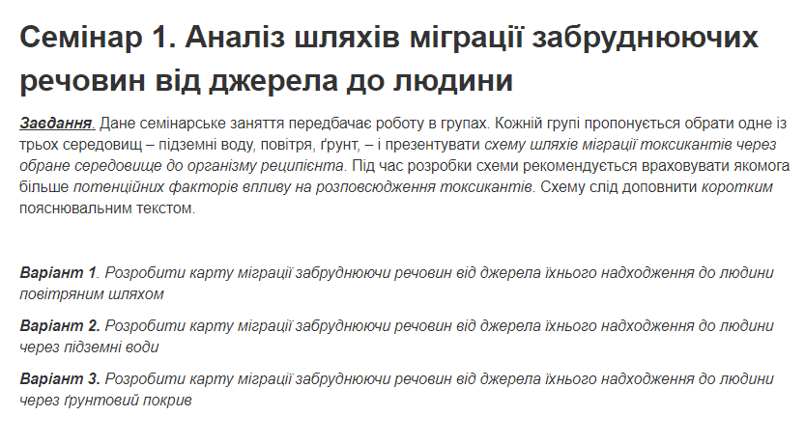
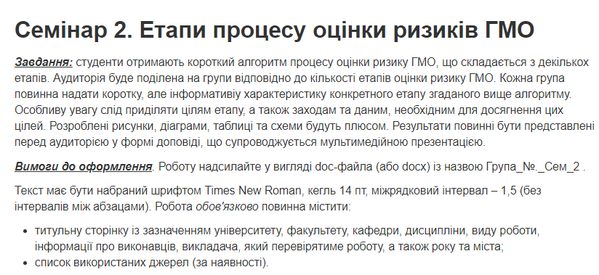
The course includes 5 seminars :

Slide 12
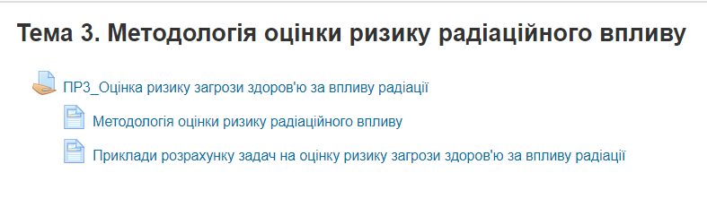
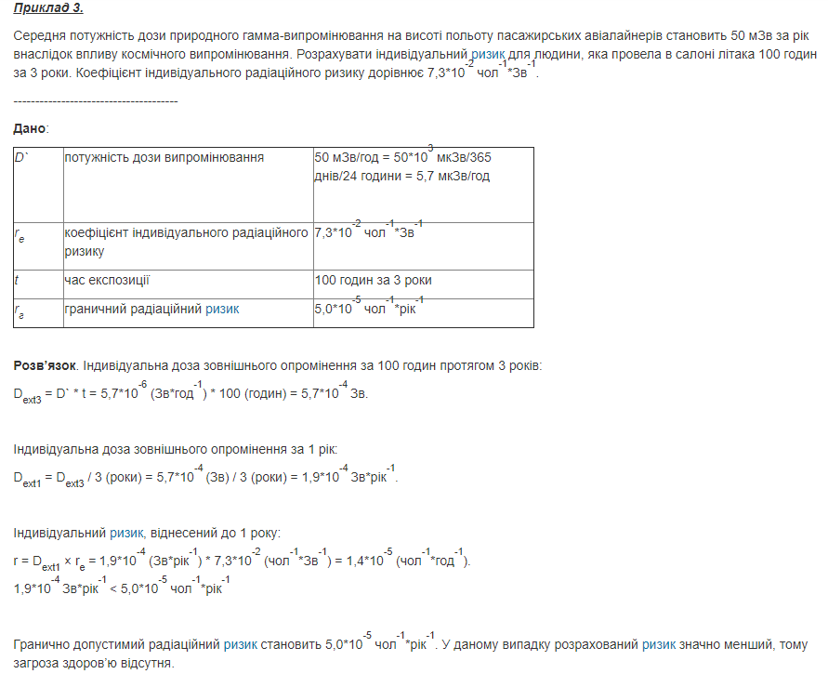
3 practical works integrated in the course contain
guidance on preparation and examples of exercises

Slide 13
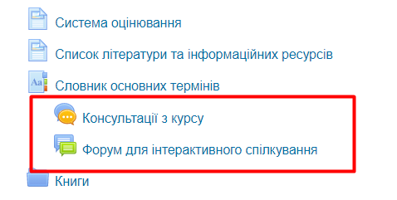
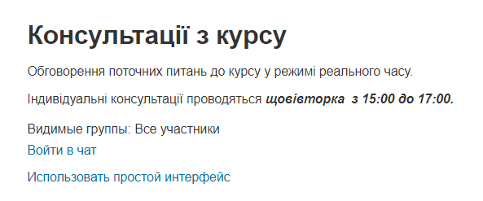
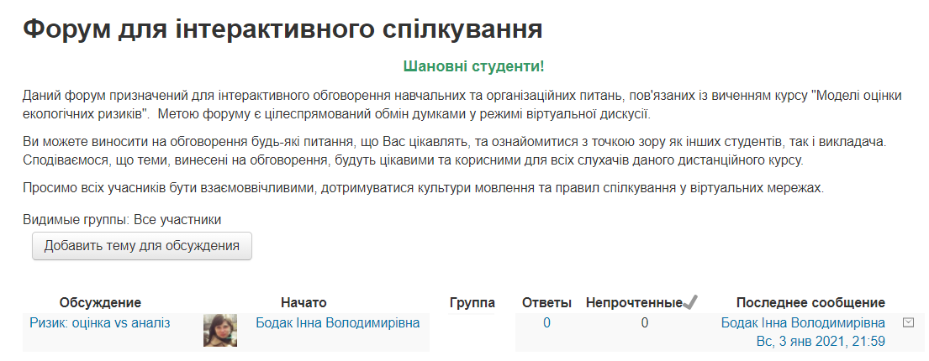
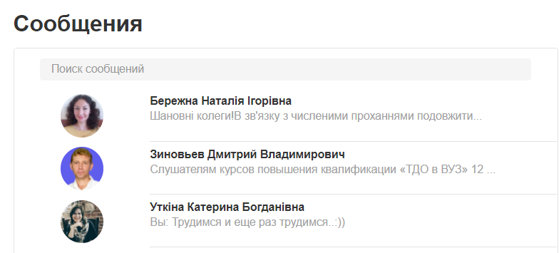
Communication with students could be conducted via Chat, Forum and Messages:

Slide 14
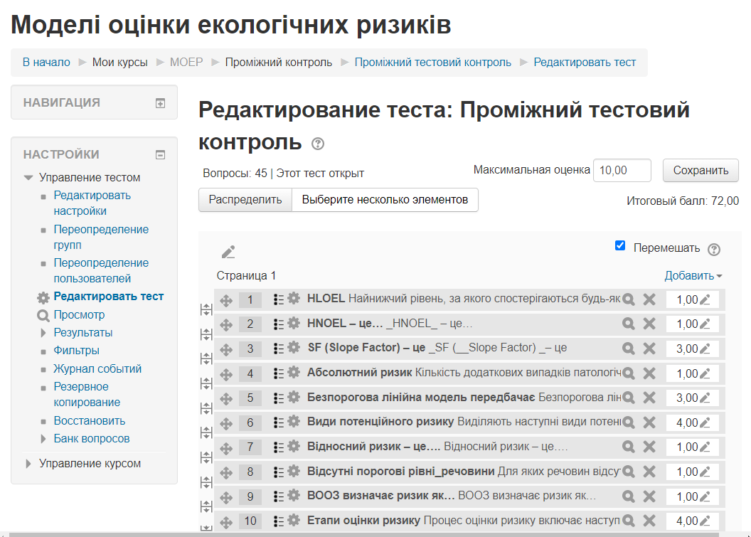
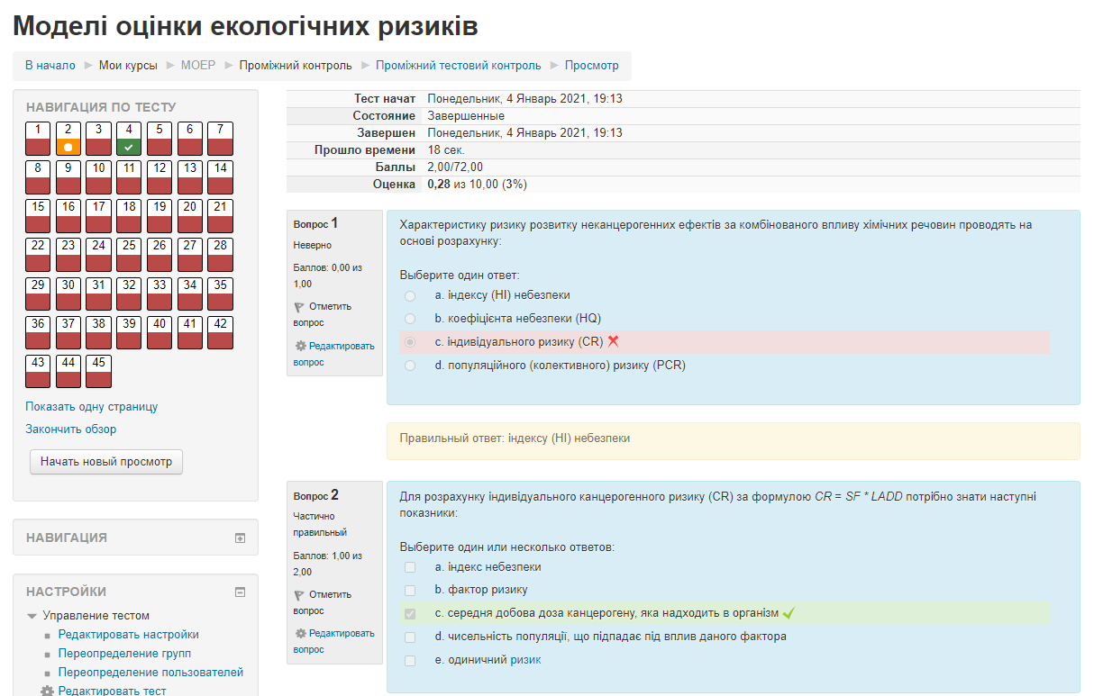
Test preparation, execution and validation

Slide 15
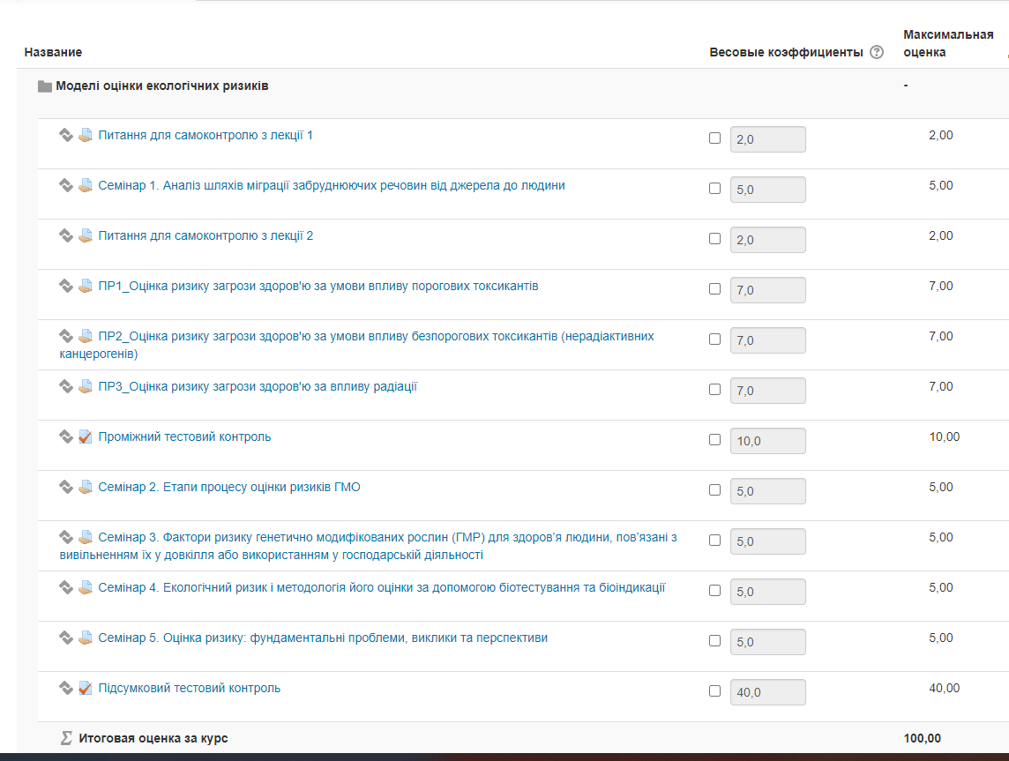
Gradebook setup
&
Achievement results

Slide 16
Course authors:
Coordinator: Alla Nekos,
V. N. Karazin Kharkiv National University (KKNU), Ukraine
nekos@karazin.ua
Authors: Alla Nekos,
V. N. Karazin Kharkiv National University (KKNU), Ukraine
Inna Bodak,
V. N. Karazin Kharkiv National University (KKNU), Ukraine

